Slide 1



Progress and Momentum towards Zero-Emission Trucks and Buses
Cristiano Façanha, PhD
EVI Pilot City Forum 2021
9 November 2021

Slide 2
Commercial vehicles represent a relatively small share of the global on-road fleet but contribute to a disproportionate share of on-road fuel consumption and emissions
36%
of on-road fuel consumption by HDVs
73%
of on-road NOx by HDVs
4%
of global on-road fleet are HDVs
ICCT (2020): Roadmap model

Slide 3


Drive to Zero is a campaign under the Clean Energy Ministerial’s Electric Vehicle Initiative and also a program of CALSTART

Slide 4
Zero-emission vehicles are coming in waves, taking foothold in beachhead applications where technology is ready first

Slide 5
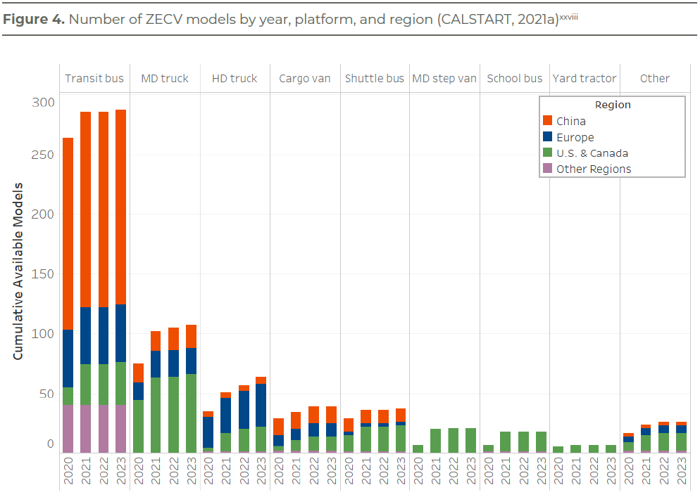
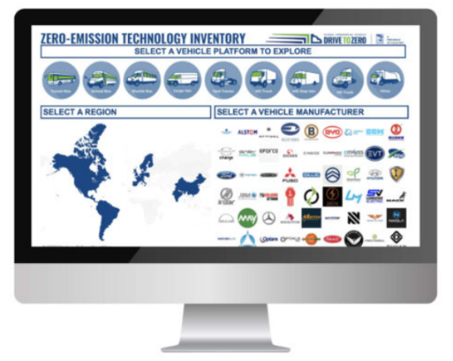
Model availability is healthy and rising, with 400+ existing and announced zero-emission commercial vehicle models
Source: Zero-emission Technology Inventory Tool (ZETI)
https://globaldrivetozero.org/tools/zero-emission-technology-inventory/
Source: MacDonnell & Façanha (2021): How Zero-Emission Heavy-Duty Trucks Can Be Part of the Climate Solution

Slide 6
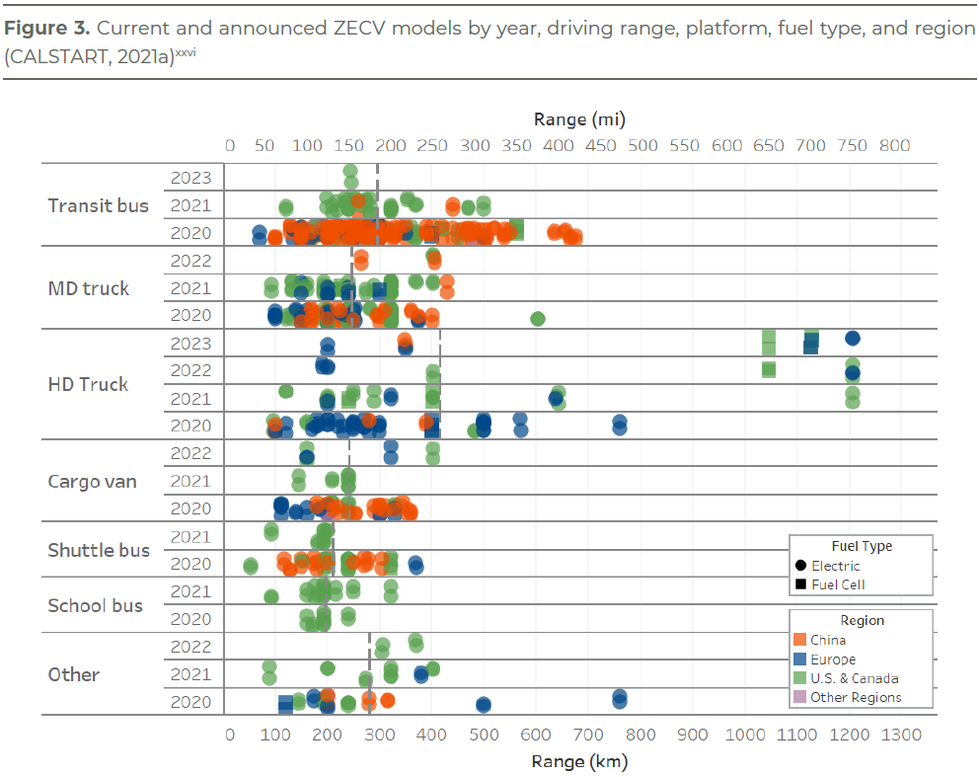
Zero-emission trucks already have ranges commensurate with fleet needs
Source: MacDonnell & Façanha (2021): How Zero-Emission Heavy-Duty Trucks Can Be Part of the Climate Solution

Slide 7
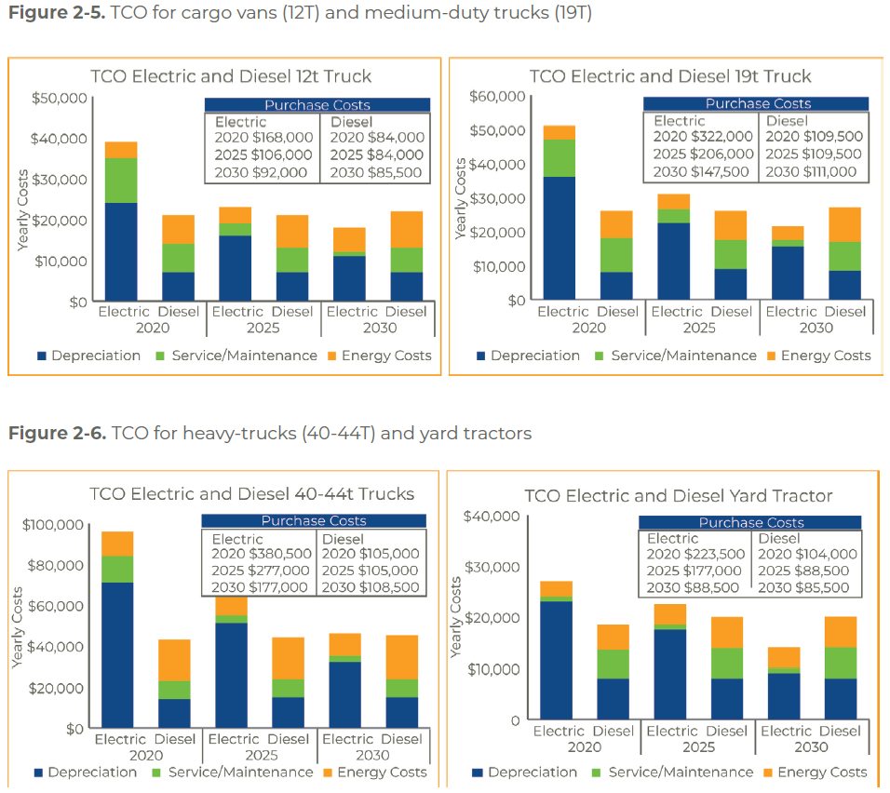
Zero-emission trucks will achieve cost parity by 2030
Source: Welch et al (2020): Moving Zero-emission Freight toward Commercialization

Slide 8

Leading countries will announce a global agreement on zero-emission trucks and buses on Transport Day

Slide 9

Thank you!
Cristiano Façanha
CALSTART
cfacanha@calstart.org
For more information:
www.globaldrivetozero.org
@TeamDriveToZero

