Slide 1

Power Sector Decarbonization Action Plan Series: Brazil
November 25th, 2024
DO NOT CITE OR REFERENCE. This work is not for distribution or commercial purposes. The methodology, formula, and analysis used and presented in this document and the views herein do not necessarily represent the views of or are endorsed by the U.S. Department of Energy or the U.S. Government, or any agency thereof.

Slide 2

Housekeeping - Zoom
This webinar is being recorded and will be shared with attendees.​​
You will be automatically muted upon joining and throughout the webinar. ​​
Please use the chat feature to add comments and share input. ​
Please use the Q&A function in your toolbar to ask questions.
If you have technical issues, please use the chat feature to message Sophie Schrader.
You can adjust your audio through the audio settings. If you are having issues, you can also dial-in and listen by phone. Dial-in information can be found in your registration email.​​
We will be launching a survey when the event ends. Your feedback is highly valuable to us!

Slide 3
Agenda
Webinar & Speaker Introductions
Overview of Clean Energy Solutions Center (CESC)
Overview of 21st Century Power Partnership (21CPP)
Brazil’s Power Sector Decarbonization Action Plan
  Planning, Building, and Operating
Connect with Us Online!

Slide 4
Webinar & Speaker Introductions
Renato Haddad
Superintendent of Power Generation
Empresa de Pesquisa Energética

Slide 5

Speaker Introductions
Caio Leocadio Superintendent of Power Generation
Glaysson Muller Superintendent of Power Generation
Gustavo Naciff
Superintendent of Economic and Energy Studies
Gustavo Ponte
Superintendent of Power Generation
Marcos Farinha
Superintendent of Energy Transmission
Rachel Henriques
Superintendent of Petroleum Derivatives and Biofuels
Renato Haddad
Superintendent of Power Generation

Slide 6
Overview of the Clean Energy Solutions Center (CESC)
Aaron Ng, CEM Desk Officer
U.S. Department of Energy
Notes:
I will now pass the mic to Jal Desai

Slide 7





The Clean Energy Solutions Center
OBJECTIVE
RATIONALE
AMBITION/TARGET
To accelerate the transition of clean energy markets and technologies.
Many developing governments lack capacity to design and adopt policies and programs that support the deployment of clean energy technologies.
Support governments in developing nations of the world in strengthening clean energy policies and finance measures
ACTORS
ACTIONS
UPDATES
Leads:
Deliver dynamic services that enable expert assistance, learning, and peer-to-peer sharing of experiences. Services are offered at no-cost to users.
Foster dialogue on emerging policy issues and innovation across the globe.
Serve as a first-stop clearinghouse of clean energy policy resources, including policy best practices, data, and analysis tools.
Website: www.cleanenergyministerial.org/initiatives-campaigns/clean-energy-solutions-center
Factsheet:
www.nrel.gov/docs/fy22osti/83658.pdf
Requests: Now accepting Ask an Expert requests!
Operating Agent:
Partners:
More than 40 partners, including UN-Energy, IRENA, IEA, IPEEC, REEEP, REN21, SE4All, IADB, ADB, AfDB, and other workstreams etc.

Slide 8






The Clean Energy Solutions Center
Ask an Expert Service
Ask an Expert is designed to help policymakers in developing countries and emerging economies identify and implement clean energy policy and finance solutions.
The Ask an Expert service features a network of more than 50 experts from over 15 countries.
Responded to 300+ requests submitted by 90+ governments and regional organizations from developing nations since inception
Training and Capacity Building
Delivered over 300 webinars training more than 20,000 public & private sector stakeholders.
Resource Library
Over 1,500 curated reports, policy briefs, journal articles, etc.
For additional information and questions, reach out to Jal Desai, NREL, jal.desai@nrel.gov

Slide 9
Overview of the 21st Century Power Partnership (21CPP)
Aaron Ng, CEM Desk Officer
U.S. Department of Energy
Notes:
Link to share: 21CPP Website (https://www.21stcenturypower.org/)

Slide 10
21CPP Overview
Accelerate the transition to clean, efficient, reliable, and cost-effective power systems.
Evolving Generation
Portfolios
Cross-Cutting Issues:
Operations, Transmission,
Distributed Generation,
Market Design,
Workforce Capacity
Coordinated Power System Planning, Building, and Operating Best Practices
Peer-learning, knowledge-sharing, and technical assistance
Electrification of Transport, Buildings, and Industry
Smart Grid, Energy Efficiency, and Demand Response
Coordinating with related CEM Campaigns and Partners

Slide 11
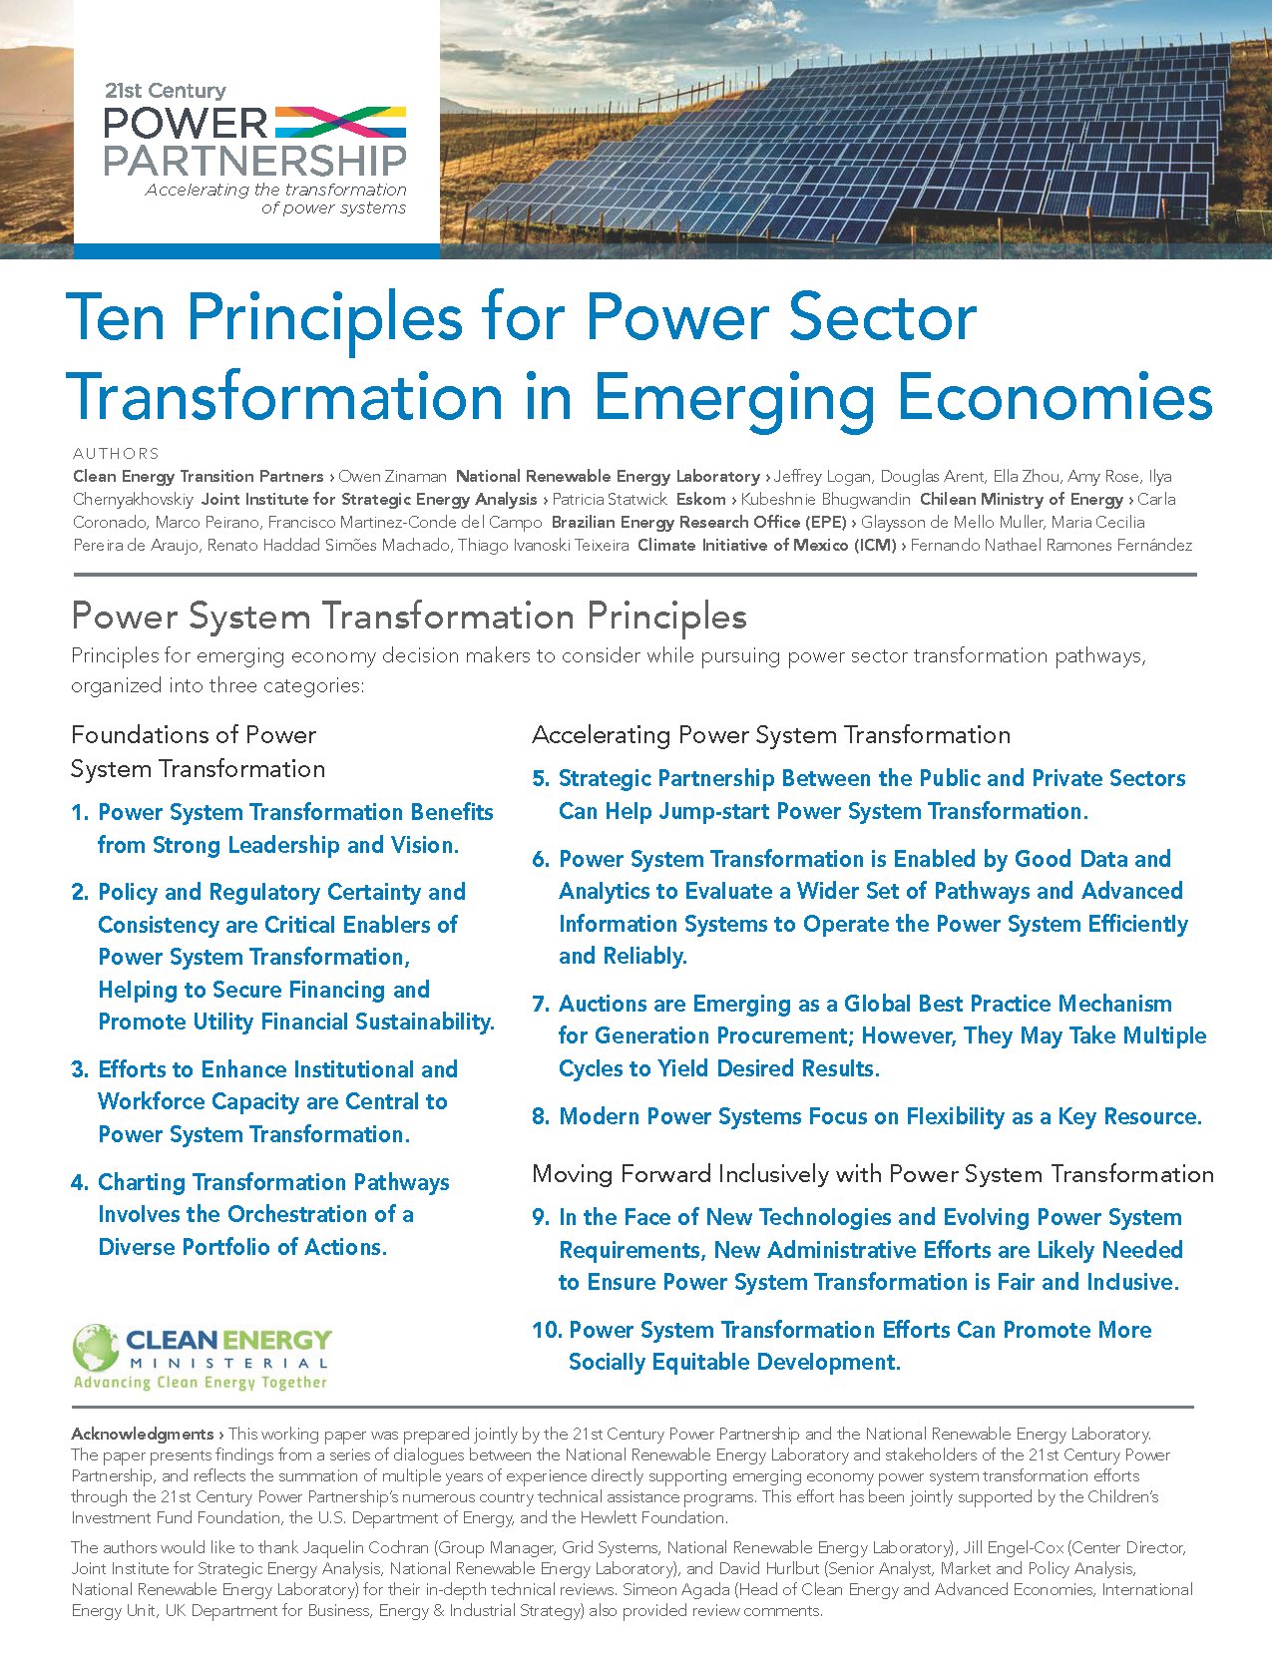
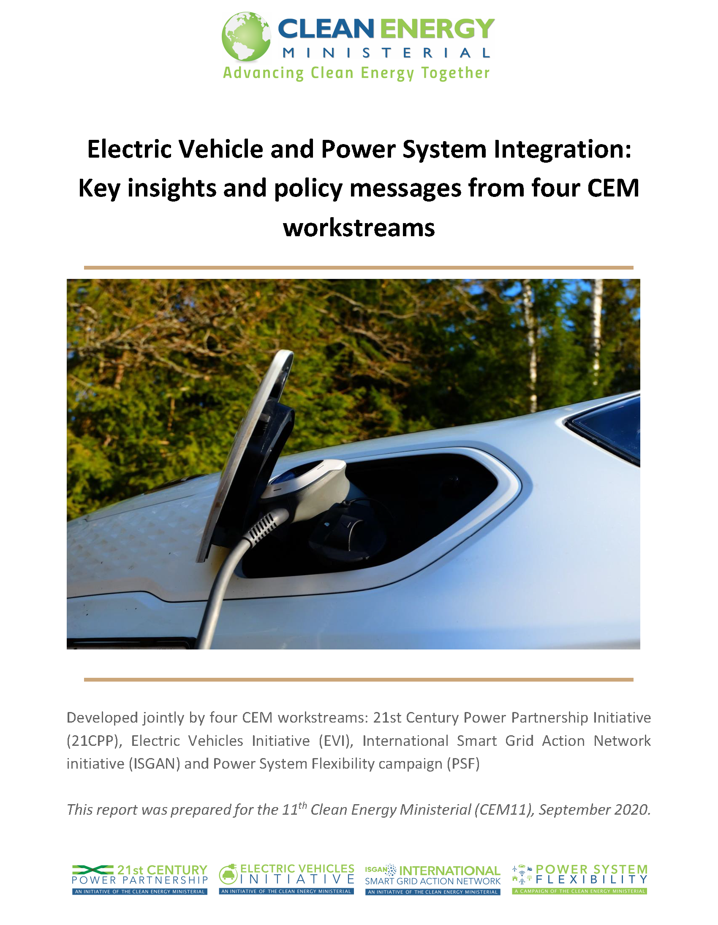
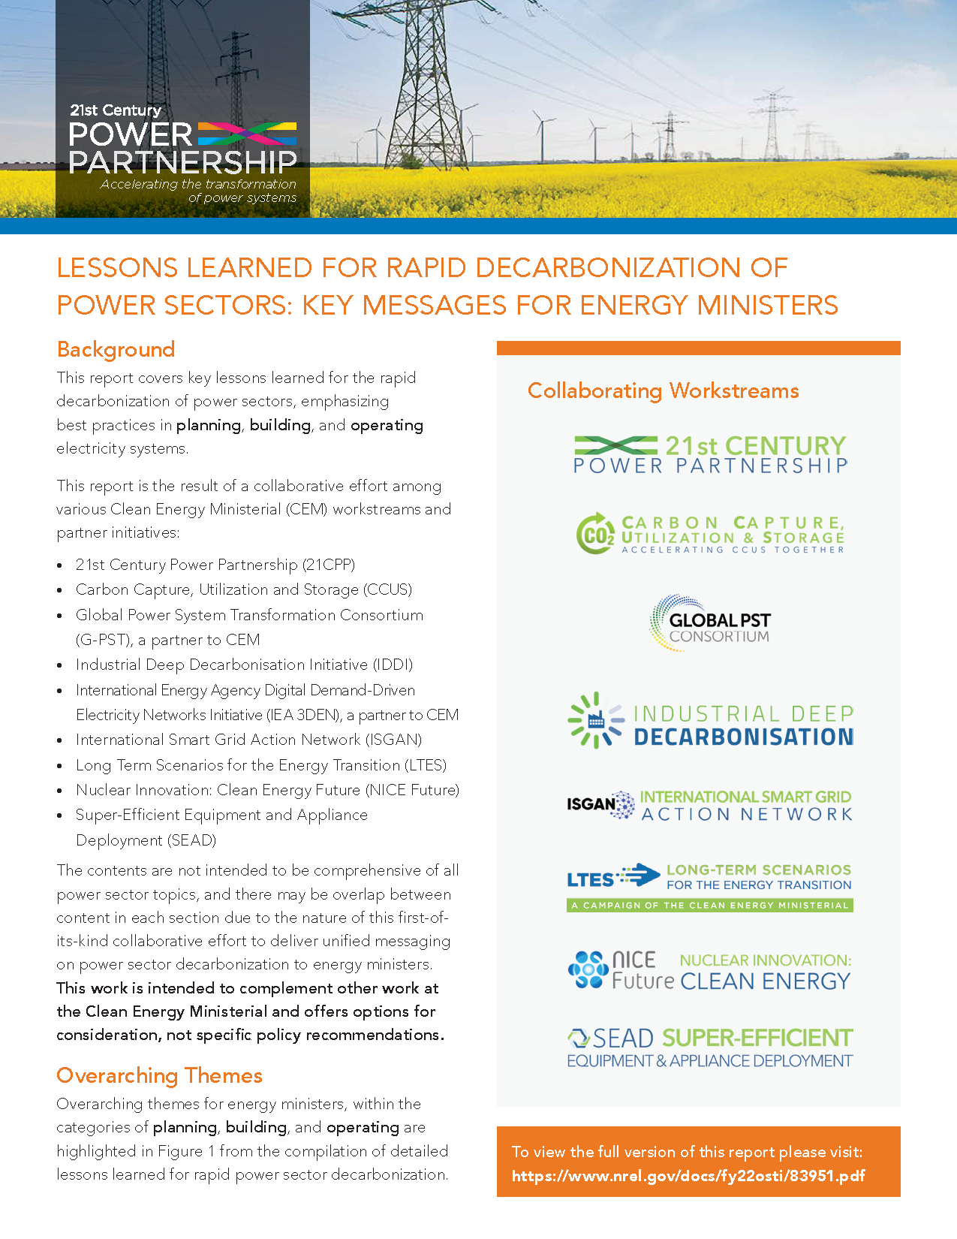


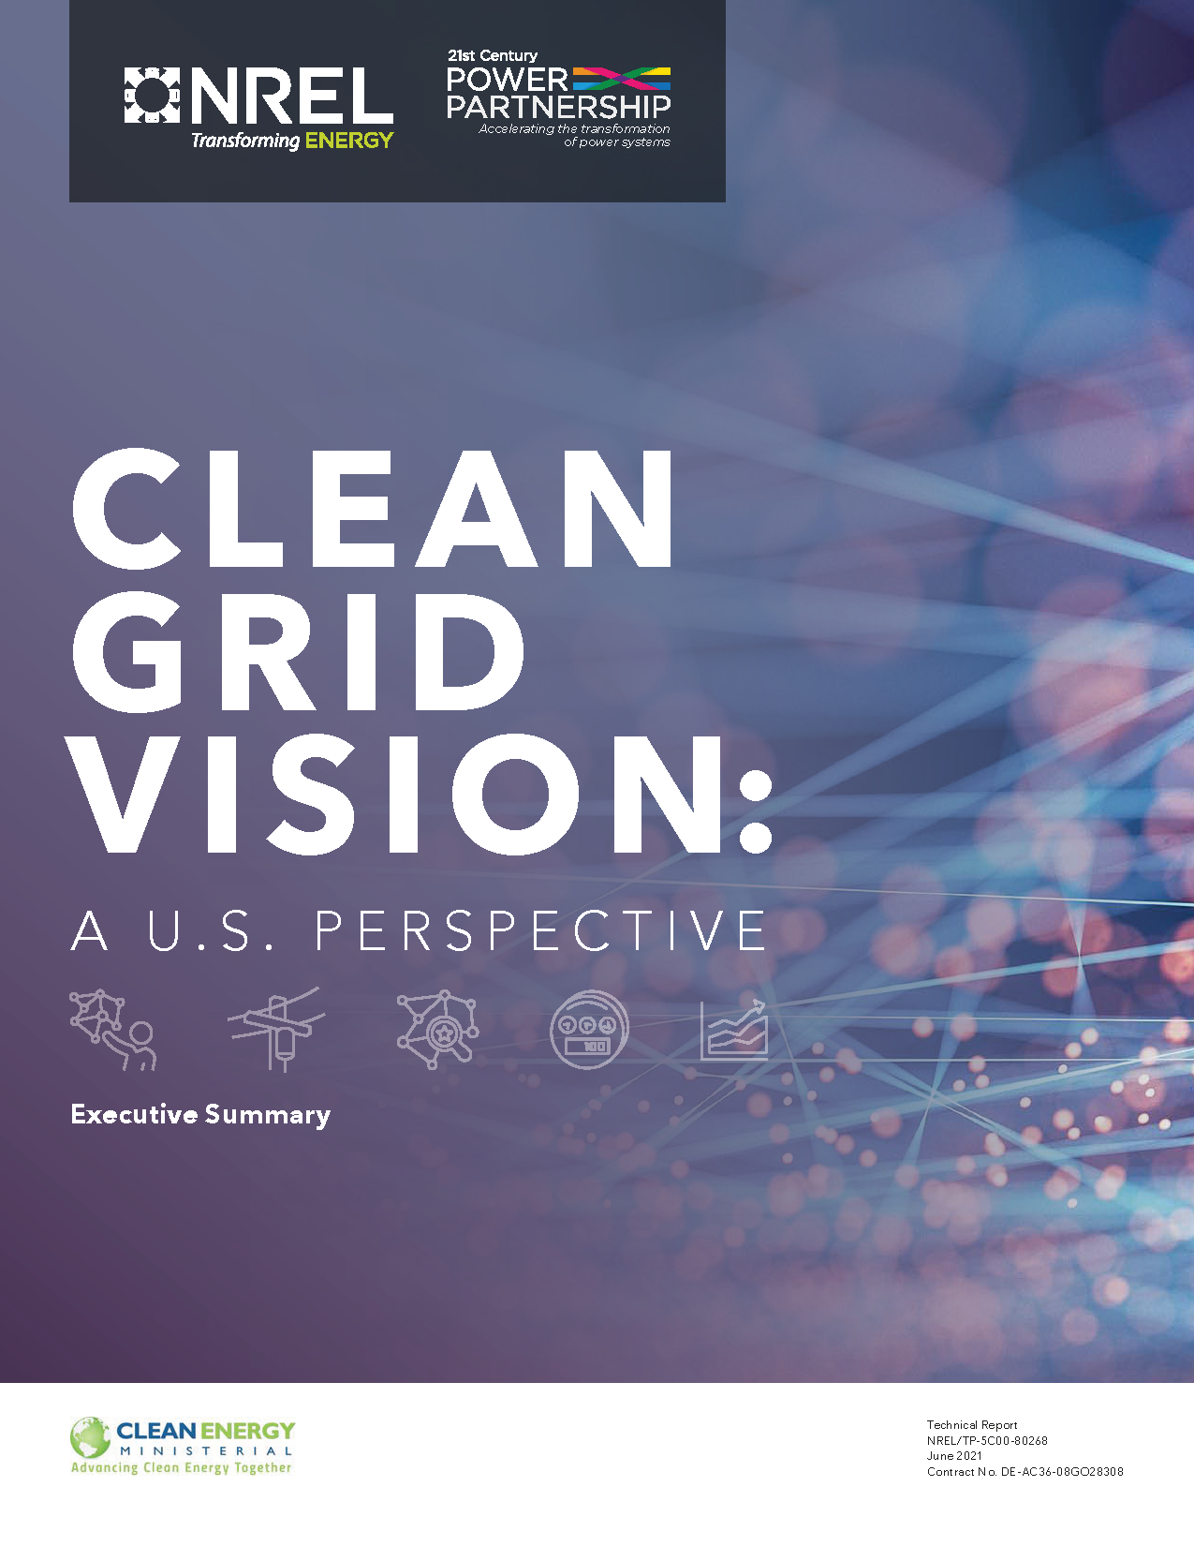
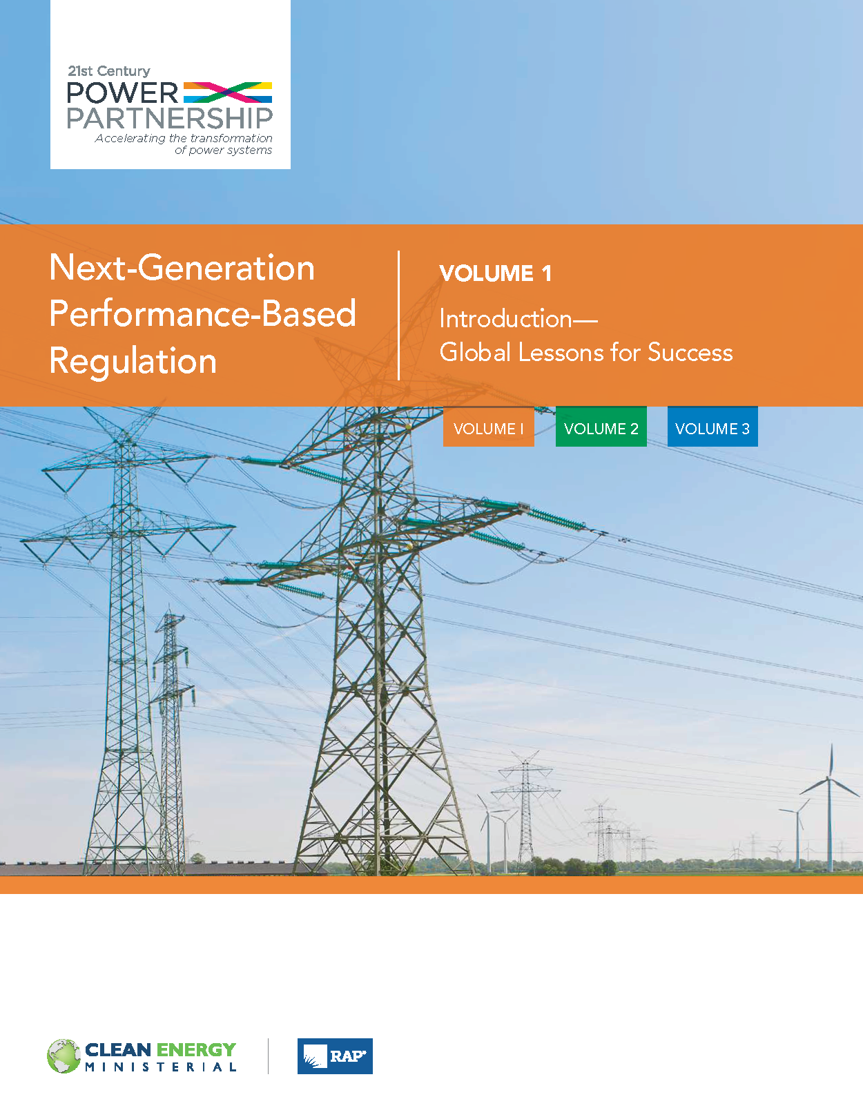
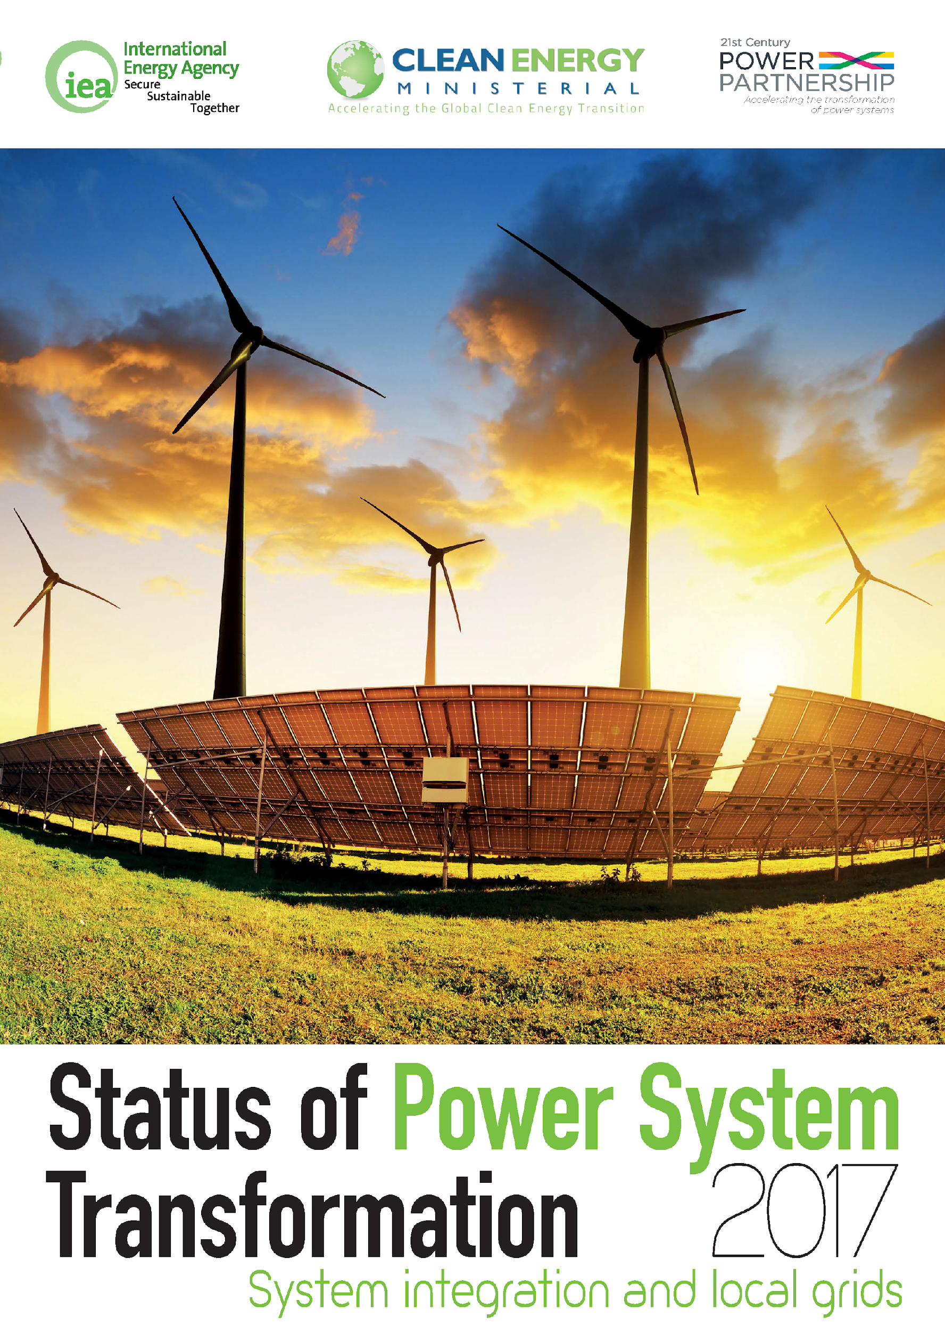
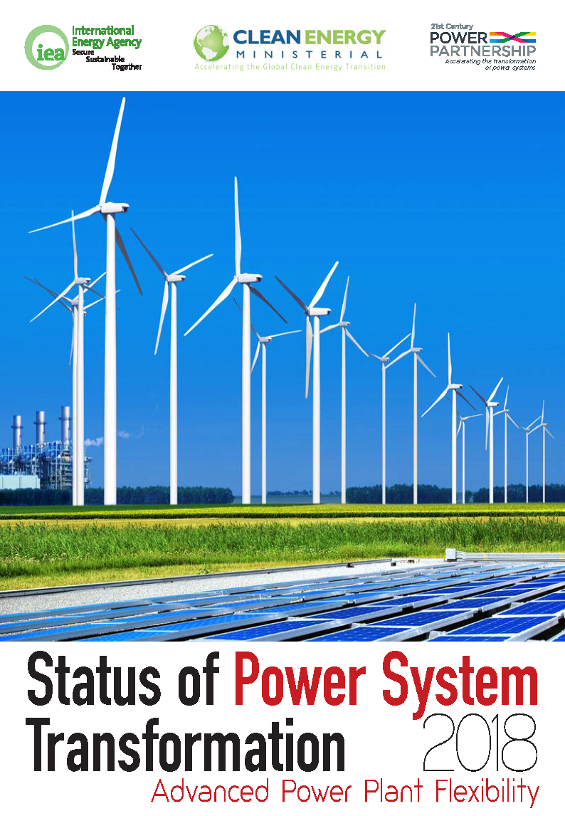
Decade of Thought Leadership
Explore the Thought Leadership reports:

Slide 12
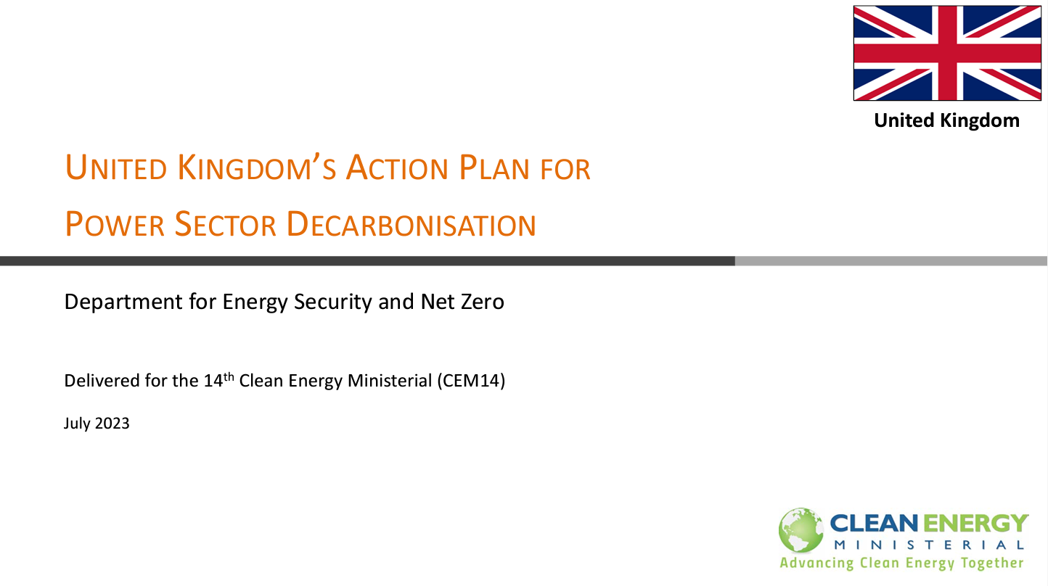
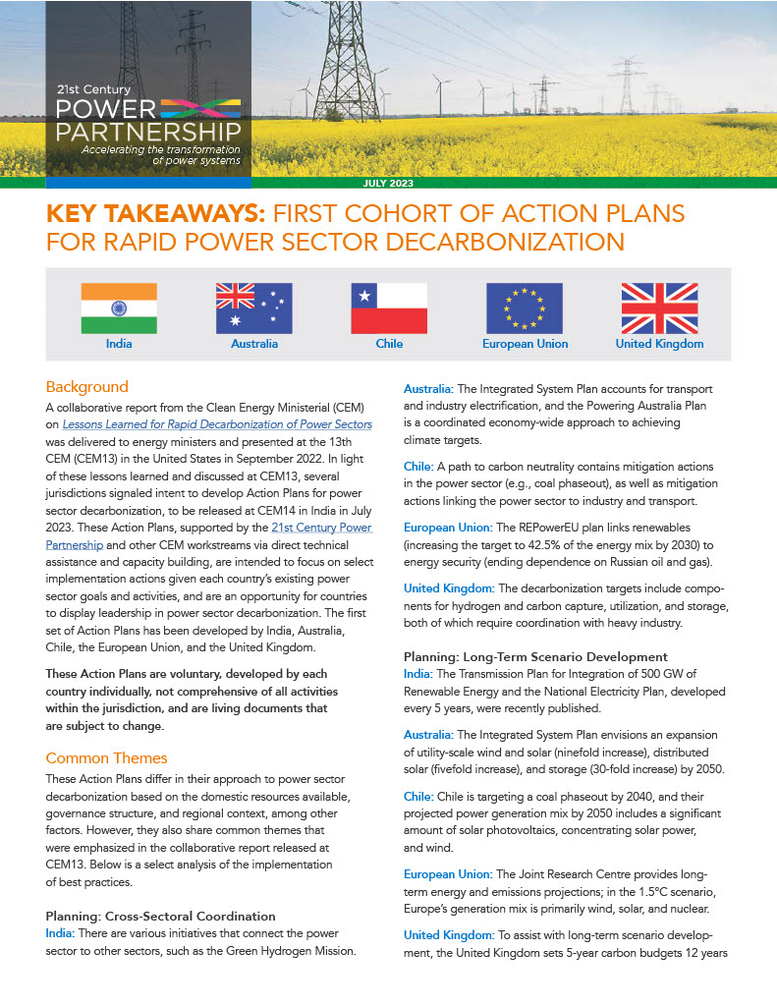
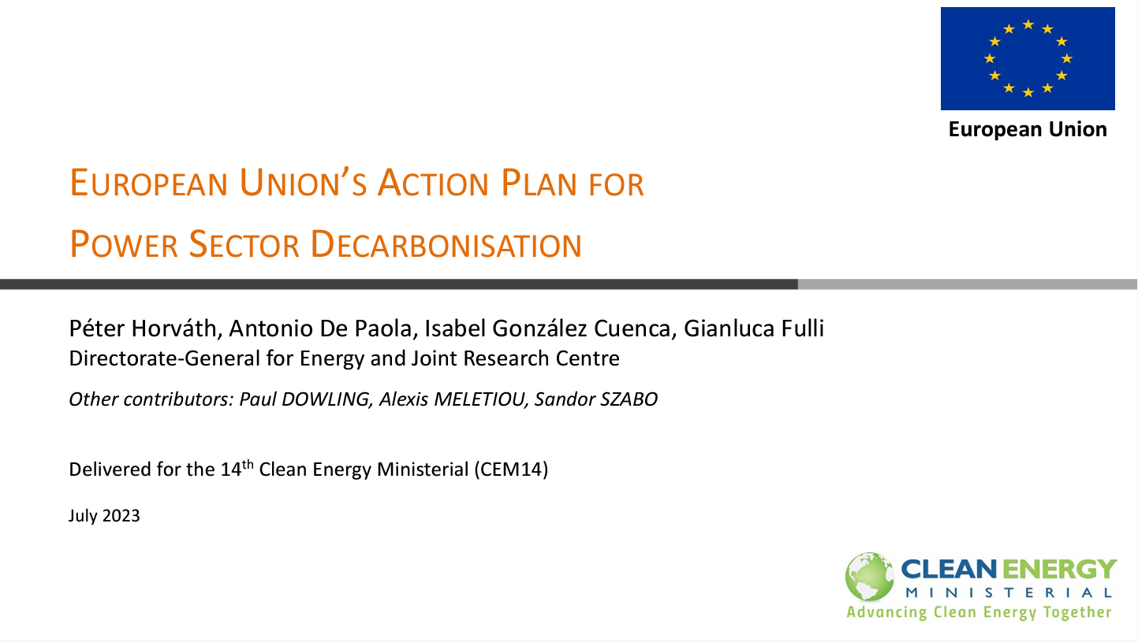

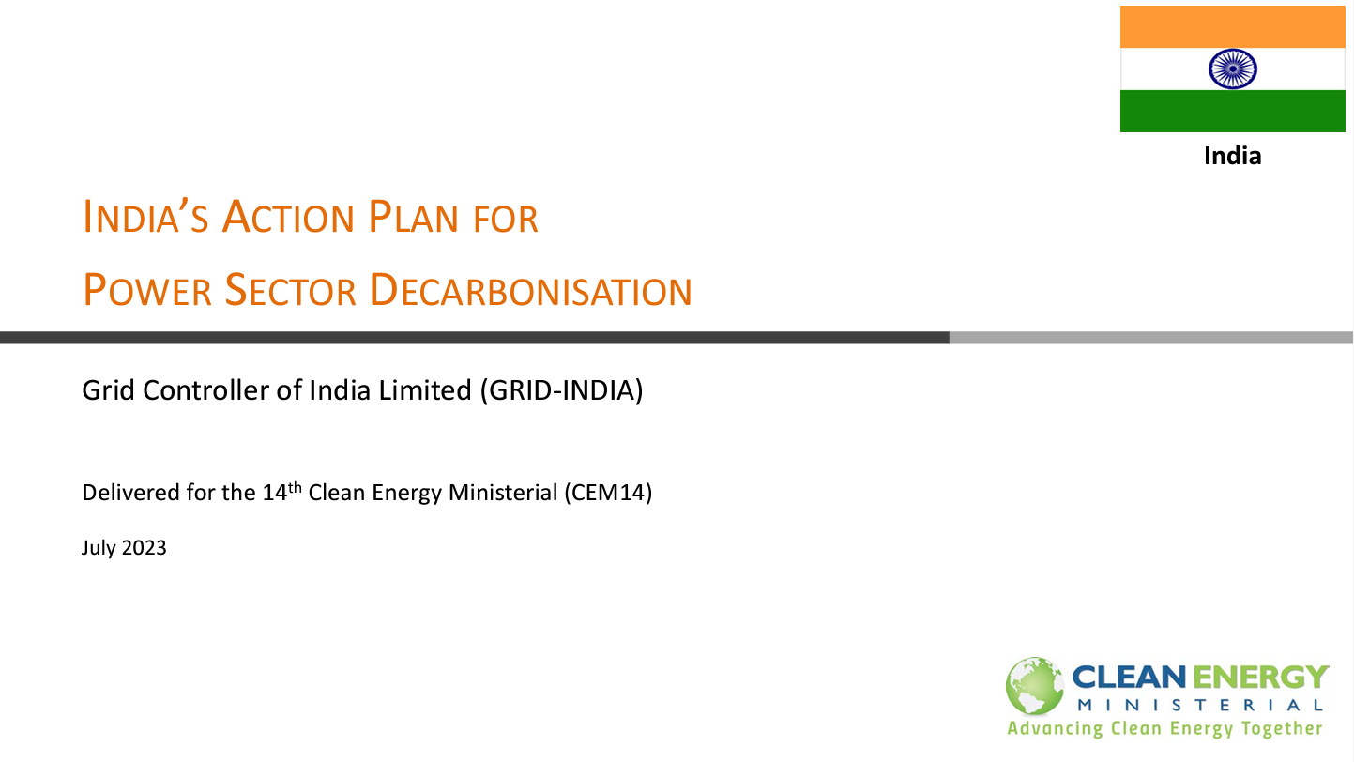
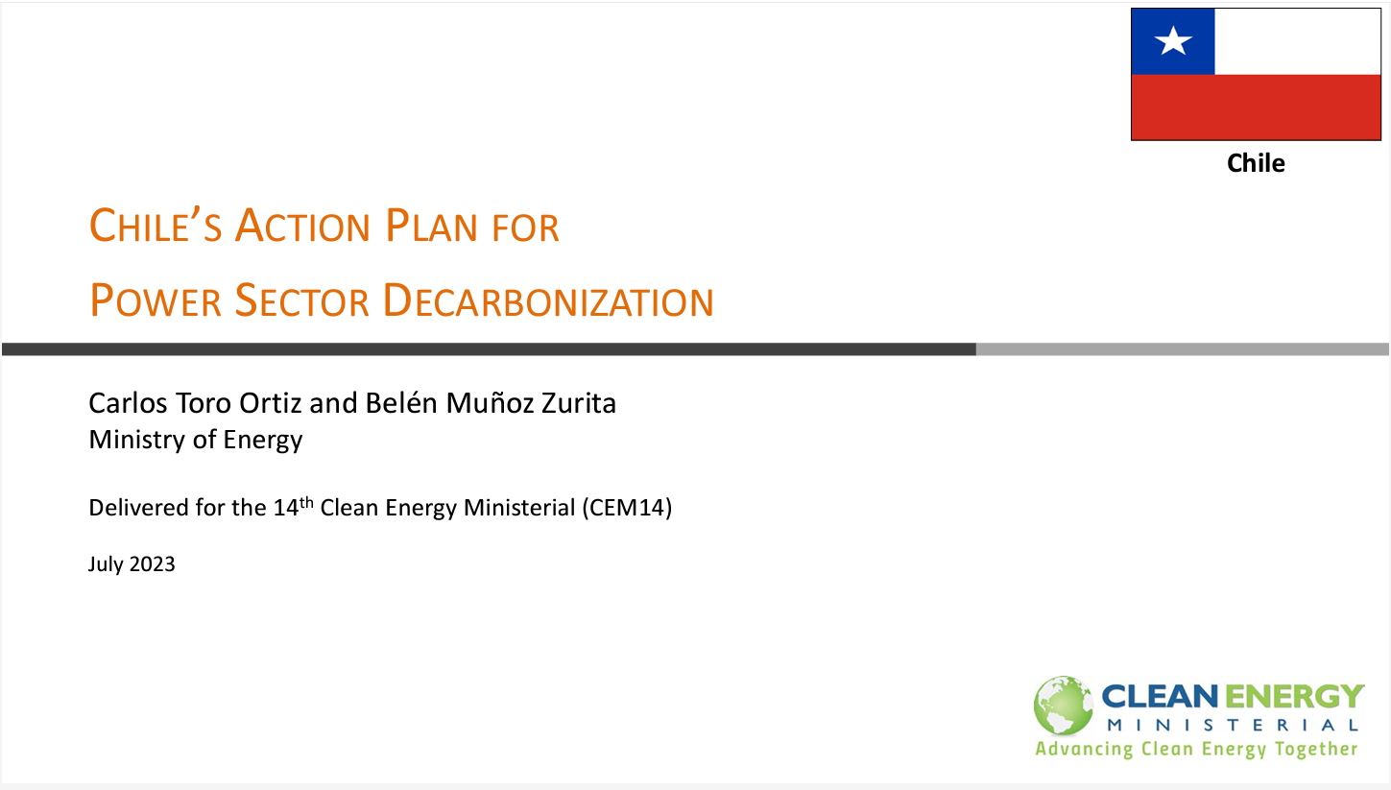
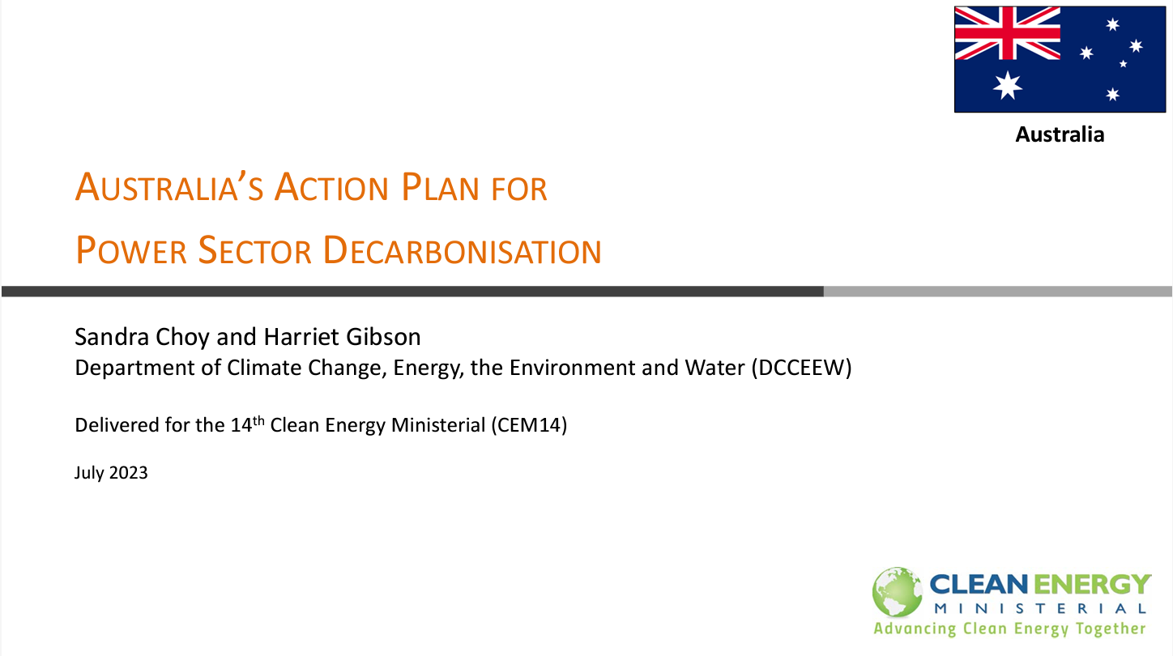

First Cohort Action Plans
Clean Energy Solutions Center (CESC) Action Plan Webinar Series:
Read the Action Plans:

Slide 13


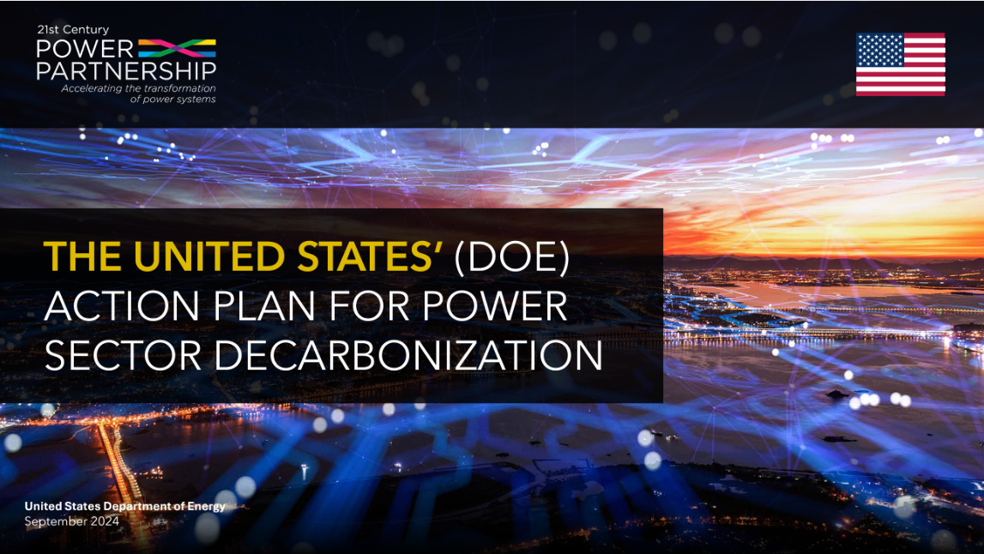

Second Cohort Action Plans
Action Plans for Rapid Power Sector Decarbonization
Brazil, Canada, United States, Uruguay

Slide 14



BRAZIL’S ACTION PLAN FOR RAPID ​DECARBONIZATION
OF POWER SECTORS​
Energy Research Office
September 2024

Slide 15
Action Plan for Power Sector Decarbonization
Background
A collaborative report from the Clean Energy Ministerial (CEM) on Lessons Learned for Rapid Decarbonization of Power Sectors was delivered to energy ministers and presented at the CEM13 in the United States in September 2022. In light of these lessons learned and discussed at CEM13, several jurisdictions signaled intent to develop Action Plans for power sector decarbonization. The first cohort of Action Plans was released at CEM14 in India in July 2023. The second cohort of action plans will be presented at CEM15 in Brazil.
The Action Plans, supported by the 21st Century Power Partnership, and other CEM workstreams via direct technical assistance and capacity building, are intended to focus on select implementation actions, given each country’s existing power sector goals and activities, and are an opportunity for countries to display leadership in power sector decarbonization. The Action Plans are organized in a framework for Planning, Building and Operating, as well as Stakeholder Engagement where appropriate based on country priorities. They complement, but are differentiated from, other international power sector initiatives such as the Breakthrough Agenda (whose broad purpose is to raise collective ambition) and the Global Power System Transformation Consortium (whose goals are to convene power system operators to accelerate research innovations and foster peer learning).
These Action Plans are voluntary, developed by each country individually, not comprehensive of all activities within the jurisdiction, and are living documents that are subject to change

Slide 16
Brazilian Action Plan in an Energy Transition Context

Slide 17
Action Plan for Power Sector Decarbonization: Planning
Brazil: A Renewable Continental-Size Power System
2024
227 GW
2034
311 GW
Brazil tends to keep almost 90% of its generation capacity from renewable sources over the next 10 years.
Notes:
Source: https://www.whitehouse.gov/briefing-room/presidential-actions/2021/01/27/executive-order-on-tackling-the-climate-crisis-at-home-and-abroad/; https://www.sustainability.gov/progress.html

Slide 18
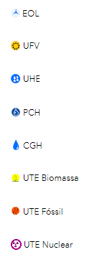
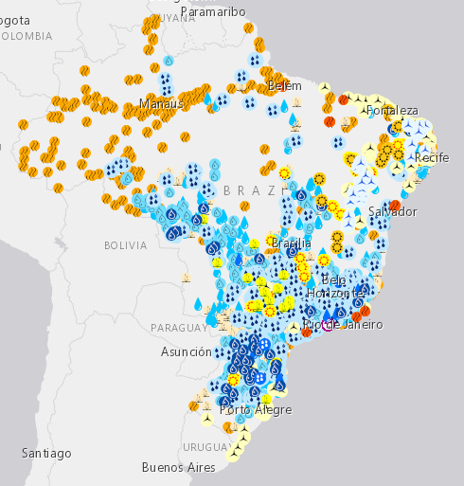
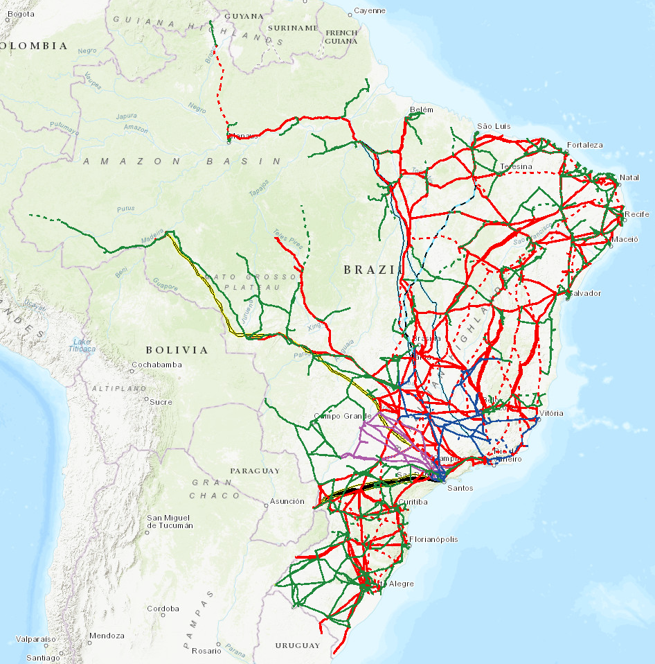
Action Plan for Power Sector Decarbonization: Planning
Brazil: A Renewable Continental-Size Power System
High concentration of wind and solar in the Northeast region:
lower operational cost.
High concentration of hydropower, big reservoirs, and large thermal plants:
operating reserve and inertia.
Source: Webmap EPE
A robust and reliable transmission system is necessary so that all available resources can be optimally and globally utilized.
Source: Webmap EPE
Notes:
Source: https://www.whitehouse.gov/briefing-room/presidential-actions/2021/01/27/executive-order-on-tackling-the-climate-crisis-at-home-and-abroad/; https://www.sustainability.gov/progress.html

Slide 19
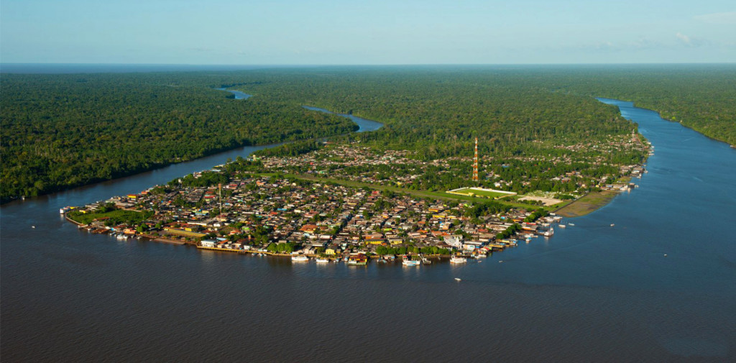
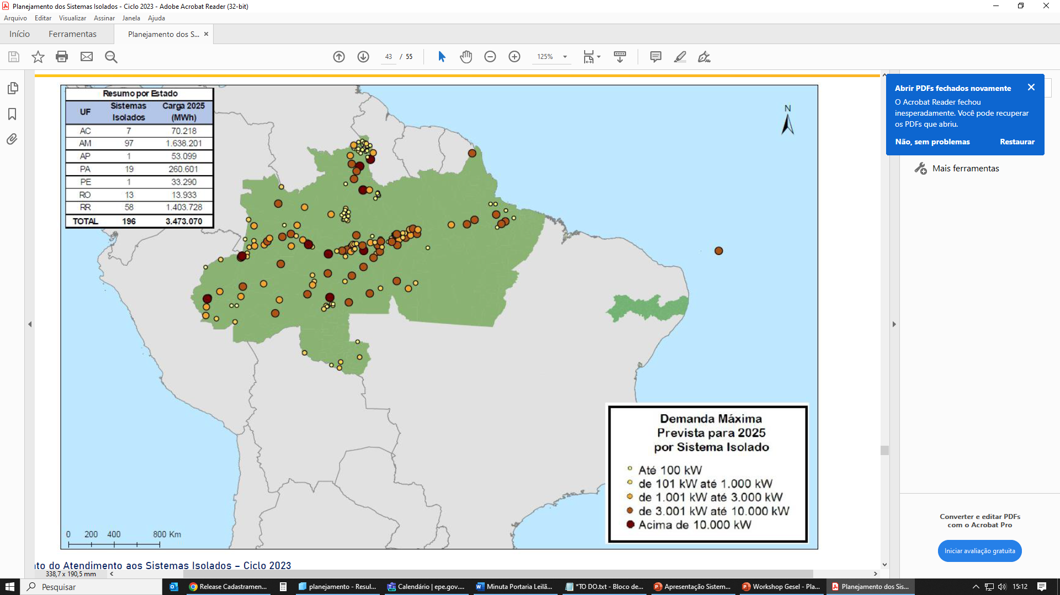

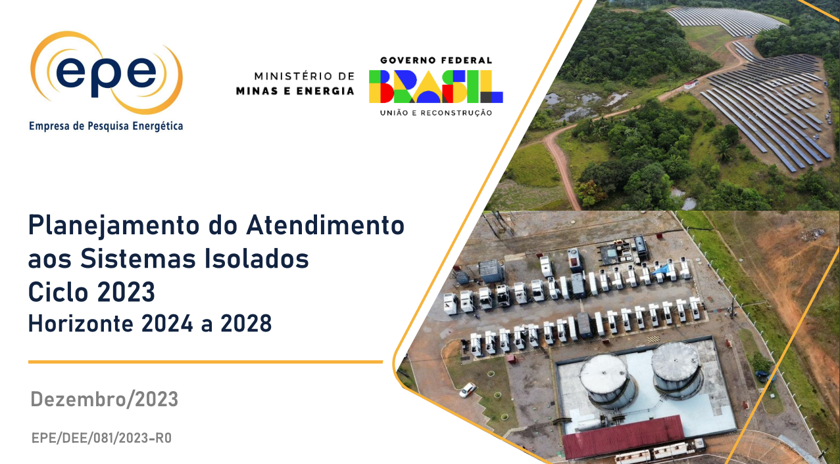
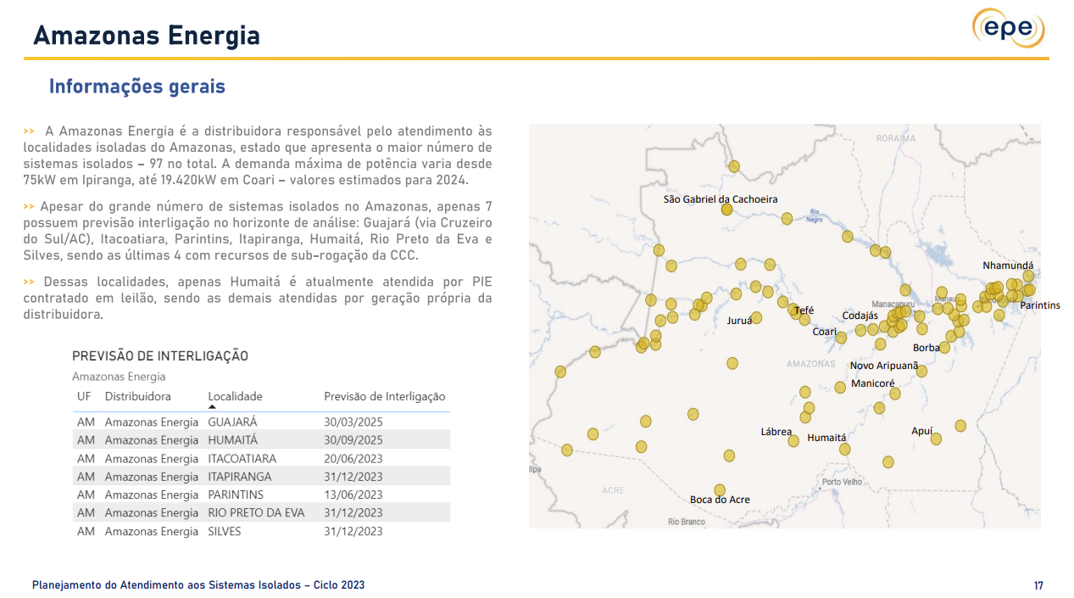
Action Plan for Power Sector Decarbonization: Planning
Decarbonize Off-Grid (and Remote) Systems
0.6% of Brazilian total energy load
Off-grid (remote) systems: Power systems not electrically connected to the National Interconnected System (SIN), due to technical or economic reasons. In Brazil, they are mainly concentrated in the North Region.
More than 190 off-grid systems
Energy Supply: 69% by diesel oil
Peak demand in 2023: 630 MW
Mostly located in the Amazon area
Around 3 million consumers
40 planned interconnections up to 2028
Off-Grid Systems
2023 Planning Report
Brazilian Energy Research Office (EPE) annually publishes the Off-Grid Systems Supply Planning Report based on data provided by distribution companies.
City of Afuá (Peak demand: 2.3 MW)
Brazilian off-grid systems
Source: EPE. “Sistemas Isolados” (2024).
Notes:
Source: https://www.whitehouse.gov/briefing-room/presidential-actions/2021/01/27/executive-order-on-tackling-the-climate-crisis-at-home-and-abroad/; https://www.sustainability.gov/progress.html

Slide 20

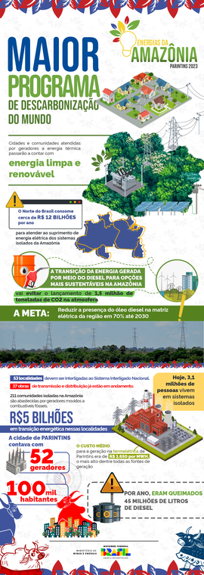




Action Plan for Power Sector Decarbonization: Planning
Decarbonize Off-Grid (and Remote) Systems
      Amazon Energies Program: Launched by the federal government in 2023, this program aims to reduce power generation from fossil fuels and energy costs in the Amazon region’s isolated systems.
Actions and Projects eligible for the program:
Interconnections
Energy Auctions
Energy Efficiency
and Loss Reduction
Funding
Data Quality and
Transparency
$
Promote interconnections of isolated systems to the SIN through new electricity transmission or distribution networks
40 planned interconnections up to 2028 and 30 more projects under evaluation.
Improve the auction guidelines to increase the competitiveness of renewable sources, including storage
New energy auction will be held in 2025.
Implementation of electrical loss reduction, energy efficiency, and demand response projects or programs
The electrical losses in some isolated systems are greater than 70%.
Program for Structural Reduction of Energy Generation Costs in the Legal Amazon (Pro-Legal Amazon)
About $300M USD for the next 10 years.
Promote the quality and transparency of information on electricity supply and fuel consumption within isolated systems
Isolated System Data Dashboard (PASI) launched in March 2024.
Notes:
Source: https://www.whitehouse.gov/briefing-room/presidential-actions/2021/01/27/executive-order-on-tackling-the-climate-crisis-at-home-and-abroad/; https://www.sustainability.gov/progress.html

Slide 21



Action Plan for Power Sector Decarbonization: Planning
Challenges and Opportunities for Brazil in an Energy Transition Context
Despite Brazil’s current clean power generation mix, challenges remain to enhancing the security of supply, promoting a fair and inclusive transition, and keeping the renewability of the power system.
Planning
Building
Operating
Actions that are starting and under construction, and for which the result will be seen in the medium and long term (years ahead).
Actions that are already in discussion and can be implemented in the mid-term horizon.
Actions and analyses that can be implemented and bring results in the short term.
Notes:
Source: https://www.whitehouse.gov/briefing-room/presidential-actions/2021/01/27/executive-order-on-tackling-the-climate-crisis-at-home-and-abroad/; https://www.sustainability.gov/progress.html

Slide 22



Action Plan for Power Sector Decarbonization: Planning
Launch of the National Energy Transition Policy
December 2023
The creation of the National Energy Transition Policy is debated in the National Energy Policy Council (CNPE).
Jan/Jul 2024
Rounds of discussions with members of the CNPE and the National Office for Social Participation of the General Office of the Presidency.
August 2024
Approval of the Resolution establishing the National Energy Transition Policy(PNTE) and its two instruments: the National Energy Transition Plan (PLANTE) and the National Energy Transition Forum (FONTE).
The National Energy Policy Council (CNPE), chaired by the Minister of Mines and Energy, comprises 17 state ministers and serves as an advisory body to the President of the Republic for the formulation of energy policies and guidelines.
Notes:
Source: https://www.whitehouse.gov/briefing-room/presidential-actions/2021/01/27/executive-order-on-tackling-the-climate-crisis-at-home-and-abroad/; https://www.sustainability.gov/progress.html

Slide 23
Action Plan for Power Sector Decarbonization: Planning
National Energy Transition Policy
Clearly articulate Brazil's ambition for an energy transition, guiding the country's efforts.
Support the alignment of energy policy with other public policies.
Increase the country's capacity to attract investments in the strengthening of energy transition supply chains, generating jobs and income.
Establish a foundation for dialogue with society and greater social participation.
Influence the development of the global energy sector, promoting opportunities for Brazil's economic and geopolitical integration.
Objectives
Notes:
Source: https://www.whitehouse.gov/briefing-room/presidential-actions/2021/01/27/executive-order-on-tackling-the-climate-crisis-at-home-and-abroad/; https://www.sustainability.gov/progress.html

Slide 24




Action Plan for Power Sector Decarbonization: Planning
Instruments of the National Energy Transition Policy
National Energy Transition Forum (FONTE)
A permanent and consultative instrument, aimed at stimulating, expanding, and democratizing discussions on energy transition between the Federal Government, civil society, the productive sector, and subnational entities.
Meetings
Plenary
Consultations
Quarterly meetings
Events
Annual Recommendation Letter to National Energy Policy Council (CNPE) and National Energy Transition Plan (PLANTE)
Notes:
Source: https://www.whitehouse.gov/briefing-room/presidential-actions/2021/01/27/executive-order-on-tackling-the-climate-crisis-at-home-and-abroad/; https://www.sustainability.gov/progress.html

Slide 25
Action Plan for Power Sector Decarbonization: Planning
Instruments of the National Energy Transition Policy
National Energy Transition Plan (PLANTE)
Long-term action plan that aligns with energy transition scenarios, supports economic and social development needs, and aims for net-zero greenhouse gas emissions in Brazil.
II - Cross-cutting Approach
Addressing aspects such as the legal-regulatory framework, investments and financing, and the social dimension of the actions.
  Legal-Regulatory Agenda
  Promotion of Investments
  Energy Inclusion
  Supply Security
  Others
I - Sectoral Approach
Covering actions to promote energy transition within each economic sector, tailored to the relevance, complexity, and specific characteristics of each sector.
  Energy in Industry
  Energy in Transportation
  Decarbonization of Oil and Gas
  Electric Power Sector
  Mining Sector
Notes:
Source: https://www.whitehouse.gov/briefing-room/presidential-actions/2021/01/27/executive-order-on-tackling-the-climate-crisis-at-home-and-abroad/; https://www.sustainability.gov/progress.html

Slide 26
I. Planning
Action Plan for Rapid Decarbonization of the Power Sector

Slide 27
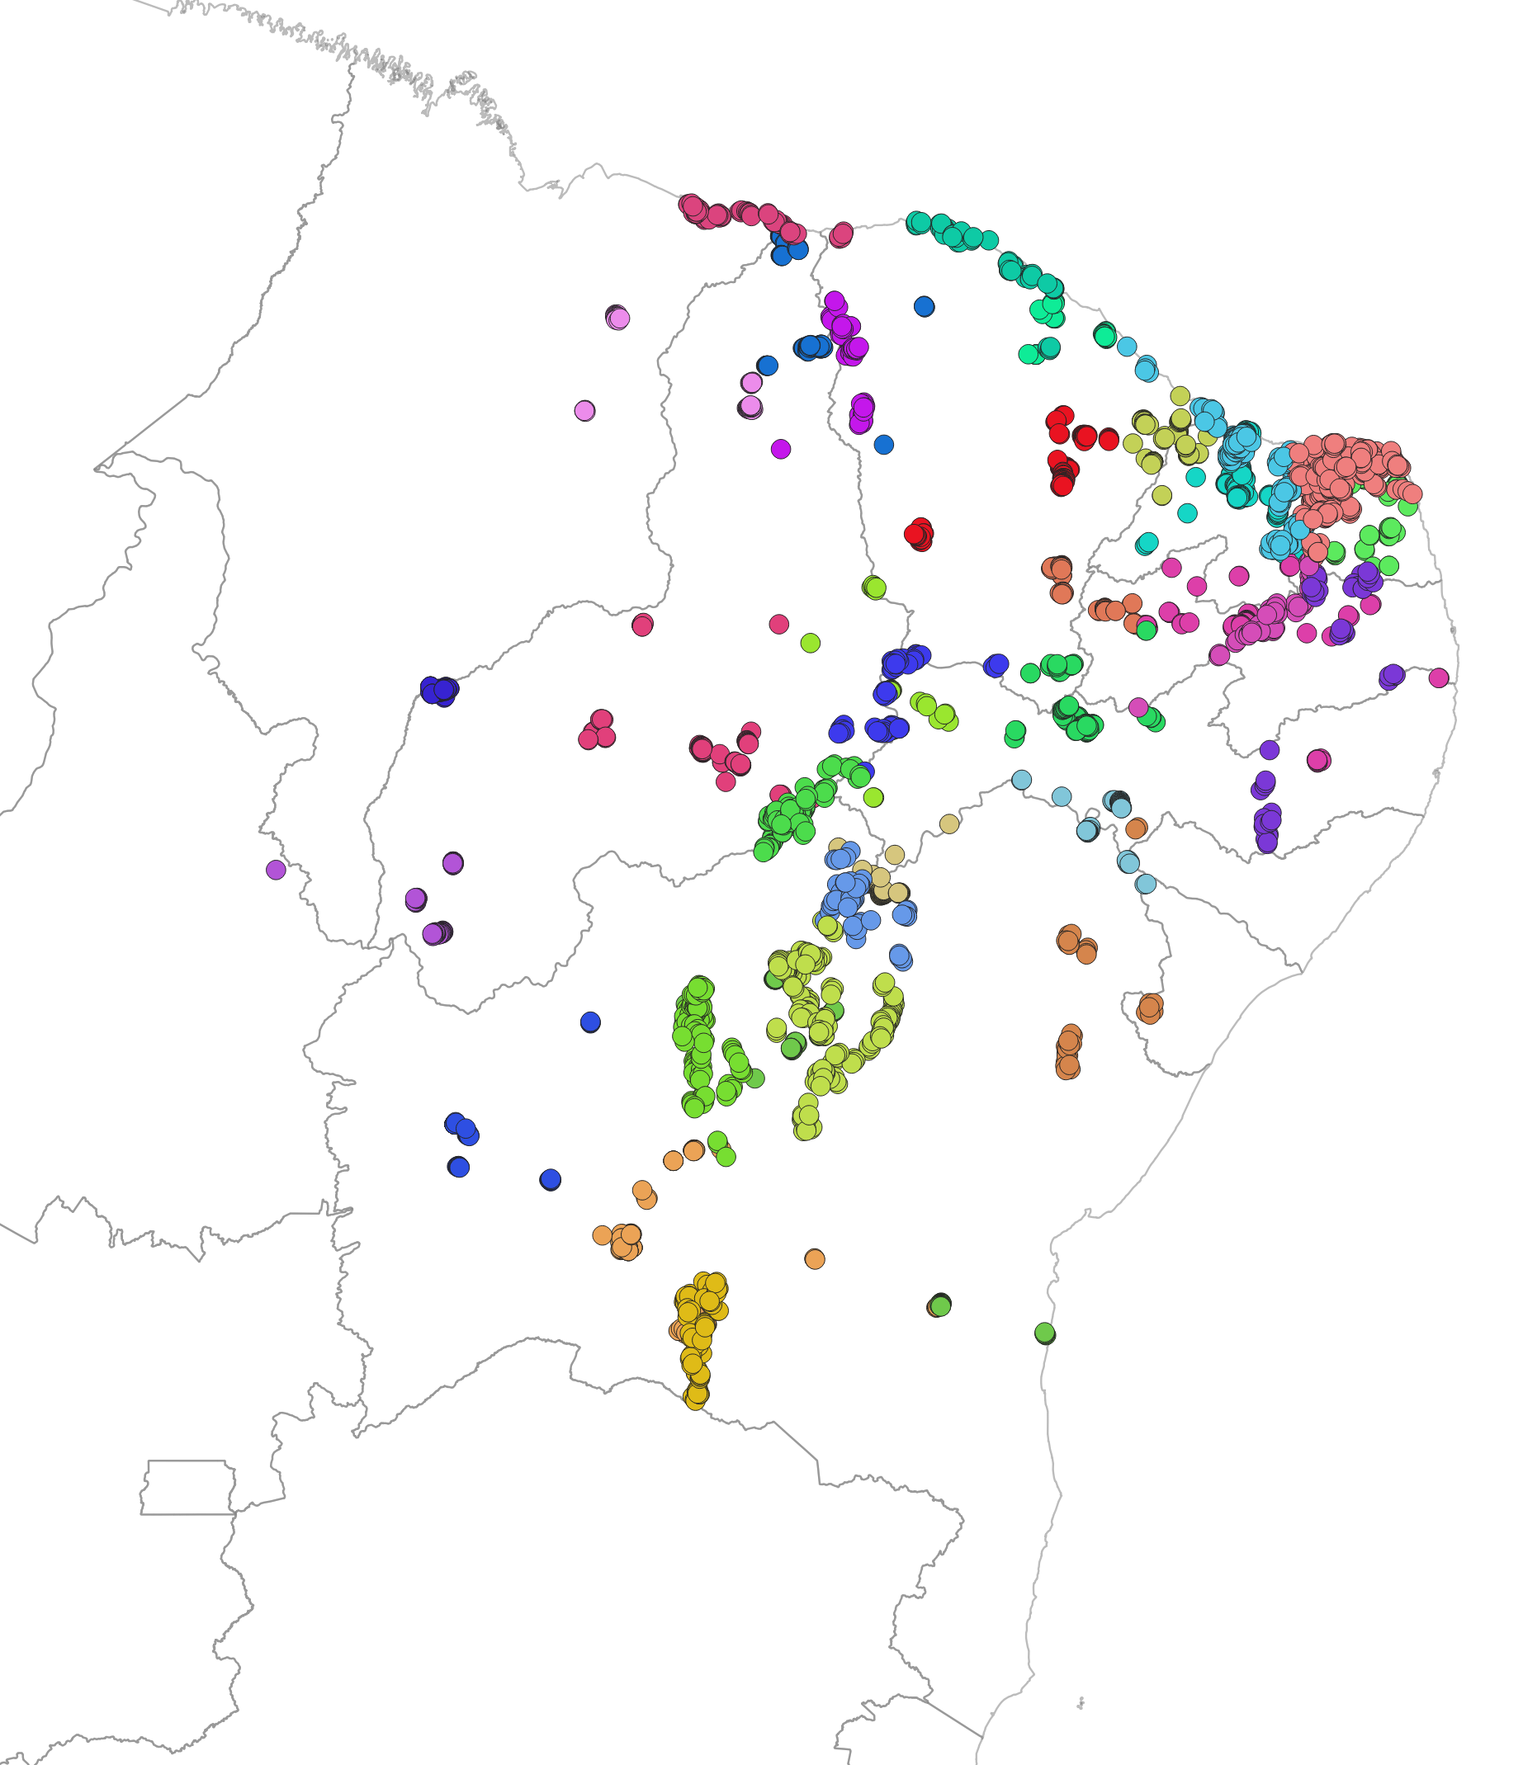
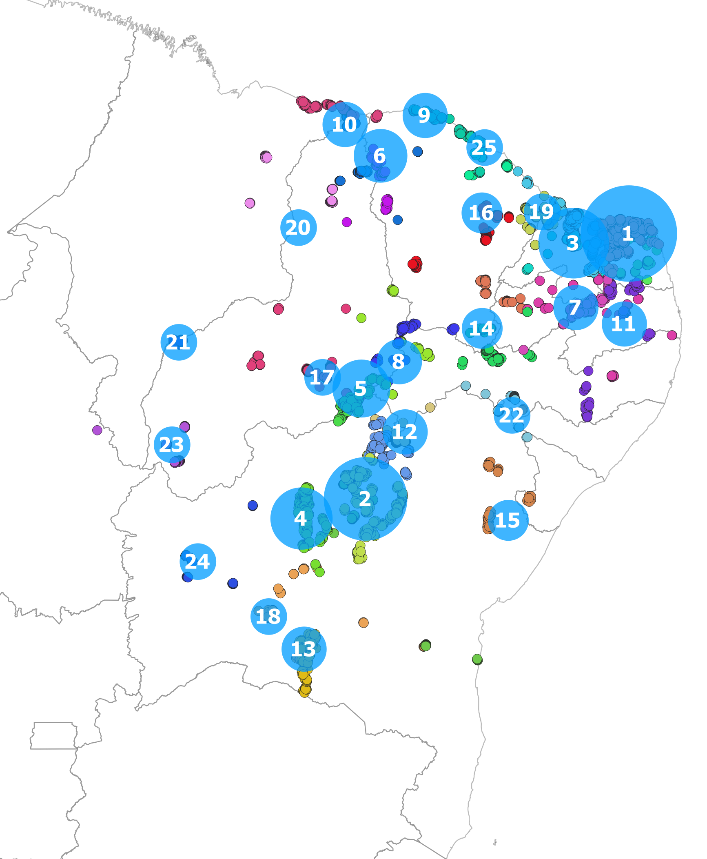
Action Plan for Power Sector Decarbonization: Planning
Proactive Transmission Planning
Location of renewable projects (wind and solar)
Transmission planning studies are using different strategies to deal with the challenge of integrating wind and solar photovoltaics (PV) to the grid.
Most of the challenges are associated with the uncertainty of the connection of future generation projects and the required time for the transmission assets to be operational (about 7 years).
To deal with these uncertainties, it was necessary to map the expected location and the installed capacity of potential projects.
By using clusterization methodologies based on the k-means methods, it was possible to identify the most promising areas for renewables expansion.
Database: SIGEL (ANEEL), AEGE (EPE)
1,845 projects; total installed capacity: 70 GW
Reference: May 2021
Results from the clusterization process. Approx. 14-GW cluster size is proportional to the installed capacity.
Notes:
Source: https://www.whitehouse.gov/briefing-room/presidential-actions/2021/01/27/executive-order-on-tackling-the-climate-crisis-at-home-and-abroad/; https://www.sustainability.gov/progress.html

Slide 28
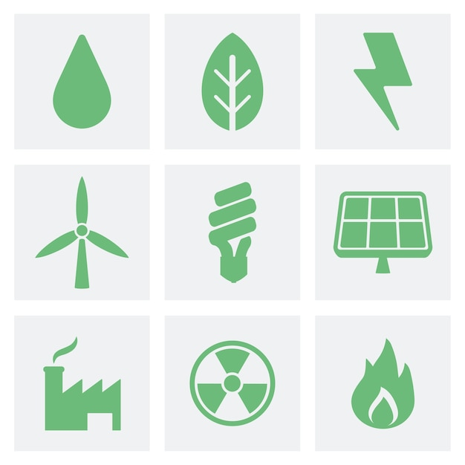
Action Plan for Power Sector Decarbonization: Planning
Proactive Transmission Planning
The prospective studies being carried out at EPE have brought a new perspective for the future expansion of the transmission grid in Brazil.
Not only do these studies consider the location of future generation projects, but they also take into consideration future system needs, such as an adequate load growth supply and an increase in reliability and resilience levels.
These studies have recommended more than 15,000 km of new transmission lines (500 kV and 230 kV), including 12 new substations (500 kV), 1 embedded 5-GW, 800-kV high-voltage DC Link (1,500 km) connecting the North and Southeast/Central-West regions.
The total required investments for these new transmission assets is around $10 billion USD.
When these assets become operational, they will allow safe integration of the generation indicated in the 10-year energy plan and provide enough capacity and resilience to cope with future system needs.
Brazilian electric regions
~1,900km
~2,700km
South
Southeast/Central-West
Northeast
North
Notes:
Source: https://www.whitehouse.gov/briefing-room/presidential-actions/2021/01/27/executive-order-on-tackling-the-climate-crisis-at-home-and-abroad/; https://www.sustainability.gov/progress.html

Slide 29
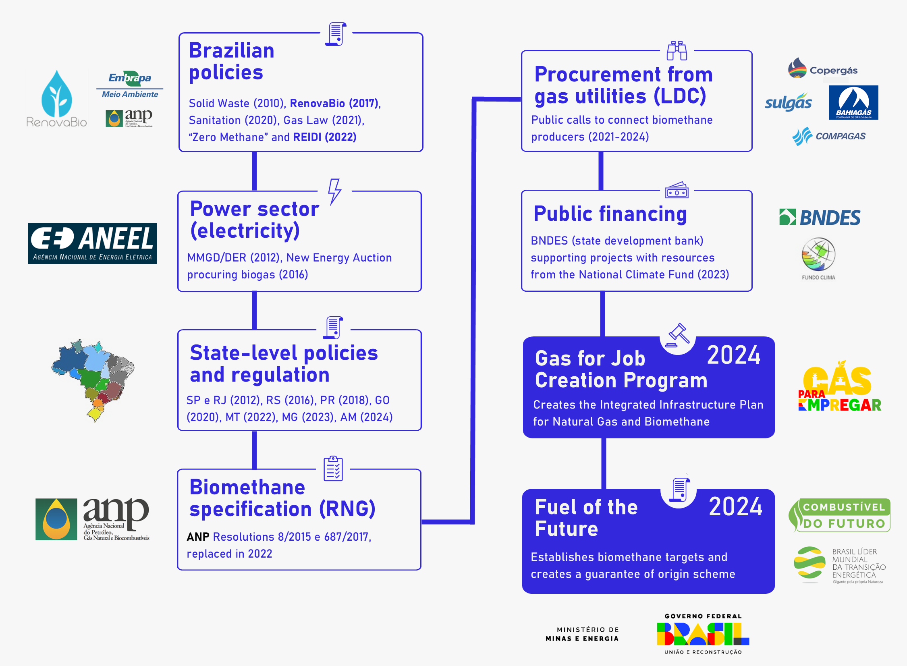
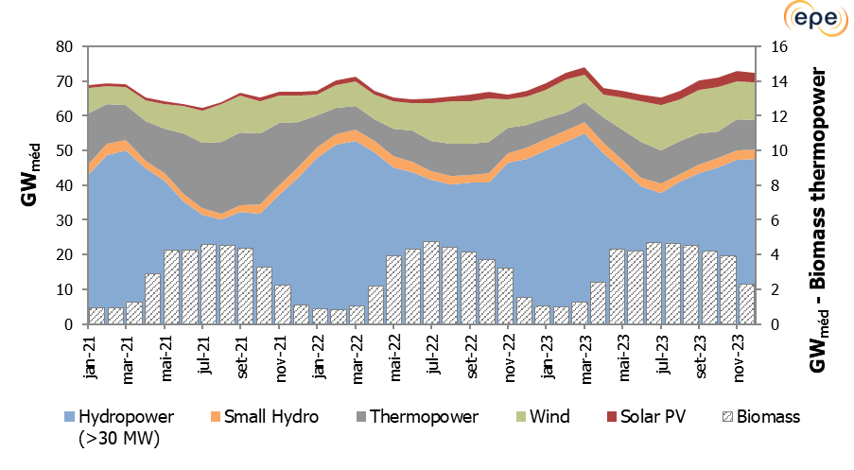

Action Plan for Power Sector Decarbonization: Planning
Bioenergy Participation in Power Generation
Biomass seasonal profile is complementary to hydropower production
Biogas: Brazilian regulatory and policy pathway
Notes:
Source: https://www.whitehouse.gov/briefing-room/presidential-actions/2021/01/27/executive-order-on-tackling-the-climate-crisis-at-home-and-abroad/; https://www.sustainability.gov/progress.html

Slide 30
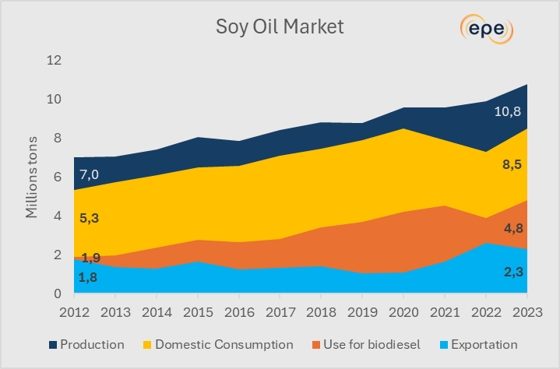
Action Plan for Power Sector Decarbonization: Planning
Biofuel Participation in Power Generation
Biodiesel for thermoelectricity
CAPACITY
Today, there are already plants operating with 100% biodiesel.
The 10-year projection of idle capacity in biodiesel plants makes it possible to meet 53% of the maximum demand of thermopower plants in the Northeast exclusively with biodiesel.
Considering those dedicated to diesel, there are 0.52 GW that could be fully supplied with biodiesel, with surplus, operating at full load.
FEEDSTOCK
The soybean oil and beef tallow are currently the main sources to the production of biodiesel.
The soybeans, soybean oil, and beef tallow now exported can be redirected to biodiesel production.
Other fatty sources are under study to be used in the biodiesel production (sewage fat, fatty acid sludge, macaúba, babassu).
Source: EPE, 2023
Notes:
Source: https://www.whitehouse.gov/briefing-room/presidential-actions/2021/01/27/executive-order-on-tackling-the-climate-crisis-at-home-and-abroad/; https://www.sustainability.gov/progress.html

Slide 31
II. Building
Action Plan for Rapid Decarbonization of the Power Sector

Slide 32





Action Plan for Power Sector Decarbonization: Building
Improvements to the Brazilian Electricity Market Design
Past
Present
Future
As the system continues to change, other improvements are needed to better address system needs, consider new requirements (like flexibility), and modernize legal and regulatory frameworks.
Today, considering new technologies and changes in generation mix, it is necessary to hold auctions to contract capacity and ensure supply security.
Expansion was based on firm energy, and it was sufficient to meet all system requirement due to hydropower plants.
Notes:
Source: https://www.wri.org/insights/implementing-clean-energy-investments-us-bipartisan-infrastructure-law

Slide 33
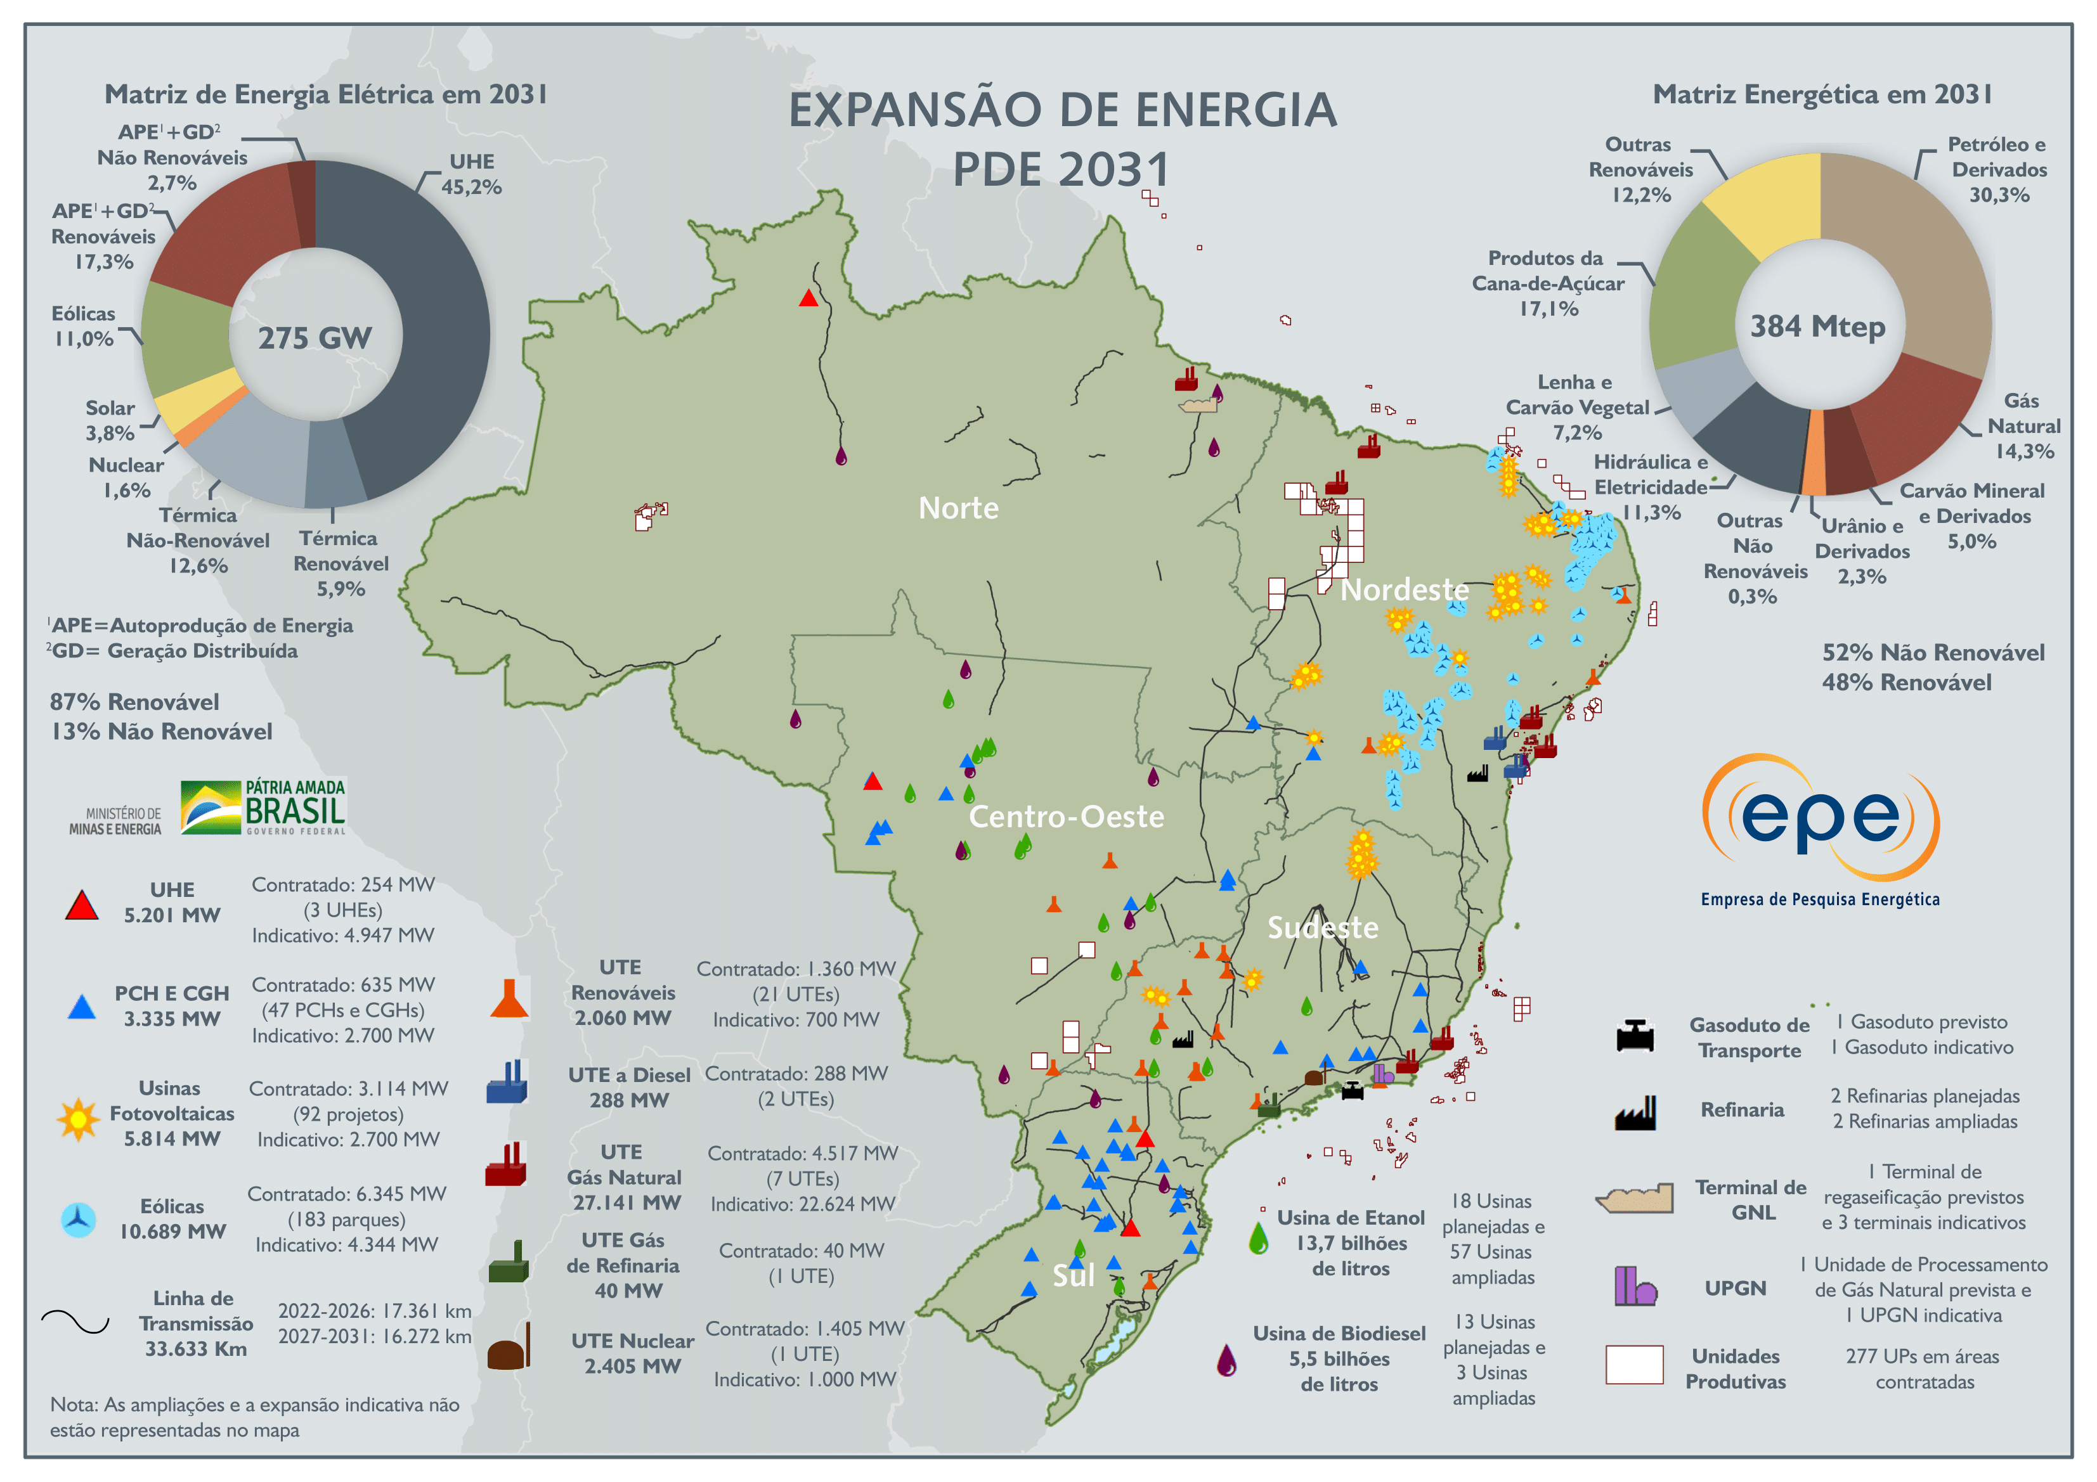
Action Plan for Power Sector Decarbonization: Building
Developments in Computational Models
Brazilian Power Generation Mix and Computational Model Improvements
PAST
PRESENT
FUTURE
Increasing the participation of variable renewable sources and more decentralized decisions requires:
More time and spatial details in modeling
More data to better understand the resources and their correlations, including with load
Notes:
Source: https://www.wri.org/insights/implementing-clean-energy-investments-us-bipartisan-infrastructure-law

Slide 34

Action Plan for Power Sector Decarbonization: Building
Flexibility Requirements Assessment
Brazilian system hourly net load evolution
As the energy mix changes to include more variable renewable energy, it is important to monitor not only average energy and capacity, but also the variations on system needs: the flexibility requirements.
In the planning horizon, the hourly net load (total energy demand – variable renewable energy generation) tends to have more intense intraday variations, the so-called energy ramps.
Flexibilidade: Estimativa de requisitos e recursos (epe.gov.br)
Data: World Resources Institute (WRI), 2021
Tuiuiú Curve
Notes:
Source: https://www.wri.org/insights/implementing-clean-energy-investments-us-bipartisan-infrastructure-law

Slide 35


Action Plan for Power Sector Decarbonization: Building
Which Resources Can Provide Flexibility in Brazil?
Hydropower Plants
Provide fast ramps with low operational costs
Challenges in modeling and detailing operational hydraulic constraints.
Existing hourly hydro flexibility resource
Summation of the largest ramps per plant
System largest hydropower ramp
Thermal Power Plants
~ 35.000 MW/h can be considered as a maximum technical potential.
Can provide capacity and flexibility
Limited by unit commitment restrictions, among other things.
~ 9,000 MW/h was already seen in a dry period.
Additional Resources
Potential resources for Brazilian grid flexibility: small hydro, biomass, demand response, batteries, and pumped storage hydro
Regulatory improvements are necessary to unlock their potential.
Source: ONS (Brazilian National Grid Operator). Open Database. https://dados.ons.org.br/dataset/geracao-usina-2
Notes:
Source: https://www.wri.org/insights/implementing-clean-energy-investments-us-bipartisan-infrastructure-law

Slide 36
Action Plan for Power Sector Decarbonization: Operating
Promoting Flexibility in Existing Power Plants
Planning and Operation
Regulatory
Development of integrated generation and transmission analyses.
Technological development of metering and review of tariff design.
Improvements in the temporal and spatial price signal.
Regulation of technologies and programs that can contribute to increased grid flexibility.
Mapping of operational challenges that limit grid flexibility.
Review of the generator revenue structure.
Effort
Enhanced input data for operational and planning models to better represent short-term constraints.
Definition of criteria and continuous monitoring of flexibility requirements.
Inclusion of new reliability evaluations in mid- and long-term planning studies.
Development of methodologies and computational tools to perform simulations with appropriate temporal granularity.
Improvements in the demand response and energy efficiency programs.
The startup and shutdown of thermal plants should be subject to the energy spot price.
Impact
Notes:
Source: https://www.ferc.gov/news-events/news/ferc-proposes-interconnection-reforms-address-queue-backlogs

Slide 37




Action Plan for Power Sector Decarbonization: Operating
Operating Hydropower Reservoirs in a Variable Renewable Context
Diversifying Power Generation Mix
Significant expansion of distributed generation, especially solar PV
Institutional Governance
Needs coordinated actions between power sector and other water users, such as the Reservoir Recovery Plan, lead by Ministry of Mines and Energy
New Role of Hydropower Plants
New hydropower plant operation strategies, aiming to preserve reservoir levels
More variable renewable sources in generation mix, such as wind and solar PV
Technological development and cost reduction tends to intensify this scenario.
Operational constraints related to multiple uses of water.
Optimization of hydro reservoirs to meet capacity and flexibility requirements
Enhanced security of supply.
What is the role of hydropower plants (especially those with large reservoirs) in a more variable renewable system?
Notes:
Source: https://www.ferc.gov/news-events/news/ferc-proposes-interconnection-reforms-address-queue-backlogs

Slide 38


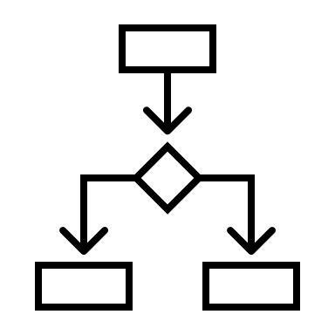




Action Plan for Power Sector Decarbonization: Operating
Resilience Challenges in Specific Regions
Water scarcity in the North region in 2023:
  Low inflows of the Madeira River
  Generation loss at Santo Antonio Hydroelectric Power Plant
  Challenges to ensuring energy and power supply
  Risks to the transmission network.
Action Plan
Assess critical scenarios and propose solutions for the resilience of the electric system in the face of extreme climate events.
Characterize vulnerabilities associated with critical scenarios in the analyzed region
List possibilities for increasing resilience
Assess benefits and indication of the main impacts and challenges
Create timelines and sequence solutions
Map routes and next steps
Scope
Roadmap for Strengthening the Resilience of the Power Sector in Response to Climate Change
Notes:
Source: https://www.ferc.gov/news-events/news/ferc-proposes-interconnection-reforms-address-queue-backlogs

Slide 39

Action Plan for Power Sector Decarbonization: Planning
Opportunities and Challenges for Small Modular Reactors
Nuclear Energy in Brazilian National Plan 2050
Recommendations:
Standardize projects to get scale and learning economies; and seek synergies in public policies.
After 2030, new projects may be based on PWR technology, small modular reactors, and fourth-generation reactor technologies, if the latter reach technological maturity and competitiveness.
Small Modular Reactor
Opportunities:
Standardization, simplicity, security and safety, construction time and cost reduction, flexibility of supply, etc.
Challenges:
Technological uncertainties, many reactor concepts being proposed, diverse range of technological alternatives, comparisons, etc.
International Atomic Energy Agency (IAEA) - Coordinated Research Projects (CRP)
“Economic Assessment of the Potential for Small Modular Reactors on a National Level”
Brazilian Association for the Development of Nuclear Activities Permanent Forum on Small Modular Reactors
U.S.-Brazil Energy Forum Study on Small Modular Reactors
Notes:
Source: https://www.whitehouse.gov/briefing-room/presidential-actions/2021/01/27/executive-order-on-tackling-the-climate-crisis-at-home-and-abroad/; https://www.sustainability.gov/progress.html

Slide 40
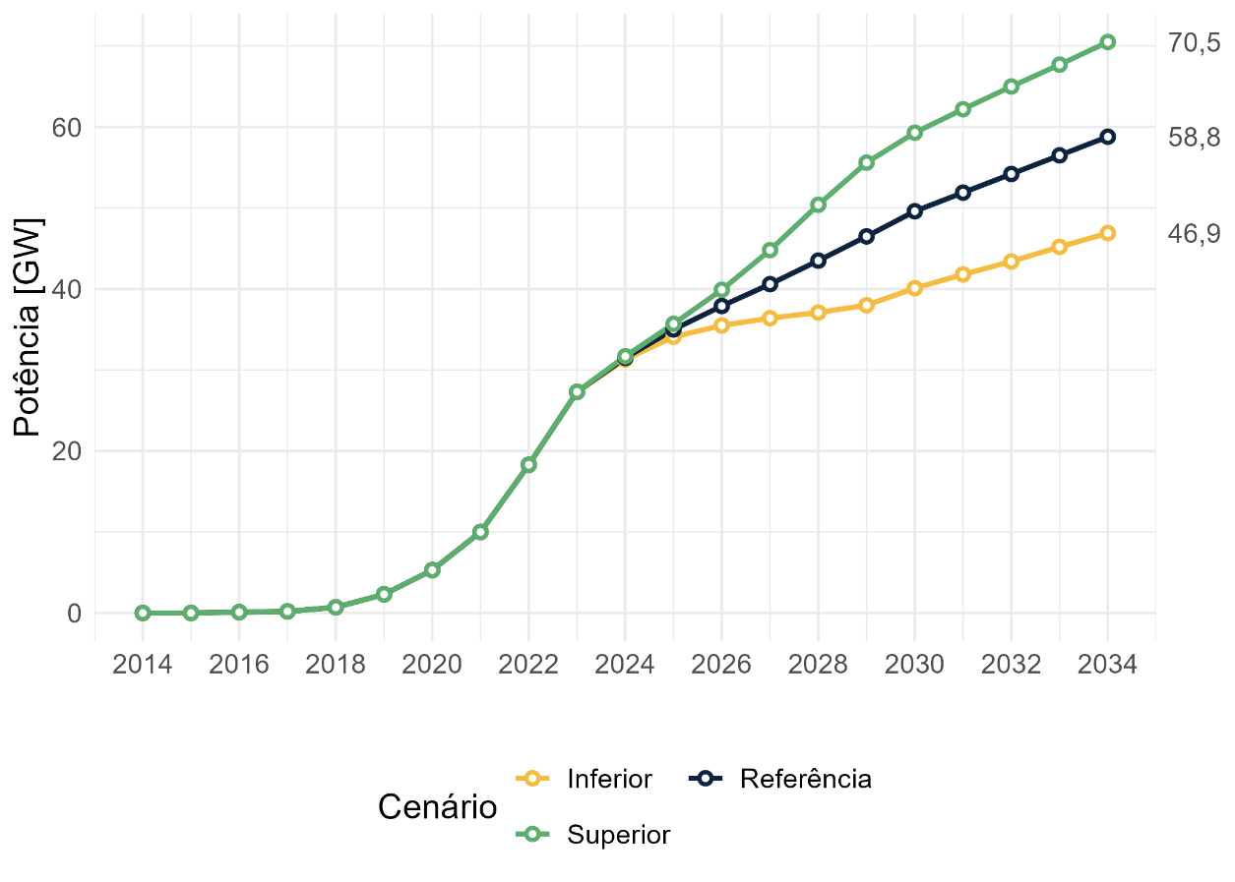

Action Plan for Power Sector Decarbonization: Building
Managing the Distributed Generation Boom
In recent years
In the future
New capacity of power generation in 2023 [GW]
Capacity forecast (GW)
For different scenarios
For the third year in a row, distributed solar PV leads the expansion.
Capacity (GW)
Share of electricity supplied by Distributed Generation on regulated market
Reference
Scenarios
Lower
Upper
Data from ANEEL EPE. “Painel de Dados de Micro e Minigeração Distribuída.” https://dashboard.epe.gov.br/apps/pdgd./
Data: EPE. “Plano Decenal de Expansão de Energia 2034.” www.epe.gov.br/pt/publicacoes-dados-abertos/publicacoes/plano-decenal-de-expansao-de-energia-2034.
Notes:
Source: https://www.wri.org/insights/implementing-clean-energy-investments-us-bipartisan-infrastructure-law

Slide 41
Action Plan for Power Sector Decarbonization: Building
Challenges of Implementing Distributed Generation
Quantifying costs and benefits of distributed generation: Starting in 2029, compensation for energy contributed to the grid will be based on a cost-benefit analysis. However, the methodology for this analysis remains undefined. The challenge is to develop a comprehensive and transparent approach that addresses the complex spatial and temporal dimensions of costs and benefits for distributed generation.
Aligning distributed generation with the free electricity market: The current net-billing scheme for distributed generation in Brazil does not fit with the rules of the free electricity market. Given the trend of expanding the free energy market to more customers in Brazil, it is crucial to reconcile these two markets to ensure seamless integration.
Ensuring equitable expansion of distributed generation: Currently, the adoption of PV systems is occurring mainly among affluent households, resulting in uneven distribution of costs and benefits. Implementing inclusive policies is crucial to broadening access to solar energy and ensuring more equitable benefits across society.
Source: EPE. “Plano Decenal de Expansão de Energia 2034.” www.epe.gov.br/pt/publicacoes-dados-abertos/publicacoes/plano-decenal-de-expansao-de-energia-2034.
Notes:
Source: https://www.wri.org/insights/implementing-clean-energy-investments-us-bipartisan-infrastructure-law

Slide 42

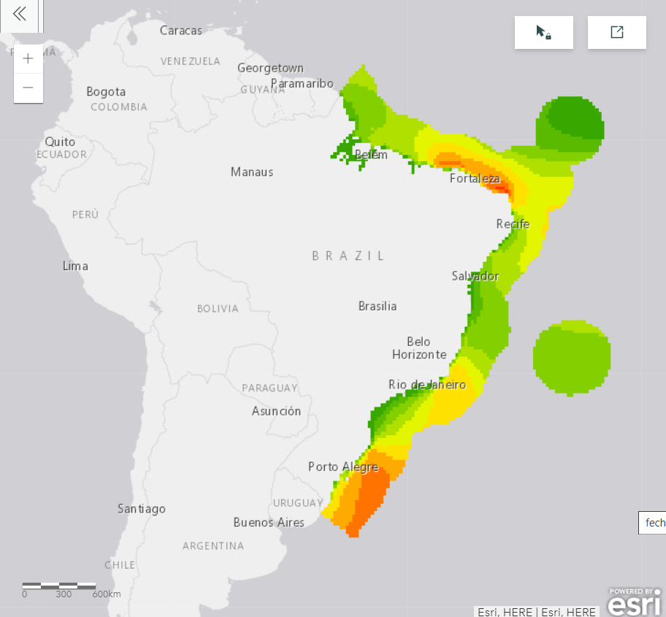
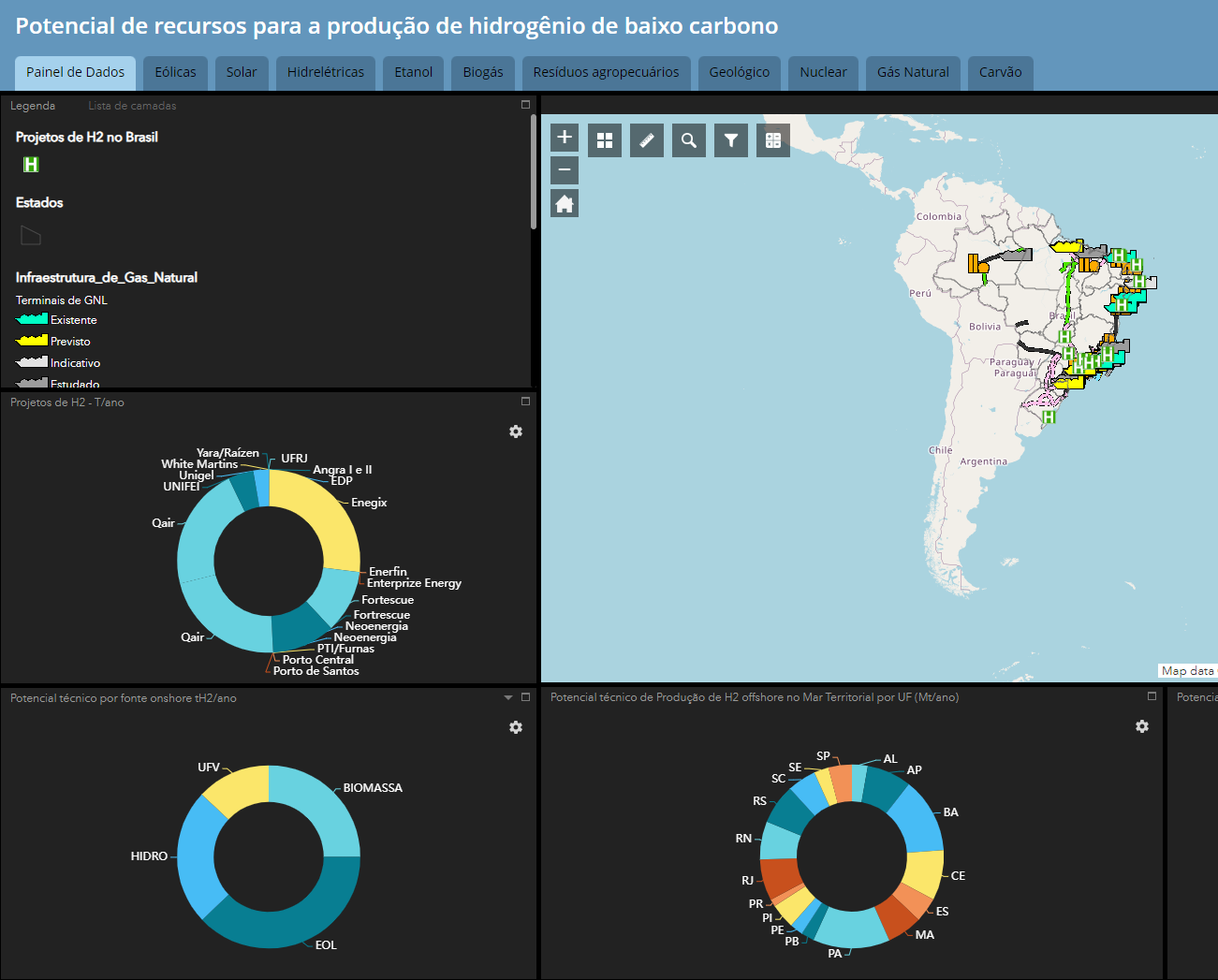

Action Plan for Power Sector Decarbonization: Building
Legal and Regulatory Framework Improvements To Allow New Technologies
Offshore Wind
Storage
Hydrogen
Legal framework to be approved
(Bill # 576 in Congress)
Decree # 10.946/22
  Rules for seabed leasing
Several developers and players
  97 projects (234.2 GW) so far.
  From: Ibama
Great potential: ~700 GW
in shallow waters (up to 50 m) and wind speed >7 m/s. From: Roadmap
Regulation under discussion
Pumped hydro storage
  Large experience on hydro power plants
  Three studies and a tool for site identification: 1, 2, 3
  Roadmap under development.
Batteries: multiple uses
  Behind the meter
  Utility scale: flexibility and capacity
  As transmission assets
  Isolated systems: increase renewable penetration and replace diesel. From: 1,2, 3, 4
National Hydrogen Program (PNH2) in place
3-year work plan
Technology neutrality
Recent legal framework: Law #14.948/2024.
Several studies on different routes and uses: Green, Blue, Gray, Turquoise, Refineries.
Great potential: 1.8 Gt/year
Remaining technical potential until 2050: 96% from renewables From: PDE 2031.
Green hydrogen
  Impact on load and new generation
  + 30 GW asked for grid connection.
Total
6,91 TW
697 GW
Up to 50-m depth
(≥7,0 m/s)
H2 dashboard
Notes:
Source: https://www.wri.org/insights/implementing-clean-energy-investments-us-bipartisan-infrastructure-law

Slide 43







Action Plan for Power Sector Decarbonization: Building
R&D Program
Brazil has been able to maintain annual R&D investments between 700 million and 1 billion US dollars per year in the energy sector.
The National Energy Policy Council has prioritized publicly oriented resources for seven strategic themes in the energy sector (Resolution 02/2021).
Investments in research, development, and demonstration (RD&D) mapped by Inova-e
Data: Inova-e Platform. EPE (2024).
Nuclear
Digital Transformation
Hydrogen
Energy
Storage
Biofuels
Technologies for Sustainable Thermoelectric Generation
Strategic Minerals for the Energy Sector
Publicly oriented investment: Private investment derived from legal obligations with the purpose of inducing companies to make investments in RD&D.
Public investment: Expenditure on reimbursable and non-reimbursable RD&D projects carried out through public institutions that promote innovation in Brazil.
Hydrogen
Notes:
Source: https://www.wri.org/insights/implementing-clean-energy-investments-us-bipartisan-infrastructure-law

Slide 44
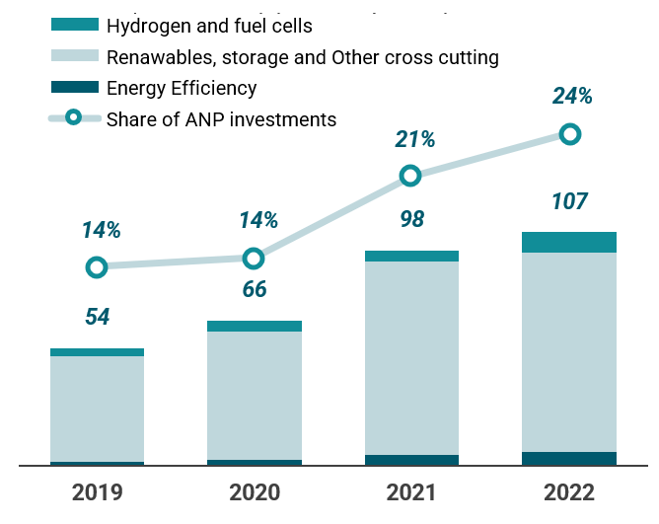


Action Plan for Power Sector Decarbonization: Building
R&D Program
Some other insights on the Brazilian RD&D investments database
The migration of expertise and diversification in the oil and gas sector.
Data from RD&D regulated by the Brazilian Oil & Gas regulator suggest that in recent years there has been a diversification of projects, with investments in technologies aligned with the energy transition. In 2022, almost one-quarter of regulated resources were allocated to non-fossil technologies.
The growing investment in innovation in the hydrogen chain.
Inova-e data points to growing investment in innovation in the hydrogen chain. The expectation is that, in the coming years, investments in low-carbon hydrogen will gain even more importance, both due to the influence of National Policy Council resolution nº02/2021 and the development of PNH2.
Hydrogen and fuel cell RD&D investments, from 2016 to 2022 (U.S. million)
The first version of PNH2, launched in 2023, proposes increasing annual investment in R&D to 200 million reais by 2025 (equivalent to $40 million USD on 2023 exchange rate).
PNH2 seeks to strengthen the market and industry for hydrogen with low-carbon emissions as an energy vector in Brazil.
Data: EPE. 2024. Inova-e Platform. https://dashboard.epe.gov.br/apps/inova-e-eng/dashboard.html.
Data source: EPE. 2024. Inova-e Platform. https://dashboard.epe.gov.br/apps/inova-e-eng/dashboard.html.
Hydrogen
Notes:
Source: https://www.wri.org/insights/implementing-clean-energy-investments-us-bipartisan-infrastructure-law

Slide 45
III. Operating
Action Plan for Rapid Decarbonization of the Power Sector

Slide 46
Action Plan for Power Sector Decarbonization: Operating
Increase Consumer Participation in Power System: Demand Response
Pilot Project
Voluntary Demand Reduction
In 2021, during the water scarcity in Brazil, the Voluntary Demand Reduction program for industrial consumers had important results, which contributed to improving the situation of the national energy system. Several industrial sectors participated, which translates to significant cost savings for both energy providers and consumers.
First Auction
In 2024, the first specific auction for demand response will take place, which will be prepared by system operator and regulatory agency.
Since 2018, new actions have already been taken to develop the demand response in Brazil, mainly for industrial consumers. A pilot project was created with significant participation of industry stakeholders in 2018, with low consumer participation.
Actions developed in demand response in Brazil's electrical system
Notes:
Source: https://www.ferc.gov/news-events/news/ferc-proposes-interconnection-reforms-address-queue-backlogs

Slide 47



Action Plan for Power Sector Decarbonization: Operating
Increase consumers participation in Power System: Energy Efficiency
One of the programs with the best results in energy efficiency is the Procel Seal. The Procel Seal of Energy Efficiency is a certification program in Brazil designed to promote energy-saving practices and technologies across various sectors.
One of the primary outcomes of the Procel Seal initiative has been a significant reduction in energy consumption across the country. For instance, products with the Procel Seal are often up to 30% more efficient than their non-certified counterparts.
240 billion kWh have been saved since 1986.
Notes:
Source: https://www.ferc.gov/news-events/news/ferc-proposes-interconnection-reforms-address-queue-backlogs

Slide 48
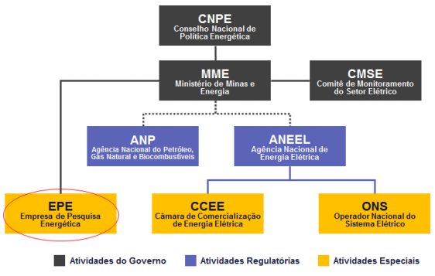














Action Plan for Power Sector Decarbonization
Stakeholder Engagement and Inclusion: Energy Sector Governance
Official institutions
Private sector associations and civil society
Public consultations and social participation are important parts of the government decision process in the Brazilian energy sector.
Notes:
Source: https://www.energy.gov/diversity/justice40-initiative

Slide 49
Action Plan for Power Sector Decarbonization: Planning
Challenges and Opportunities for Brazil in an Energy Transition Context
Although Brazil already has a clean power generation mix, some challenges remain to enhancing security of supply, promoting a fair and inclusive transition, and keeping the renewability of the power system.
Planning
Building
Operating
Implement and monitor Energias da Amazônia program
Increase biofuel participation
Deploy infrastructure to ensure the best use of renewable potential.
Manage distributed generation boom
Improve the market design and legal and regulatory framework
Develop and improve software used in the power system.
Rethink the role of hydropower plants and reservoirs
Promote flexibility
Increase consumer participation.
Notes:
Source: https://www.whitehouse.gov/briefing-room/presidential-actions/2021/01/27/executive-order-on-tackling-the-climate-crisis-at-home-and-abroad/; https://www.sustainability.gov/progress.html

Slide 50
Action Plan for Power Sector Decarbonization
References
Planning
Off-grid systems planning: https://www.epe.gov.br/pt/publicacoes-dados-abertos/publicacoes/sistemas-isolados
Off-grid System Data Dashboard: PASI
Brazilian National Plan 2050: Relatorio Final do PNE 2050.pdf (epe.gov.br)
Building
Brazilian Ten Years Plan 2034: www.epe.gov.br/pt/publicacoes-dados-abertos/publicacoes/plano-decenal-de-expansao-de-energia-2034
Brazilian Ten Years Plan 2034 – Distributed Generation and Batteries behind the meter: Apresentação do PowerPoint (epe.gov.br)
Distributed Generation Data Panel: https://dashboard.epe.gov.br/apps/pdgd/
Power System Flexibility: Requirements methodology and resources in Brazil: Flexibilidade: Estimativa de requisitos e recursos (epe.gov.br)
Roadmap Offshore Wind: Publicações (epe.gov.br)
Decree # 10.946/22: D10946 (planalto.gov.br)
Isolated systems batteries studies:. Publicações (epe.gov.br), Publicações (epe.gov.br), Publicações (epe.gov.br), Microsoft Word - NT Acre Lote III_v9 GP.docx (aneel.gov.br)
Pumped-hydro storage studies: EPE-DEE-NT-006_2019-r0.pdf; Publicações (epe.gov.br); Usinas Hidrelétricas Reversíveis (UHR): Desafios para inserção em mercados de energia (epe.gov.br)
National Hydrogen Program: PNH2
Baseline to support the Brazilian Hydrogen Strategy: NT_Hidrogênio_EN_revMAE (1).pdf (epe.gov.br)
Operating
Roadmap for Strengthening the Resilience of the Power Sector in Response to Climate Change: Publicações (epe.gov.br)

Slide 51
Brazil's Action Plan for Rapid
Decarbonization of Power Sectors

Slide 52

Connect With Us Online
Clean Energy Solutions Center (CESC)
  Check out our website
  LinkedIn
  CESC updates and event invitations
21st Century Power Partnership (21CPP)
  Check out the 21CPP website
  LinkedIn
  21CPP Resources
Clean Energy Ministerial (CEM)
  Check out our website
  LinkedIn
  Subscribe to the CEM newsletter!

Slide 53
Thank You!
DO NOT CITE OR REFERENCE. This work is not for distribution or commercial purposes. The methodology, formula, and analysis used and presented in this document and the views herein do not necessarily represent the views of or are endorsed by the U.S. Department of Energy or the U.S. Government, or any agency thereof.

