Slide 1

Power Sector Decarbonization Action Plan Series: Uruguay
December 18th, 2024
DO NOT CITE OR REFERENCE. This work is not for distribution or commercial purposes. The methodology, formula, and analysis used and presented in this document and the views herein do not necessarily represent the views of or are endorsed by the U.S. Department of Energy or the U.S. Government, or any agency thereof.
Notes:
Good morning, good afternoon, good evening. Thank you all for joining today’s webinar. I know it is going to be a very productive and interesting webinar. This webinar is brought to you Clean Energy Solutions Center and 21st Century Power Partnerships; two of the workstreams of the Clean Energy Ministerial. I welcome all the participants and speakers. It is great to see the participation from around the world.
Let me give you a rundown of agenda and speakers for today.

Slide 2
Agenda
Webinar & Speaker Introductions
Overview of Clean Energy Solutions Center (CESC)
Overview of 21st Century Power Partnership (21CPP)
Uruguay’s Power Sector Decarbonization Action Plan
Connect with us Online!

Slide 3

Housekeeping - Zoom
This webinar is being recorded and will be shared with attendees.​​
You will be automatically muted upon joining and throughout the webinar. ​​
Please use the chat feature to add comments and share input. ​
Please use the Q&A function in your toolbar to ask questions.
If you have technical issues, please use the chat feature to message Sophie Schrader.
You can adjust your audio through the audio settings. If you are having issues, you can also dial-in and listen by phone. Dial-in information can be found in your registration email.​​
We will be launching a survey when the event ends. Your feedback is highly valuable to us!

Slide 4
Webinar & Speaker Introductions
Holly Darrow, Researcher
National Renewable Energy Laboratory

Slide 5


Speaker Introductions
Sandra Dickison
Andrés Osta
Deputy Director for Multilateral Climate and Clean Energy Engagement,
U.S. Department of Energy
Economist & Advisor, Uruguay Ministry of Industry, Energy and Mining
Celeste Elhordoy
Head of International Affairs and Cooperation, Uruguay Ministry of Industry, Energy, and Mining

Slide 6
Overview of the Clean Energy Solutions Center (CESC)
Sandra Dickison, Deputy Director for Multilateral Climate and Clean Energy Engagement, U.S. Department of Energy
Notes:
I will now pass the mic to Jal Desai

Slide 7





The Clean Energy Solutions Center
OBJECTIVE
RATIONALE
AMBITION/TARGET
To accelerate the transition of clean energy markets and technologies.
Many developing governments lack capacity to design and adopt policies and programs that support the deployment of clean energy technologies.
Support governments in developing nations of the world in strengthening clean energy policies and finance measures
ACTORS
ACTIONS
UPDATES
Leads:
Deliver dynamic services that enable expert assistance, learning, and peer-to-peer sharing of experiences. Services are offered at no-cost to users.
Foster dialogue on emerging policy issues and innovation across the globe.
Serve as a first-stop clearinghouse of clean energy policy resources, including policy best practices, data, and analysis tools.
Website: www.cleanenergyministerial.org/initiatives-campaigns/clean-energy-solutions-center
Factsheet:
www.nrel.gov/docs/fy22osti/83658.pdf
Requests: Now accepting Ask an Expert requests!
Operating Agent:
Partners:
More than 40 partners, including UN-Energy, IRENA, IEA, IPEEC, REEEP, REN21, SE4All, IADB, ADB, AfDB, and other workstreams etc.

Slide 8






The Clean Energy Solutions Center
Ask an Expert Service
Ask an Expert is designed to help policymakers in developing countries and emerging economies identify and implement clean energy policy and finance solutions.
The Ask an Expert service features a network of more than 50 experts from over 15 countries.
Responded to 300+ requests submitted by 90+ governments and regional organizations from developing nations since inception
Training and Capacity Building
Delivered over 300 webinars training more than 20,000 public & private sector stakeholders.
Resource Library
Over 1,500 curated reports, policy briefs, journal articles, etc.
For additional information and questions, reach out to Jal Desai, NREL, jal.desai@nrel.gov

Slide 9
Overview of the 21st Century Power Partnership (21CPP)
Sandra Dickison, Deputy Director for Multilateral Climate and Clean Energy Engagement, U.S. Department of Energy
Notes:
Link to share: 21CPP Website (https://www.21stcenturypower.org/)

Slide 10
21CPP Overview
Accelerate the transition to clean, efficient, reliable, and cost-effective power systems.
Evolving Generation
Portfolios
Cross-Cutting Issues:
Operations, Transmission,
Distributed Generation,
Market Design,
Workforce Capacity
Coordinated Power System Planning, Building, and Operating Best Practices
Peer-learning, knowledge-sharing, and technical assistance
Electrification of Transport, Buildings, and Industry
Smart Grid, Energy Efficiency, and Demand Response
Coordinating with related CEM Campaigns and Partners

Slide 11
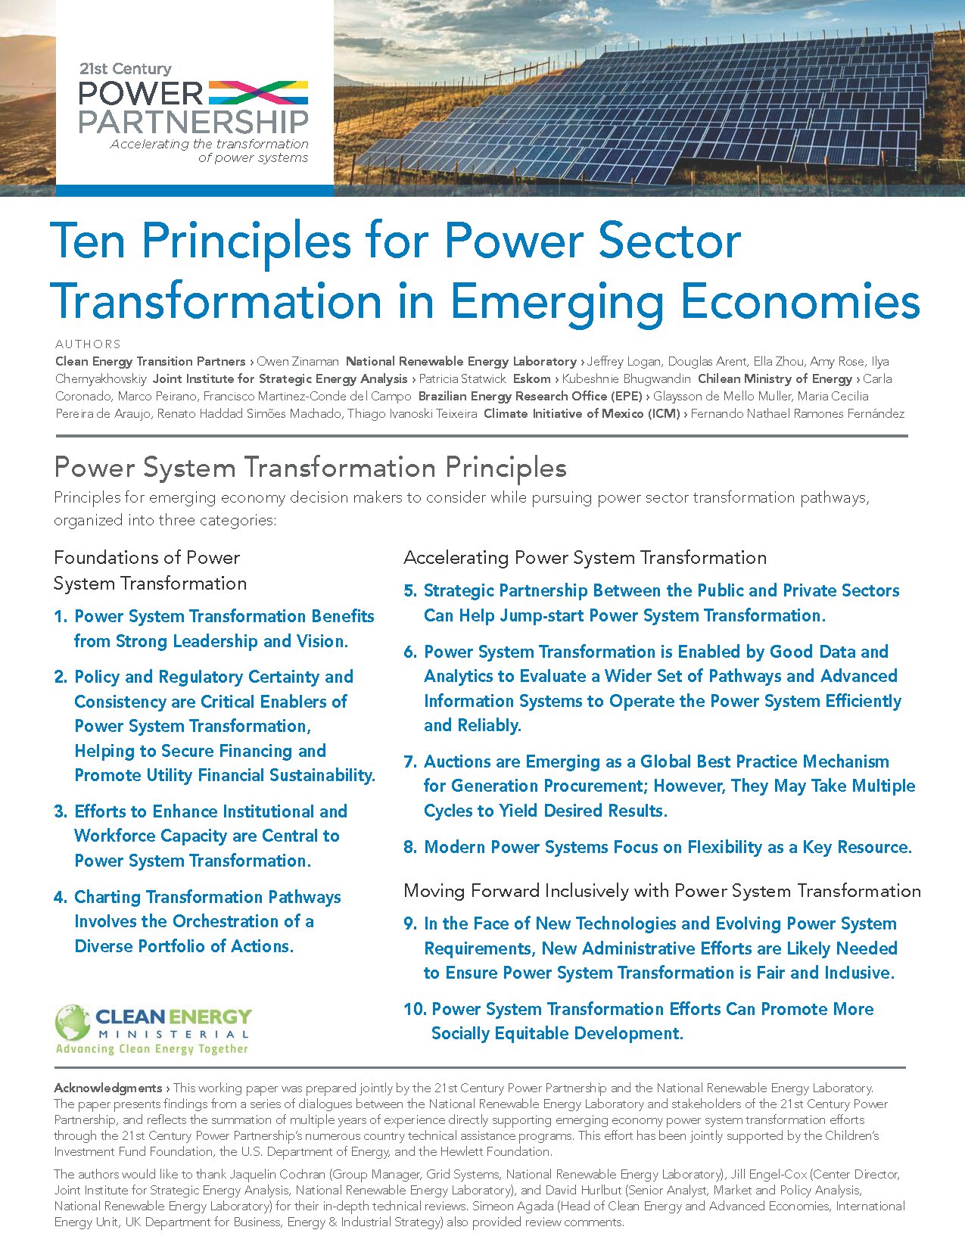
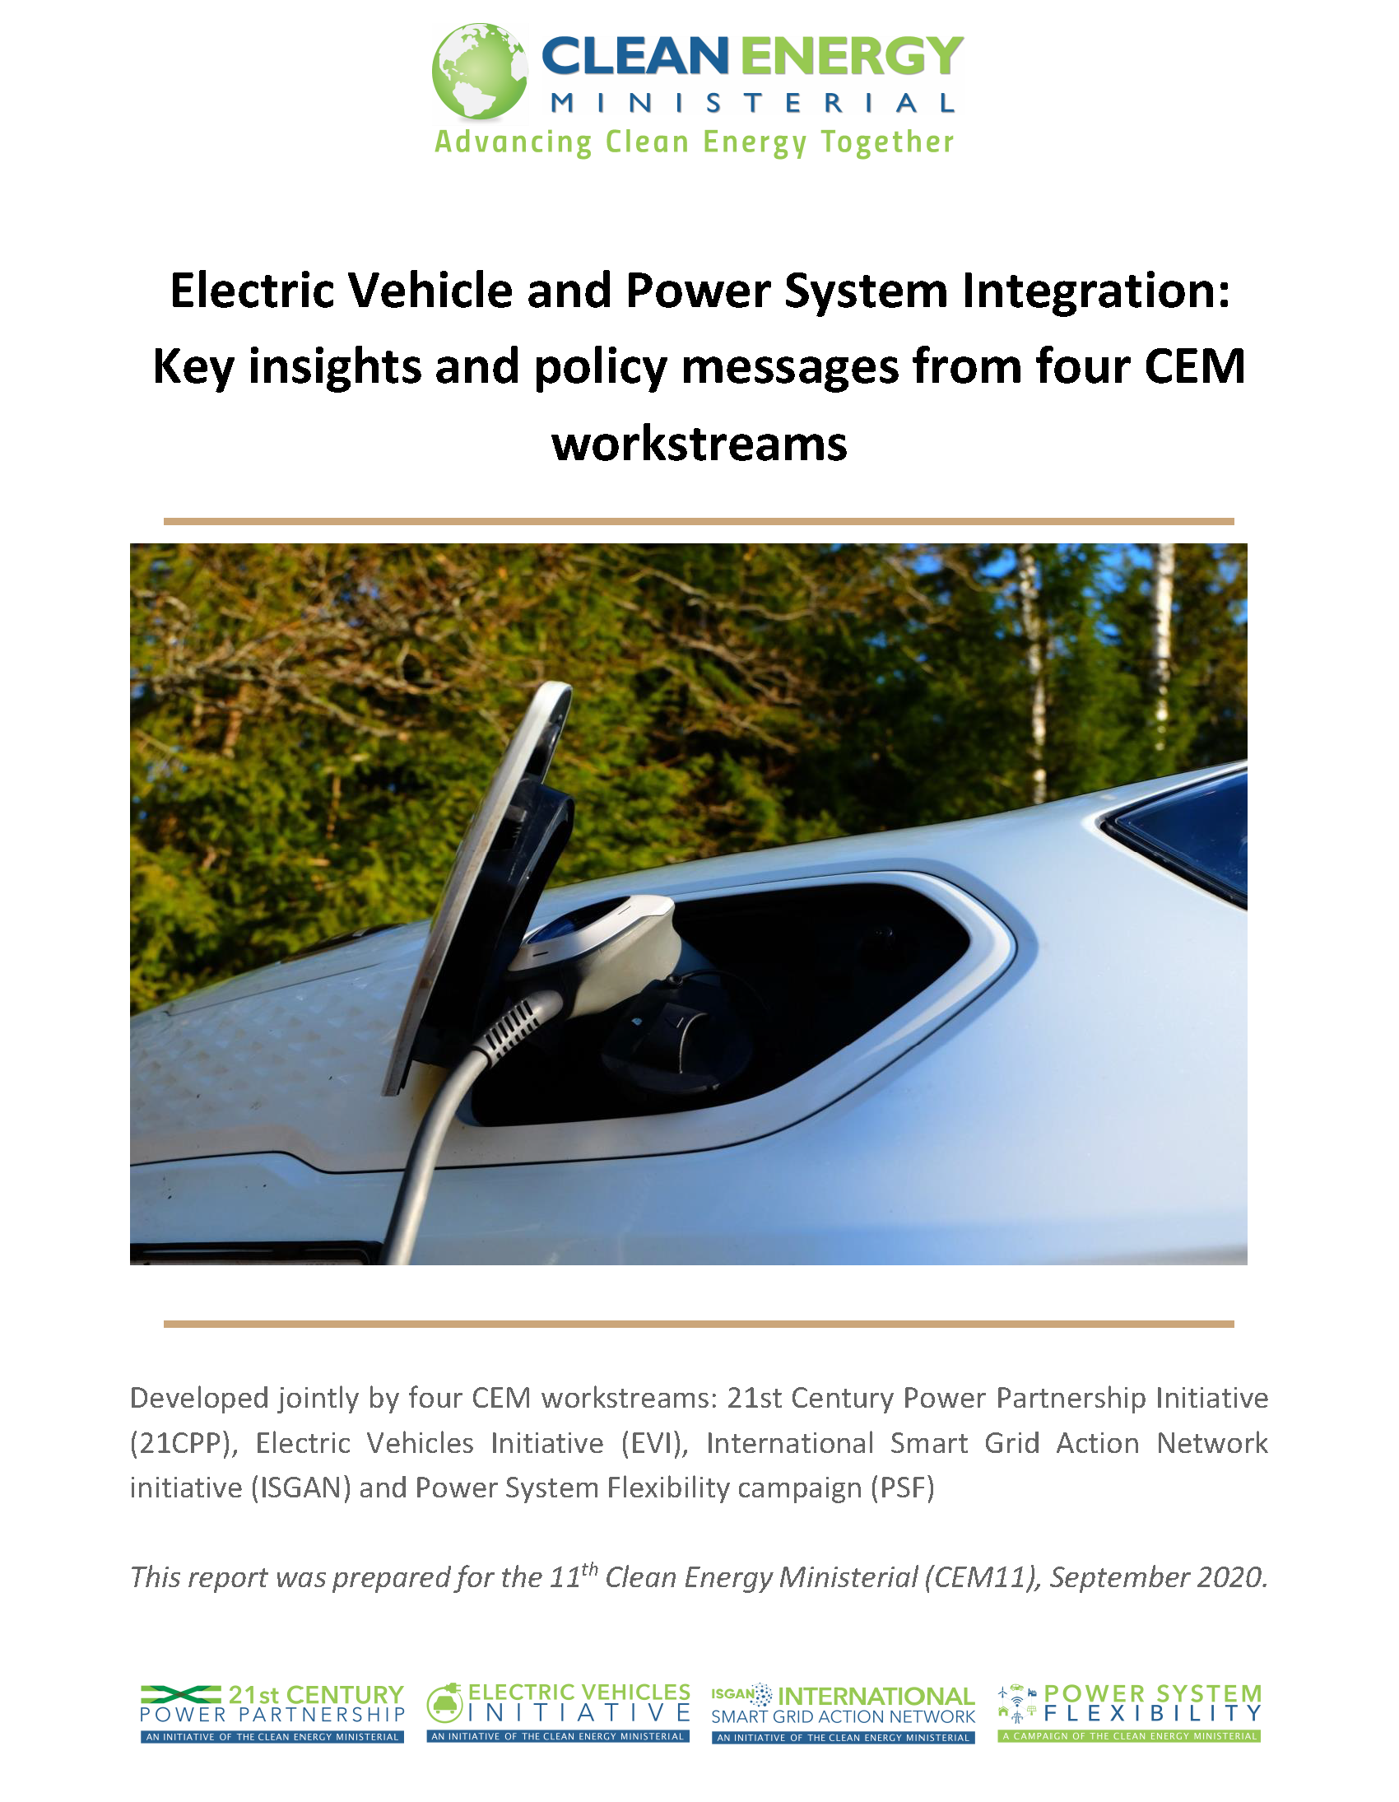
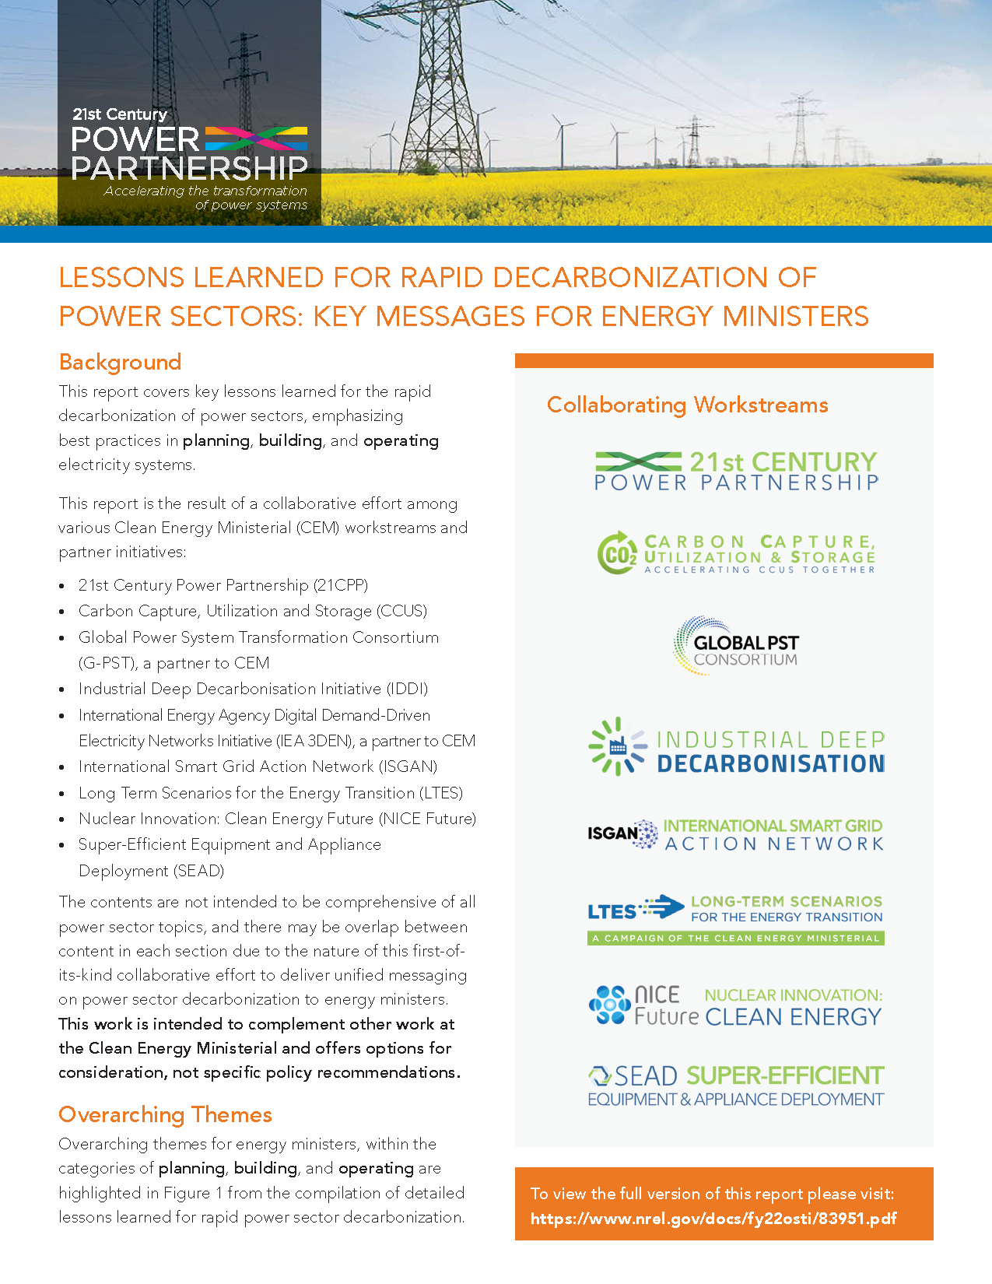


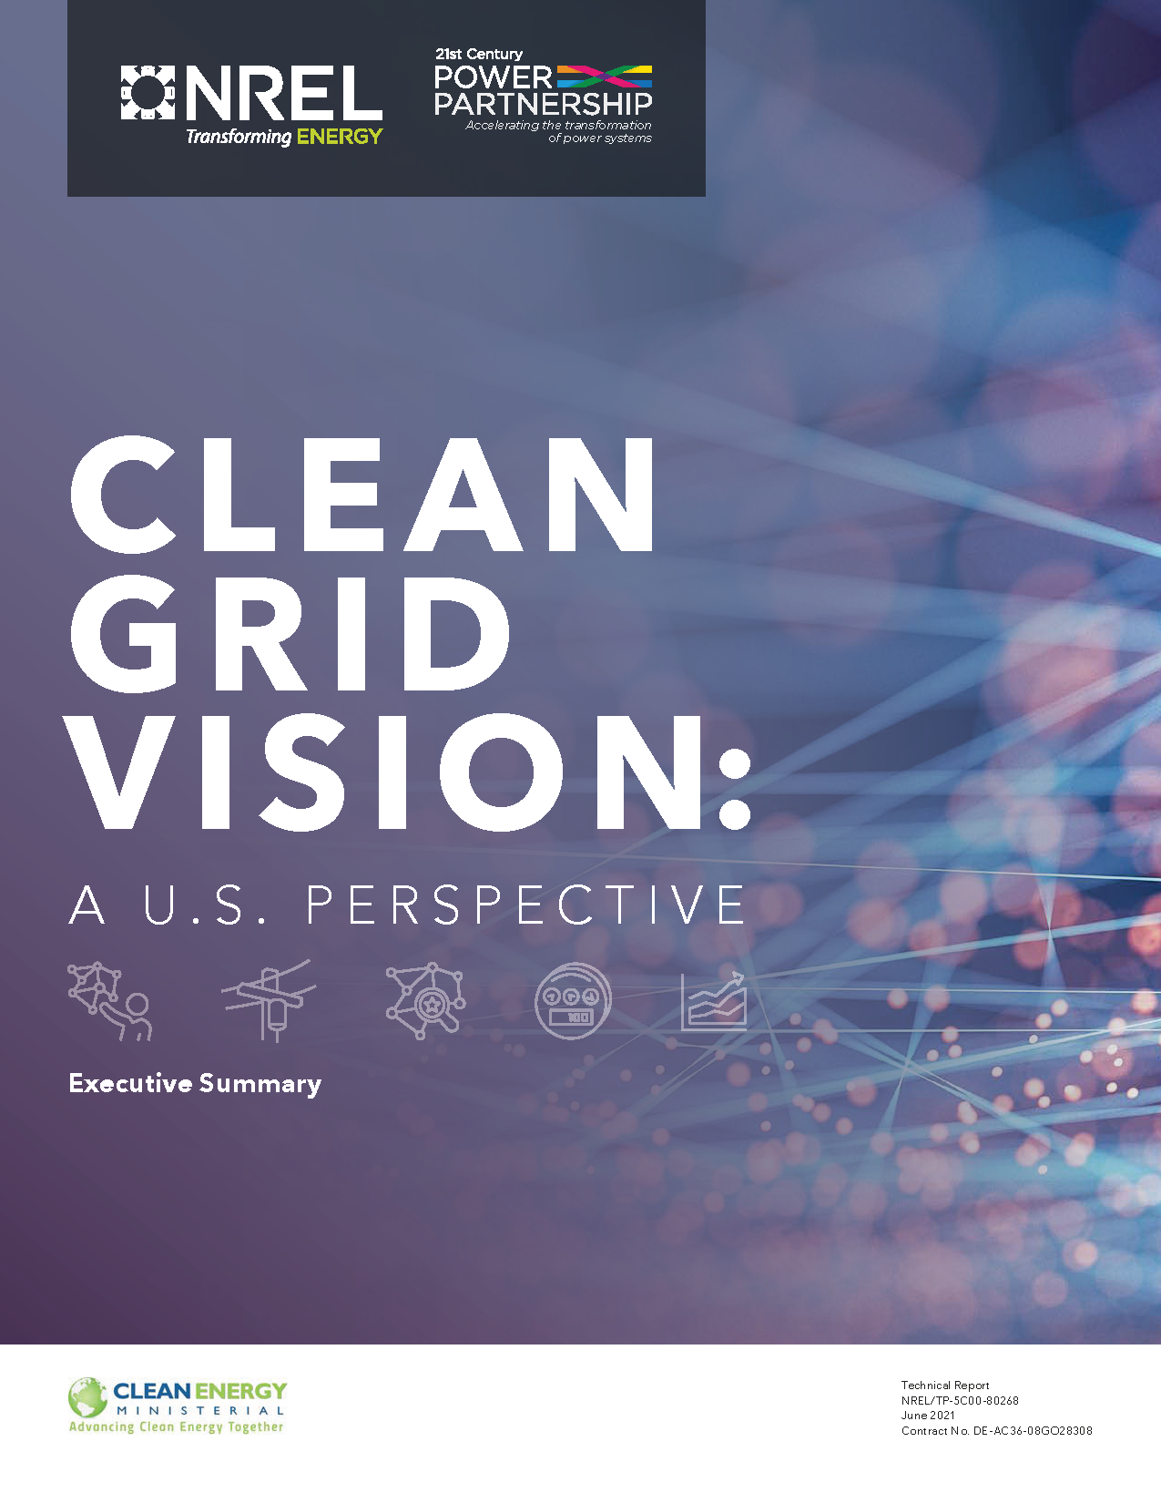
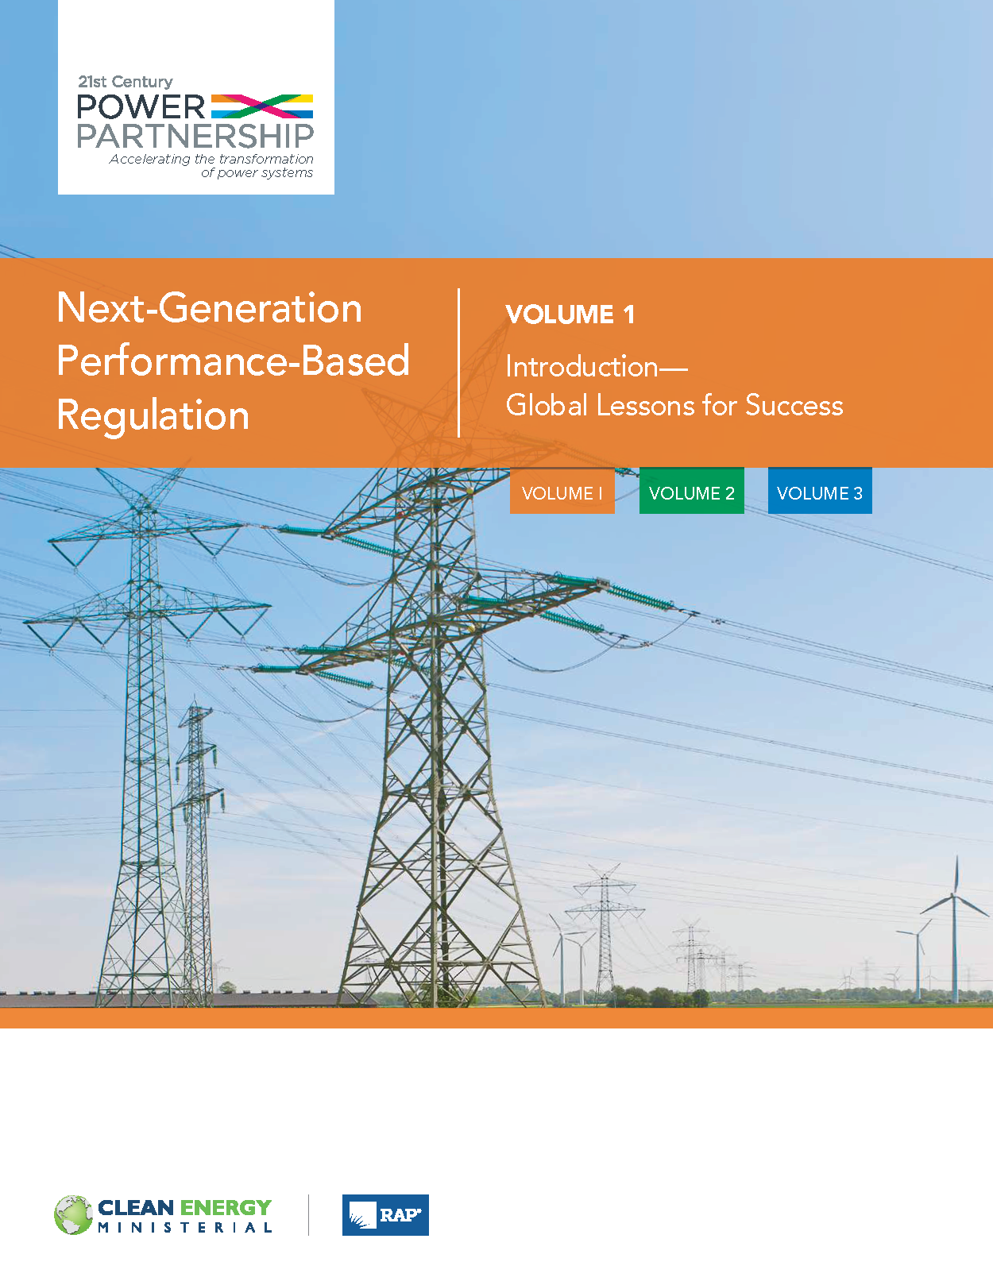
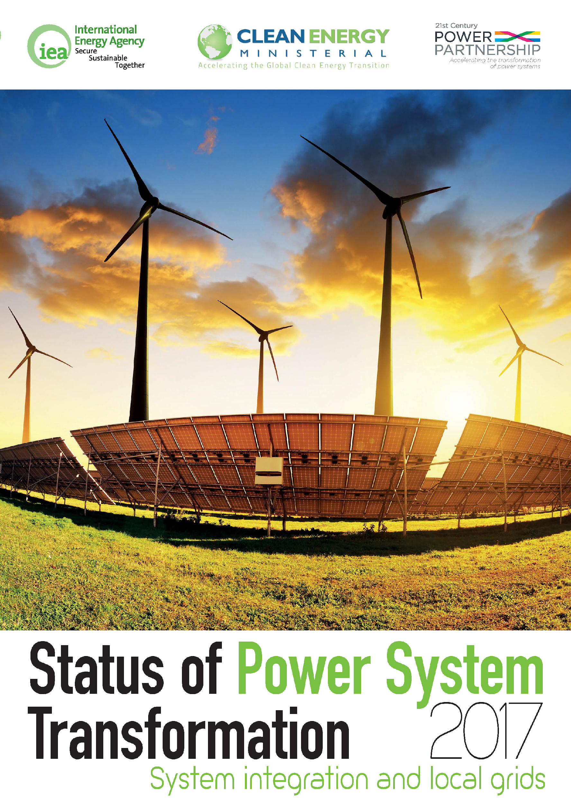
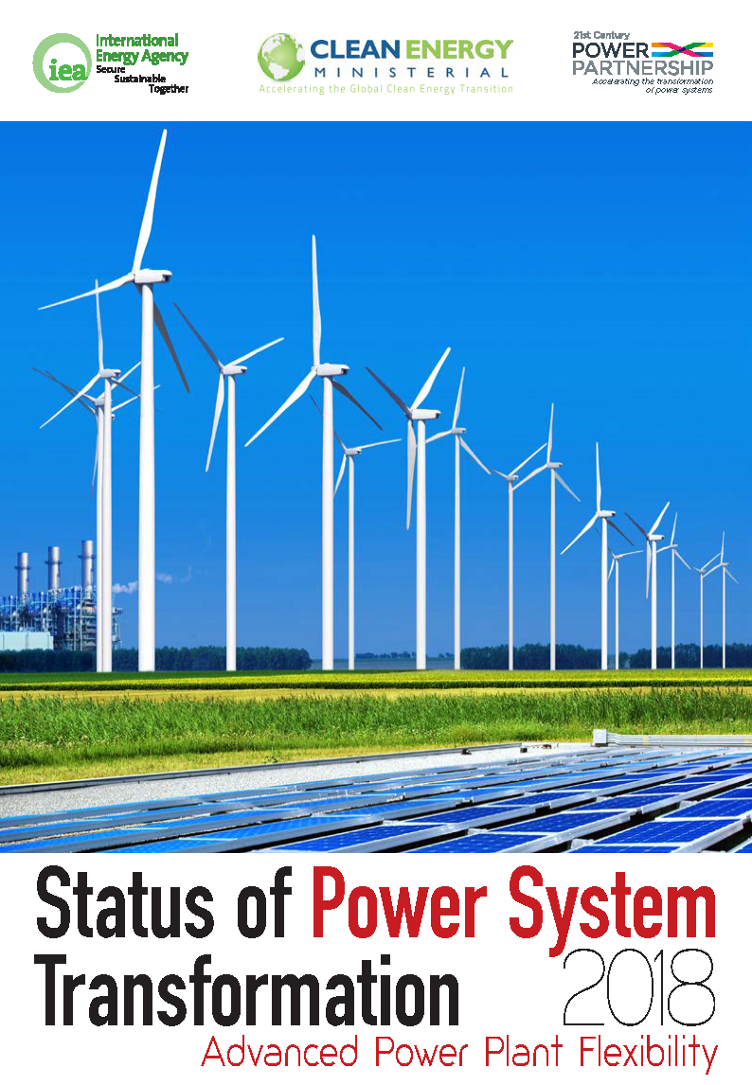
Decade of Thought Leadership
Explore the Thought Leadership reports:

Slide 12
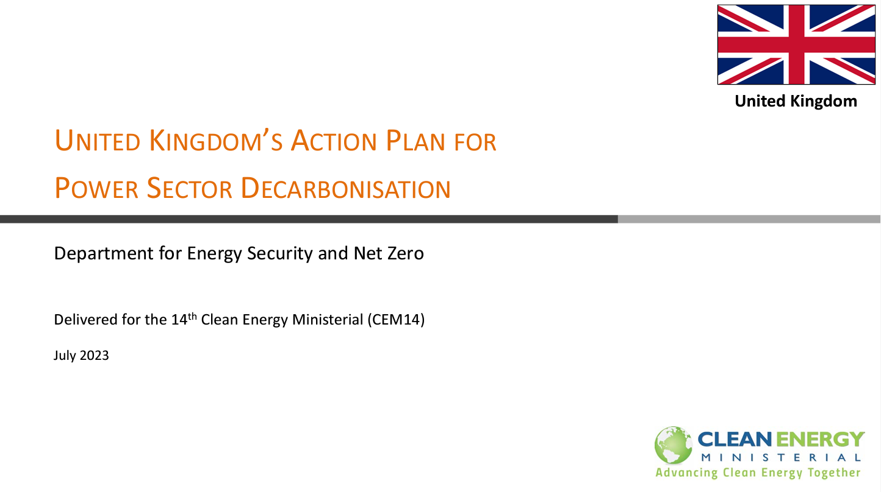
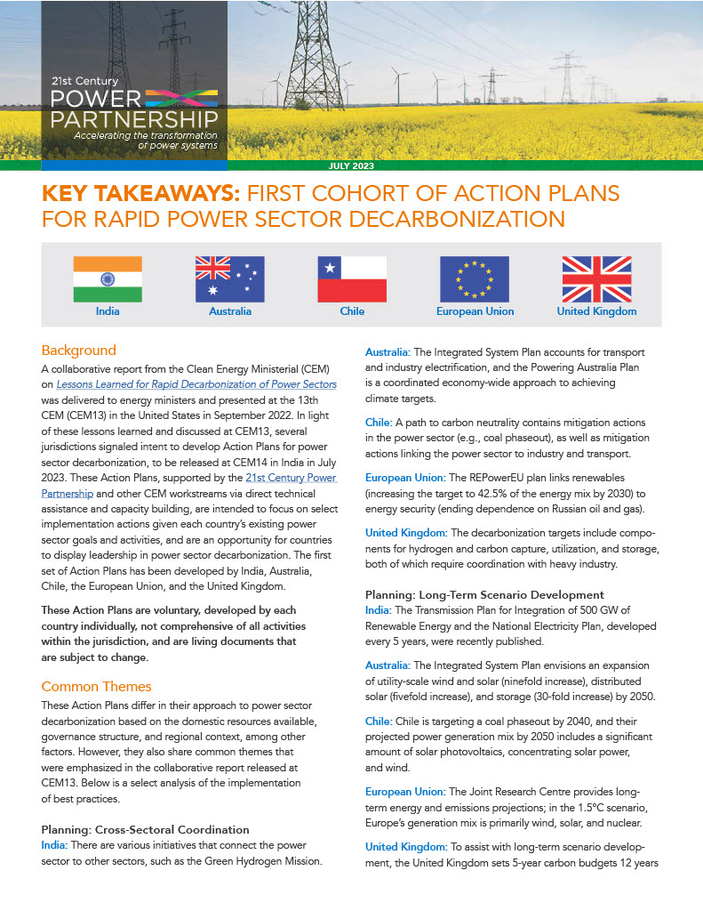
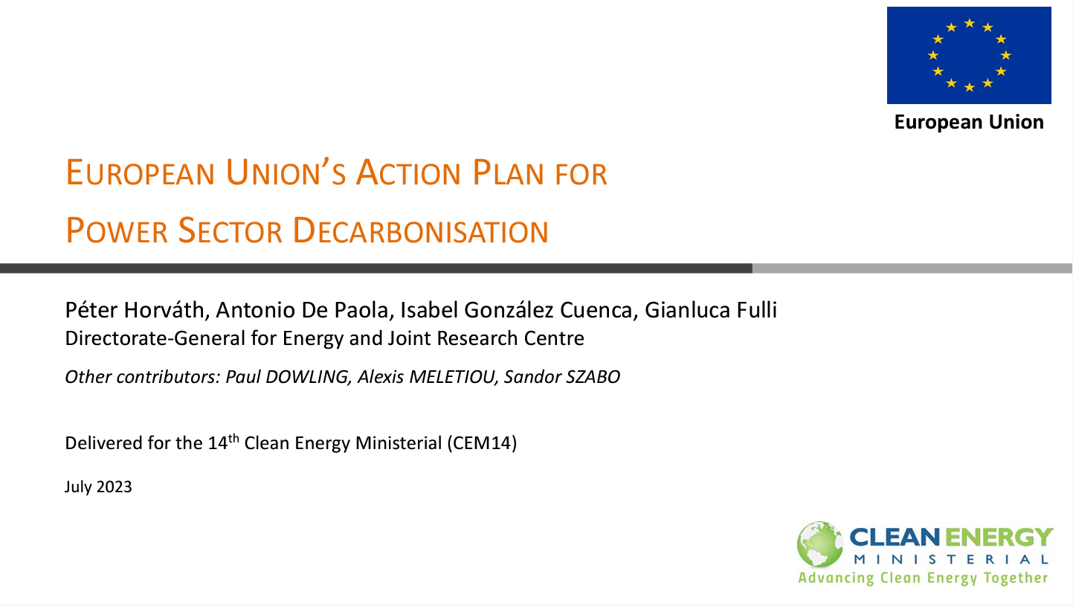
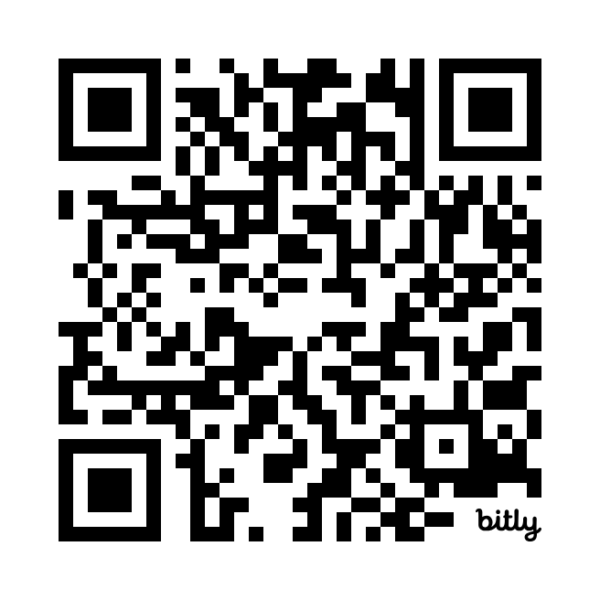
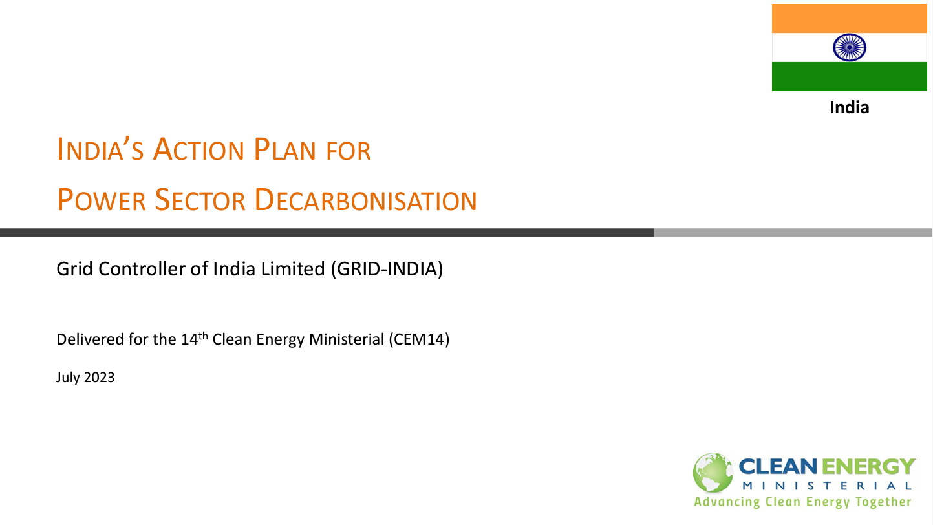
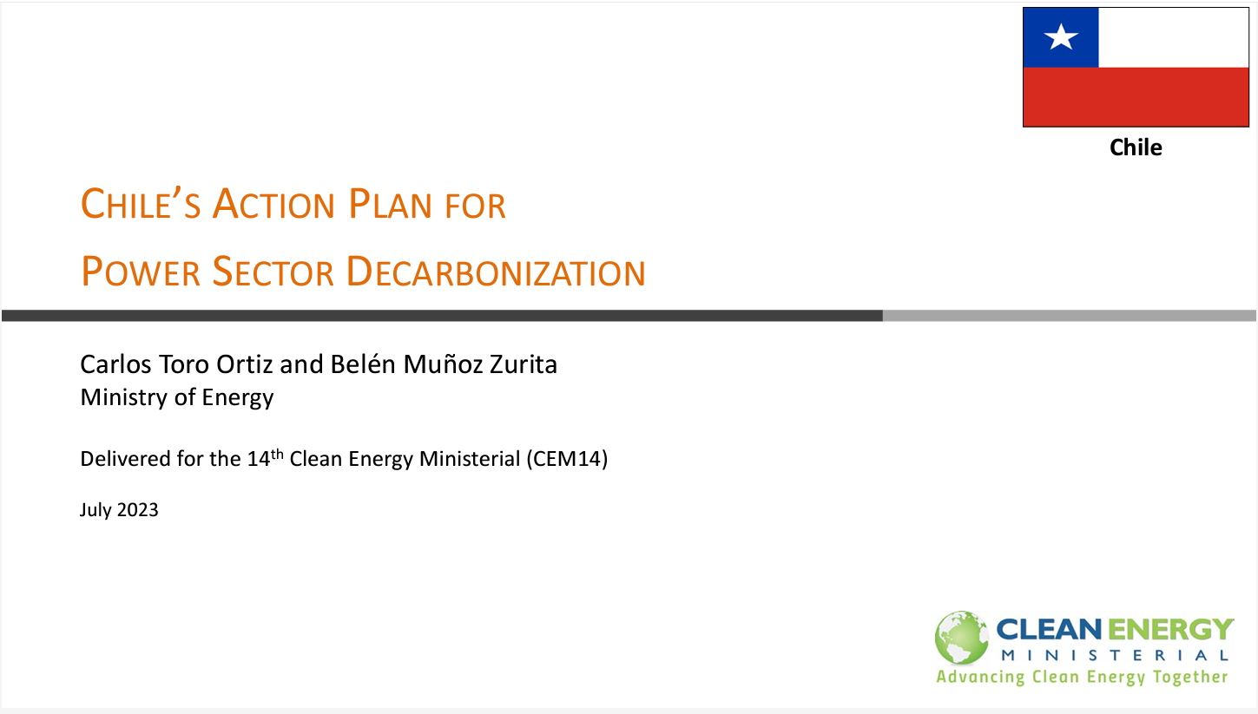
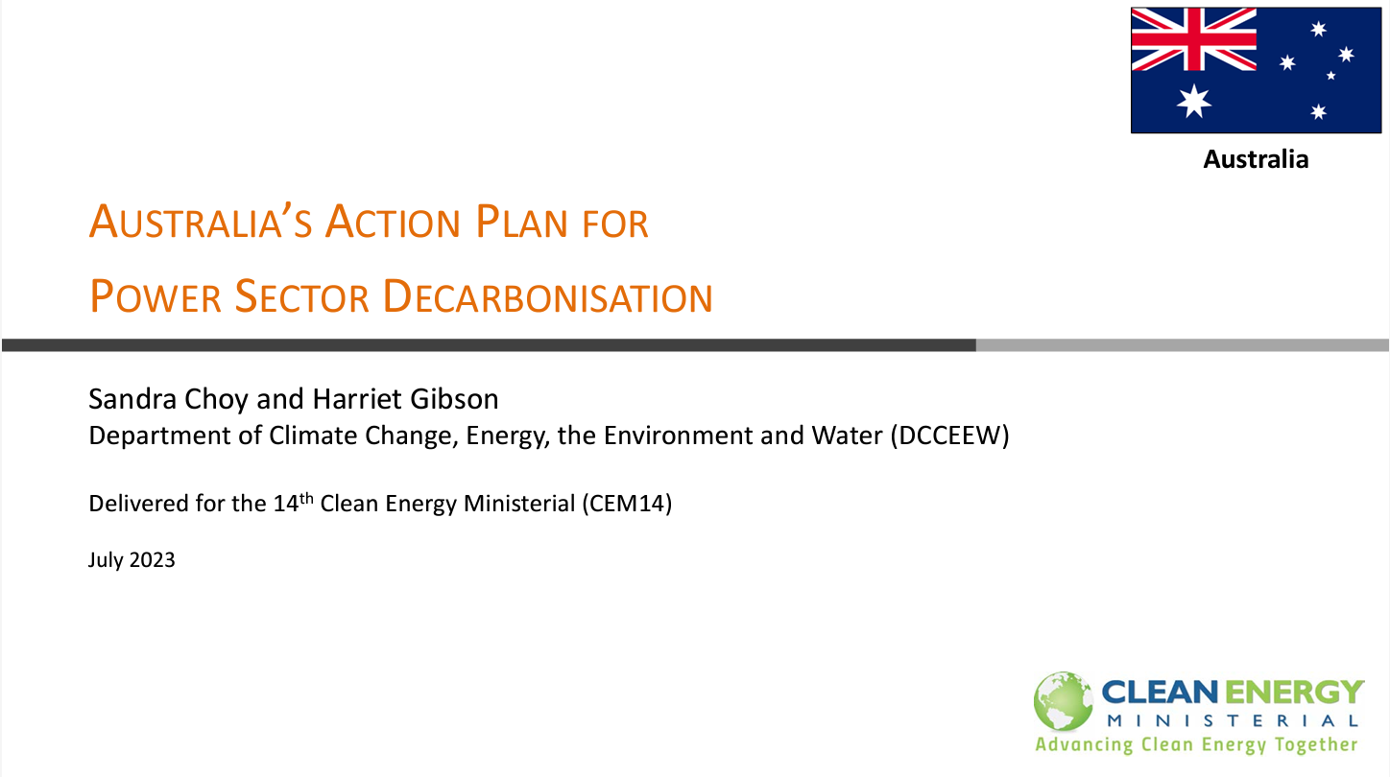
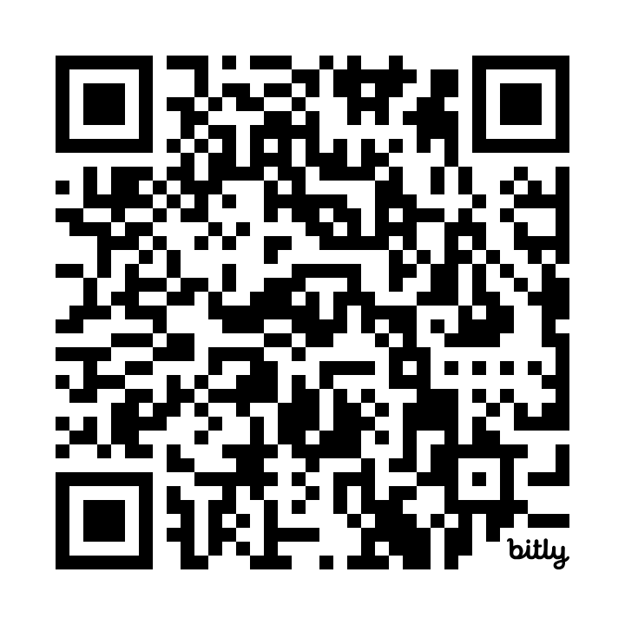
First Cohort Action Plans
Clean Energy Solutions Center (CESC) Action Plan Webinar Series:
Read the Action Plans:

Slide 13


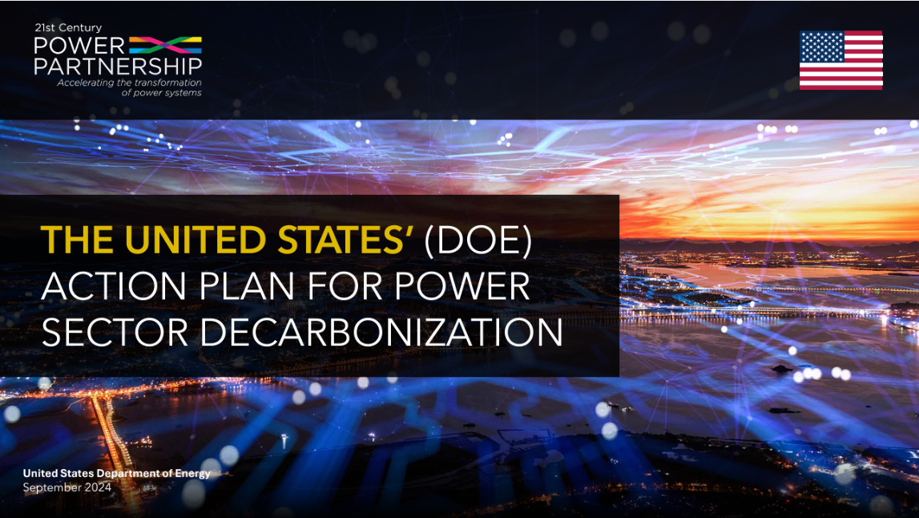

Second Cohort Action Plans
Action Plans for Rapid Power Sector Decarbonization
Brazil, Canada, United States, Uruguay

Slide 14
Uruguay’s Action Plan And Experience For Power Sector Decarbonization
Ministry of Industry, Energy and Mining

Slide 15
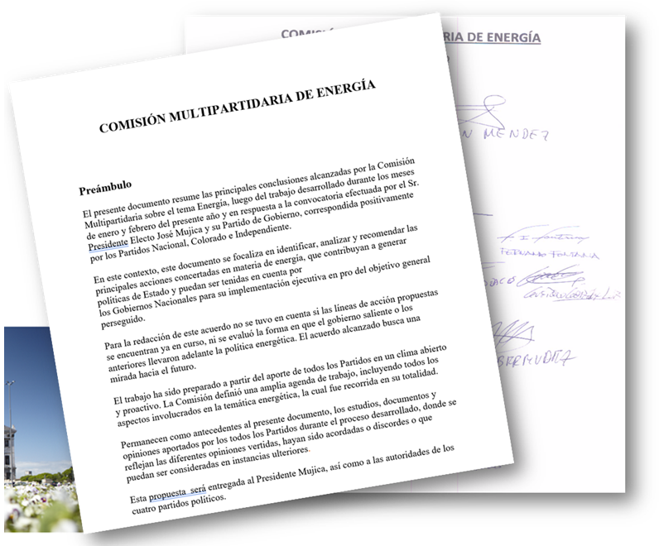
Action Plan for Power Sector Decarbonization
REGULATORY FRAMEWORK
In 1997, the Energy Market Law laid the foundations for establishing an electricity market.
In 2002 the General Regulations for the National Electrical System regulatory framework was approved.
In 2010, Uruguay, based on a political agreement involving all parties with parliamentary representation, promoted the decarbonization of the electricity sector, increasing sovereignty through the aggressive incorporation of nonconventional renewable energies, and complementing the historical participation of hydroelectric resources in the generation mix.
The mechanism for the incorporation of renewable energies was based on the execution of auctions assigning capacities per source to those that were identified as being competitive with the sources they were intended to displace.
As a result of this process, measures were developed to incorporate electricity generation from biomass (2006 and 2010), wind (2006, 2009, 2010, and 2011), and finally solar (2013).
Notes:
Source: https://www.gub.uy/ministerio-industria-energia-mineria/energia

Slide 16
Action Plan for Power Sector Decarbonization
REGULATORY CHANGES
Regulation changes have been necessary to adapt the electric sector to the high share of renewable sources in the electric system.
Some of the aspects of these regulation changes are:
Recognition of firm capacity to renewable sources
Mechanism to manage curtailment
Rules to dispatch renewable sources
Tariffs that recognize the hourly costs
Other incentives to promote load shifting from peak hours to off-peak hours as well as to increase demand through electrifying uses (cooking, heating, transport, etc.)
Notes:
Source: https://adme.com.uy/db-docs/Docs_secciones/nid_78/ProcedimientoParaGestiondeRestriccionesOperativas_v201512091831.pdf
https://www.impo.com.uy/bases/decretos/242-2023

Slide 17

Action Plan for Power Sector Decarbonization
ENERGY EFFICIENCY POLICY
Avoiding new power plants through energy efficiency: National Energy Efficiency Law approved in 2009, one of the first ones in Latin America.
The Law establishes, among others, the creation of:
Energy Efficiency Trust Fund
National Energy Efficiency Plan with a national energy savings target
Energy Efficiency Certificates → provide monetary awards to energy efficiency measures in all sectors according to their energy efficiency savings
The Energy Efficiency Trust Fund was established in 2012 to finance the Energy Efficiency Certificates, the national energy efficiency labeling system, and several other energy efficiency programs.
The first National Energy Efficiency Plan established broad policy actions and specific sectoral actions to promote the efficient reduction of the national energy demand and achieve the national energy savings target.
Source: National Energy Efficiency Plan (2015)
Notes:
Source: https://www.eficienciaenergetica.gub.uy/plan-nacional-de-eficiencia-energetica

Slide 18
Action Plan for Power Sector Decarbonization
PROSUMERS
General Regulatory Framework for the Regulated Prosumer
Prosumer → the customer who owns a supply made and measured by the distributor that generates electrical energy for its own consumption.
The injected electrical energy is remunerated at the hourly spot price.
The prosumer pays a tariff with charges that differentiate the generation costs and the costs associated with transmission, distribution, and generation backup facilities.
Notes:
Source: https://www.gub.uy/presidencia/institucional/normative

Slide 19
Action Plan for Power Sector Decarbonization
DECARBONIZATION TRANSPORT SECTOR
Approximately 60% of CO₂ emissions in the energy sector come from the transport sector.
Actions to decarbonize the transport sector include reducing emissions from the energy sources used and changes in modes of transport.
Inter-institutional lines of work → Interinstitutional Group on Energy Efficiency in Transportation (ministries of energy, transport, environment, economy; road safety agency, budget bureau, local governments, etc)
Buying and operating electric vehicle incentives
Training, research and development, dissemination, and events
Electric mobility discussion group: users, importers and sellers associations; manufacturers, transport-related chambers, academy, and any related agent.
Notes:
Sources:
https://movilidadelectrica.gub.uy
https://www.eficienciaenergetica.gub.uy/marco-legal-sistema-nacional-de-etiquetado-de-eficiencia-energética
https://www.impo.com.uy/bases/decretos/143-2024

Slide 20
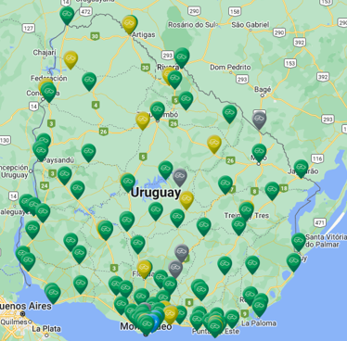
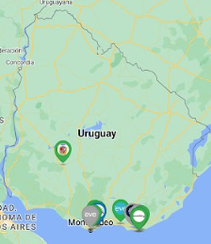
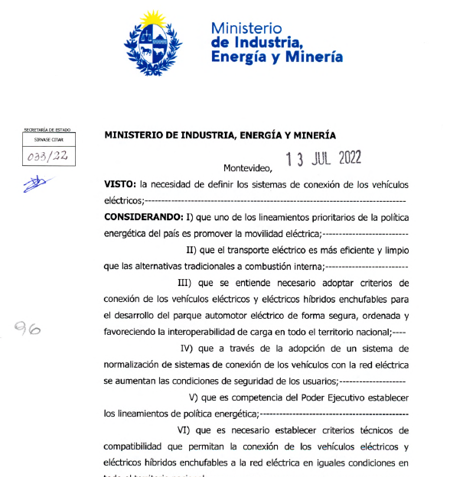
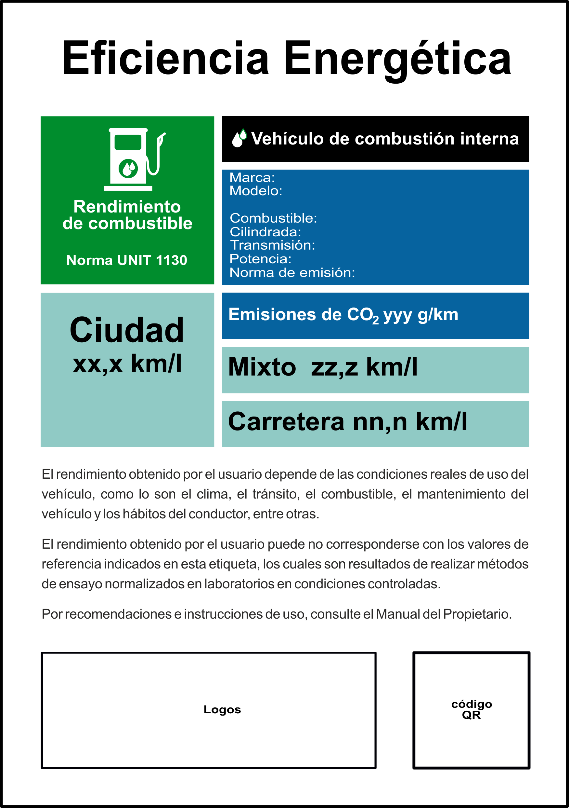
Action Plan for Power Sector Decarbonization
DECARBONIZATION TRANSPORT SECTOR
Public charging network
Relevant participation of the stated-owned utility (UTE)
Charging network strategy → a charger every 50 kms
AC chargers network nationwide → +190 chargers installed
DC fast charging → +100 installed
Public charging networks from private owners → still incipient
Regulations
Minimum technical requirements for chargers
Guidance on the conditions for providing public charging services
Economic incentive for public-access DC fast chargers developed by private initiative
Energy efficiency labeling for vehicles → mandatory for combustion from September 2024
Sustainable mobility trust for public transport
UTE
EVE-MOVE
Source: Movilidad Electrica (2024)
Notes:
Source: https://eficienciaenergetica.gub.uy

Slide 21
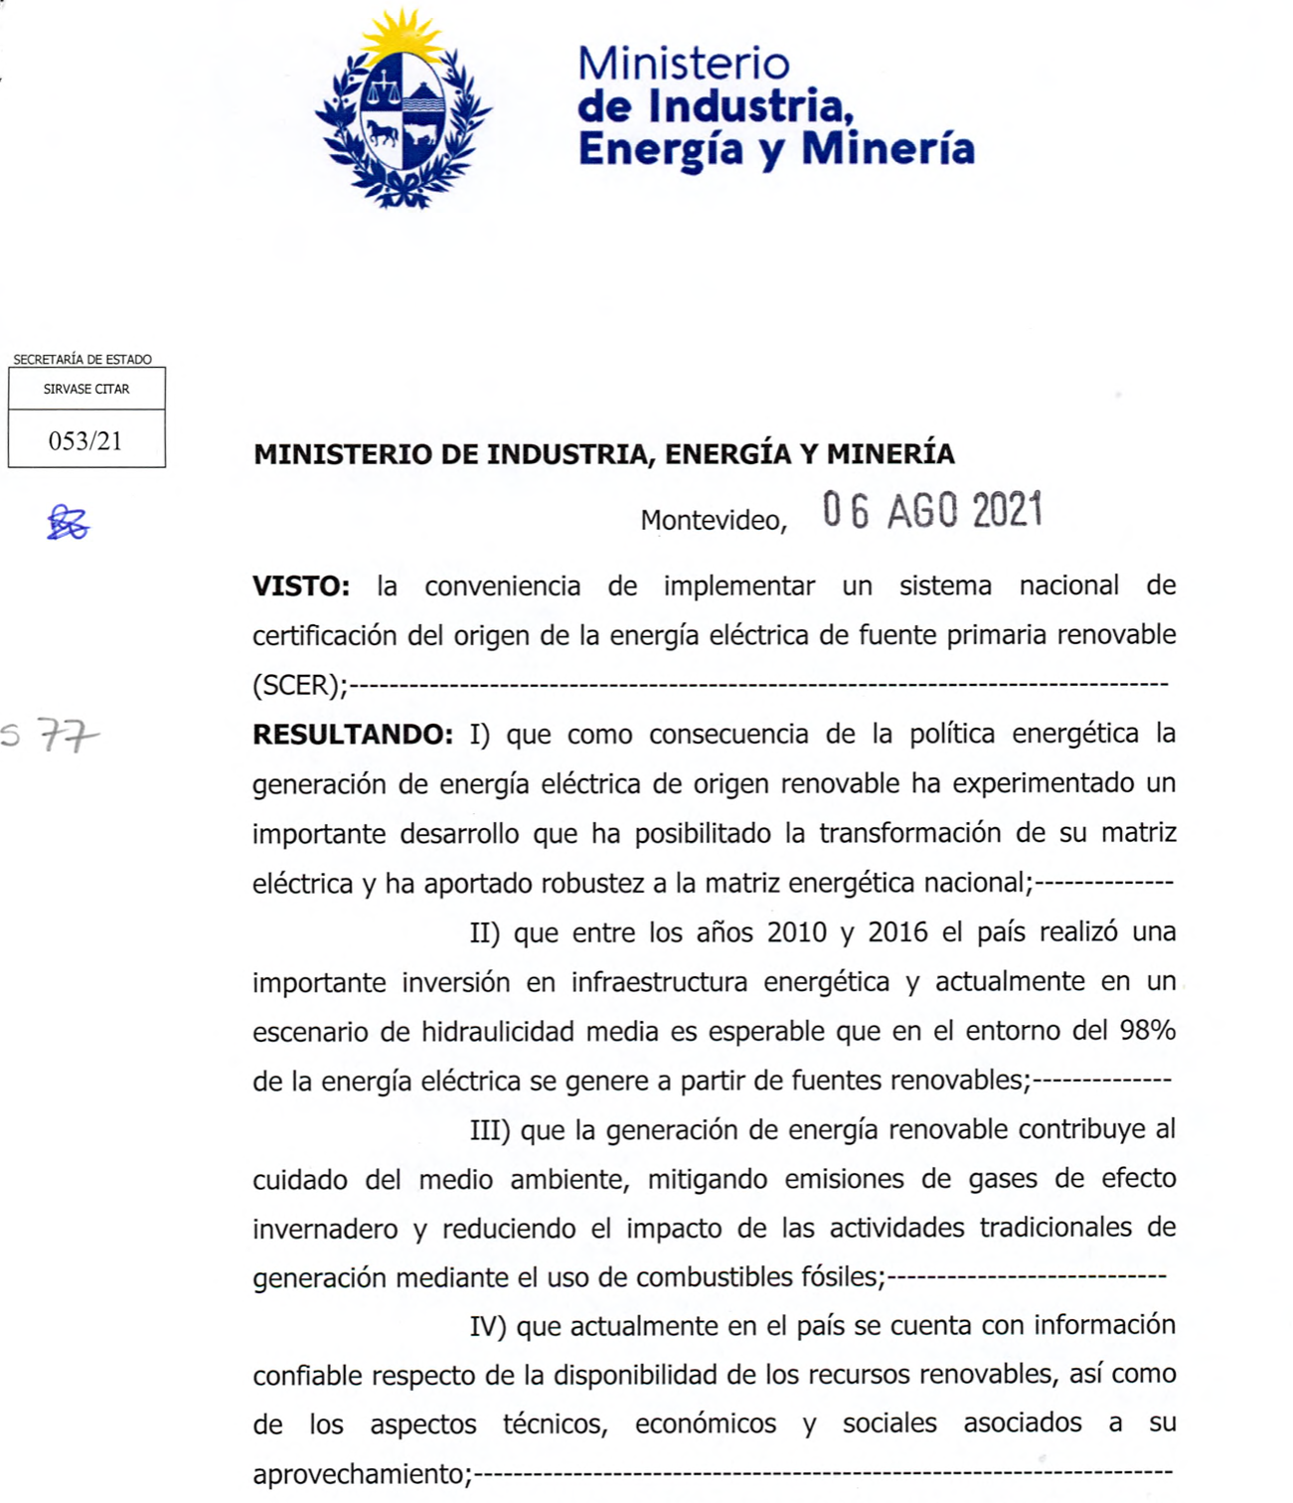

Action Plan for Power Sector Decarbonization
RENEWABLE ENERGY CERTIFICATION
Renewable Energy Certification
Renewable energy certificates are an accreditation mechanism, in electronic format, that ensure that a given number of megawatt-hours of electricity produced in a given period have been generated from renewable sources.
The allocation of certificates per source is calculated from cross-referencing generation, import, and export data with the customer's consumption data.
UTE, as well as other marketers, provide consumption data for the allocation to final consumers.
Renewable energy certificates are registered on Energy Web's blockchain, called the Energy Web Chain. This open-source public blockchain is derived from the Ethereum blockchain technology.
Source: MIEM (2024)
Notes:
Source: https://certificacion-energiarenovable.miem.gub.uy/

Slide 22
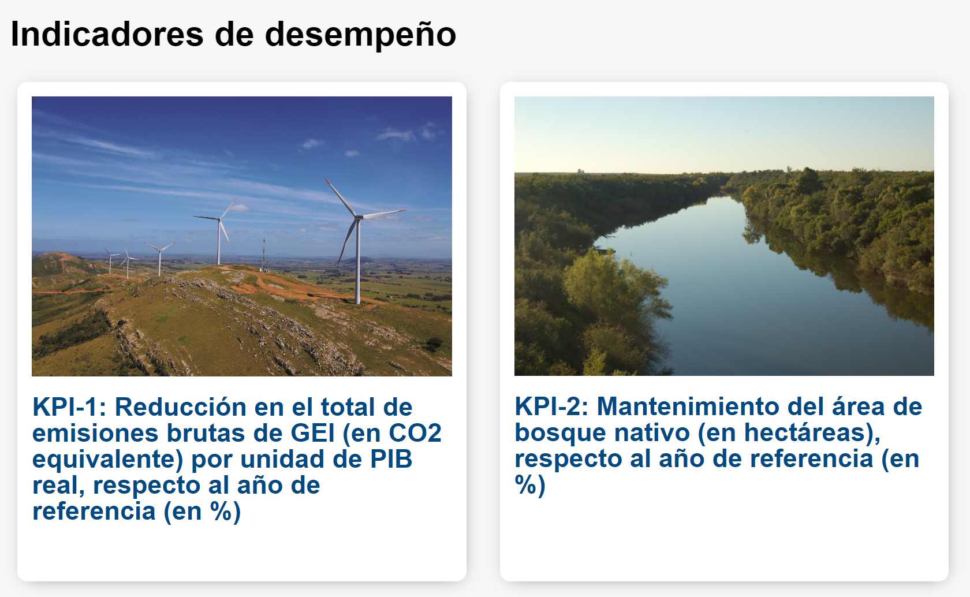
Action Plan for Power Sector Decarbonization
Climate Change Indicator Index-Linked Bond
The Climate Change Indicator Index-Linked Bond framework aligns Uruguay's sovereign financing strategy with its climate and nature conservation objectives, based on the commitments made in the Paris Agreement.
It outlines Uruguay's sustainable strategic priorities and sets targets for Key Performance Indicators, linked to the evolution of GHG emissions intensity and the area of native forests.
The performance targets are based on the quantitative targets set by Uruguay in its NDC.
Notes:
Source: https://sslburuguay.mef.gub.uy/30686/21/areas/bono-indexado-a-indicadores-de-cambio-climatico-biicc-de-uruguay.html

Slide 23
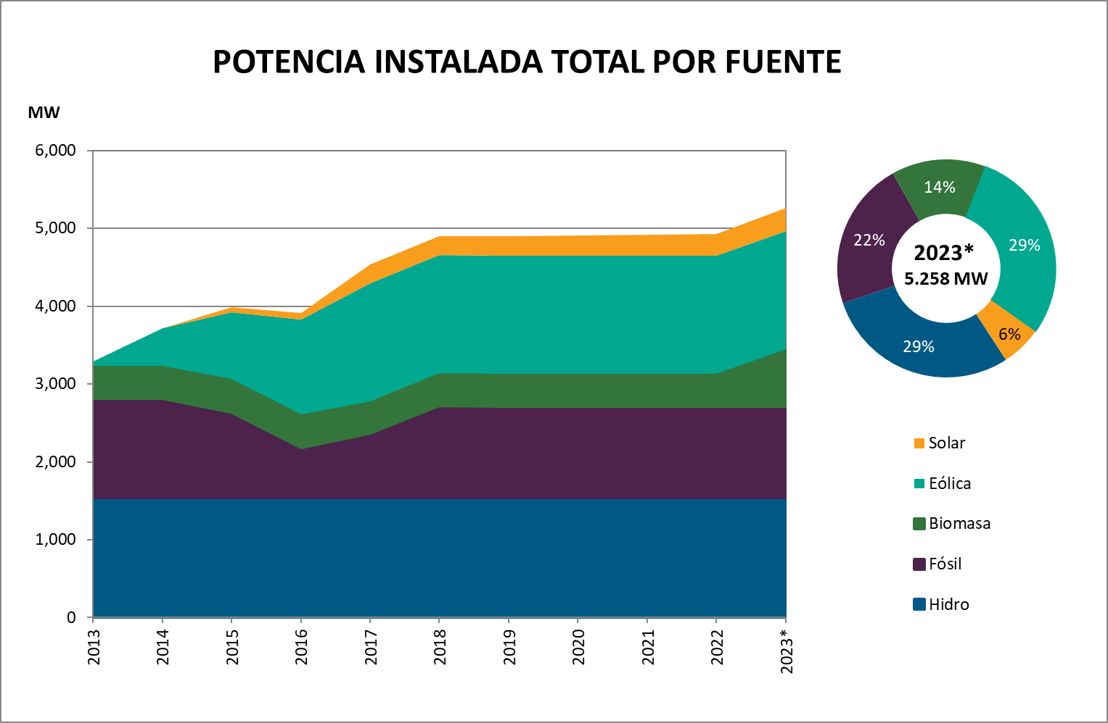
Action Plan for Power Sector Decarbonization
RESULTS
The positive impacts of the transformation of the electricity sector are observable in every dimension:
In just 10 years, Uruguay practically doubled its generation capacity by installing renewable technologies.
As a result of the incorporation of these assets, it is possible to ensure a participation of more than 90% of indigenous renewable sources in the electricity matrix (97% in a year of average hydropower).
Source: BEN: National Energy Balance (2024)
Uruguay's electricity matrix reached 92% renewables even in the year with the lowest hydro contribution on record.
Source: BEN: National Energy Balance (2024)
Notes:
Source: https://www.gub.uy/ministerio-industria-energia-mineria/ben

Slide 24
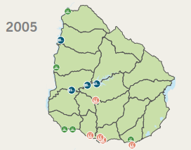
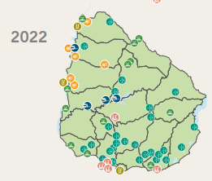
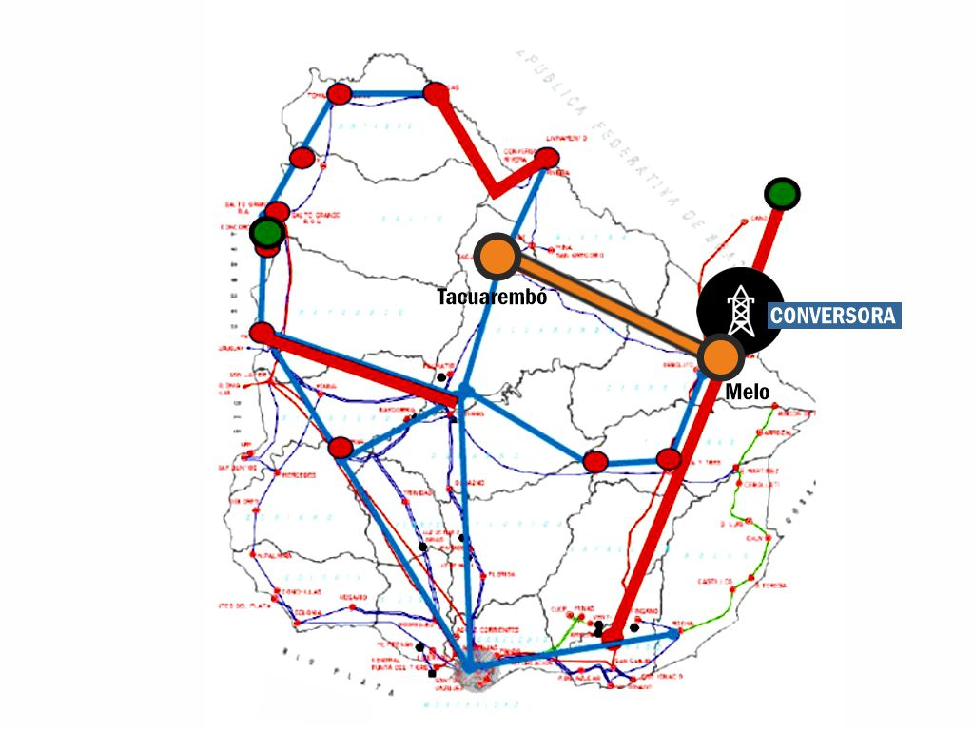
Action Plan for Power Sector Decarbonization
RESULTS
The Uruguayan electricity system has gone from being a centralized and inflexible hydrothermal system to a geographically distributed system throughout the country, adding wind, solar, and biomass waste generation to the historical power plants.
In addition, the transmission system has been reinforced in order to make the system more robust, moving from a radial system to a system with redundancy (ring closure of 500-kV transmission lines).
Source: National Energy Balance (BEN) (2024)
The robustness of the National Interconnected System (SIN) has been increased through distributed generation and the reinforcement of transmission lines.
Source: National Administration of Power Plants and Electrical Transmissions (UTE)
Notes:
Source: https://www.gub.uy/ministerio-industria-energia-mineria/ben
https://www.ute.com.uy/institucional/ute/utei

Slide 25
Action Plan for Power Sector Decarbonization
RESULTS
Traditionally, Uruguay had the role of regional energy sink for part of the region, resorting to the systematic import of electricity in order to meet its domestic demand.
As a result of the transformation of the electricity generation sector and the regional interconnection infrastructure with Brazil (complementing the historic interconnection with Argentina), Uruguay has become a net exporter of electricity since 2013 in years of average rainfall.
Source: BEN: National Energy Balance (2023)
Uruguay changed its role from a net electricity importer to net electricity exporter.
Notes:
Source: https://www.gub.uy/ministerio-industria-energia-mineria/ben

Slide 26
Action Plan for Power Sector Decarbonization
RESULTS
The energy policy implemented in the country has also become an important environmental policy.
On the one hand, it has enabled a significant reduction in greenhouse gas (GHG) emissions by minimizing the use of fossil fuels in the electricity matrix.
At the same time, electricity generation from biomass has enabled the recovery of almost 30% of industrial and agro-industrial waste.
Source: BEN: National Energy Balance (2024)
From the global environmental point of view, Uruguay has achieved a substantial reduction in the GHG emission factor of the SIN associated with its internal demand, reaching an average of 44.4 t carbon dioxide (CO₂) /GWh in the last decade.
Notes:
Source: https://www.gub.uy/ministerio-industria-energia-mineria/ben
https://www.gub.uy/ministerio-ambiente/sites/ministerio-ambiente/files/documentos/publicaciones/Politica_CC_1.pdf

Slide 27
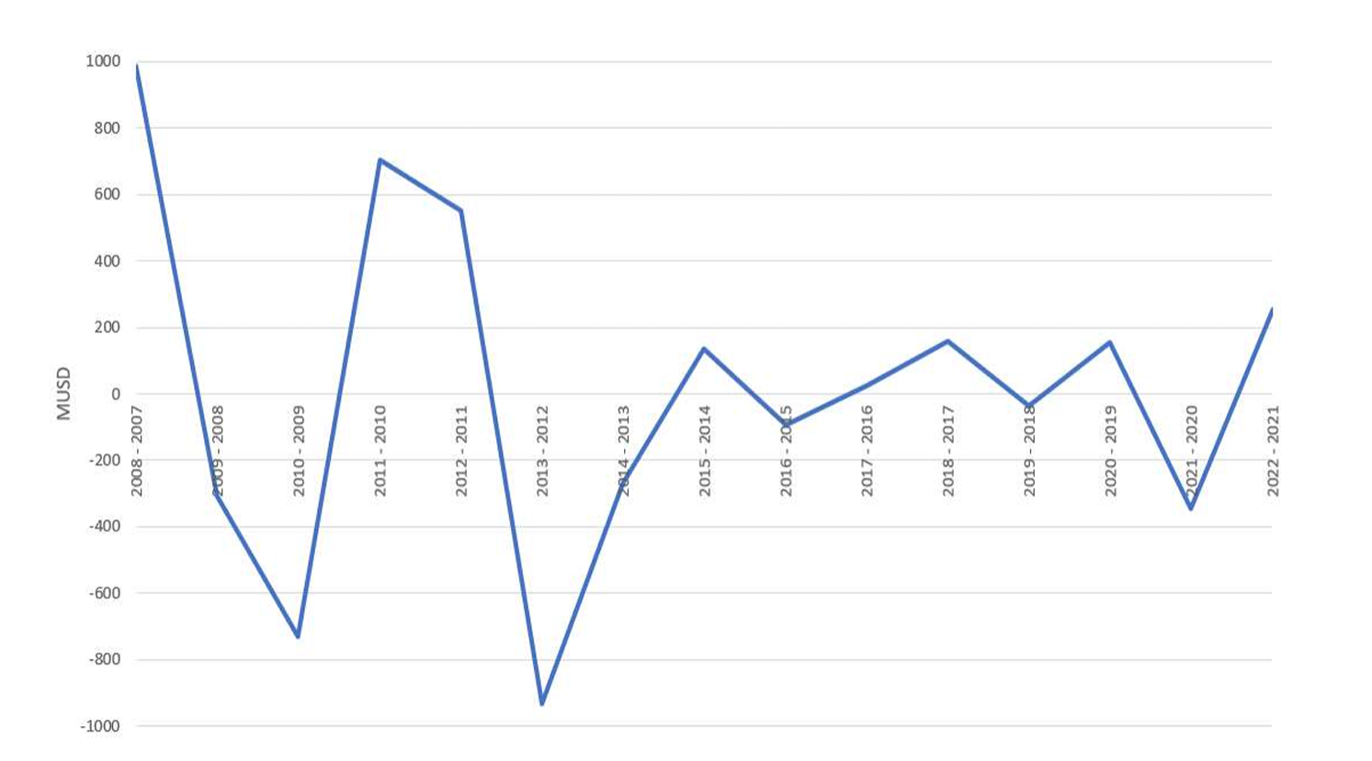
Action Plan for Power Sector Decarbonization
RESULTS
From an economic point of view, the matrix transformation results in lower expected system generation cost and reduced cost variability
part of the benefits obtained have been transferred to tariffs → the residential tariff has been reduced by 30% in real terms
Annual variability of demand sourcing cost (USD)
Source: BEN: National Energy Balance (2024)
The transformation of the electricity sector has been additionally economically convenient for both the system and the users.
Notes:
Source: https://www.gub.uy/ministerio-industria-energia-mineria/ben

Slide 28
Action Plan for Power Sector Decarbonization
RESULTS
Source: FERC, 2022
Notes:
Source: UTE

Slide 29
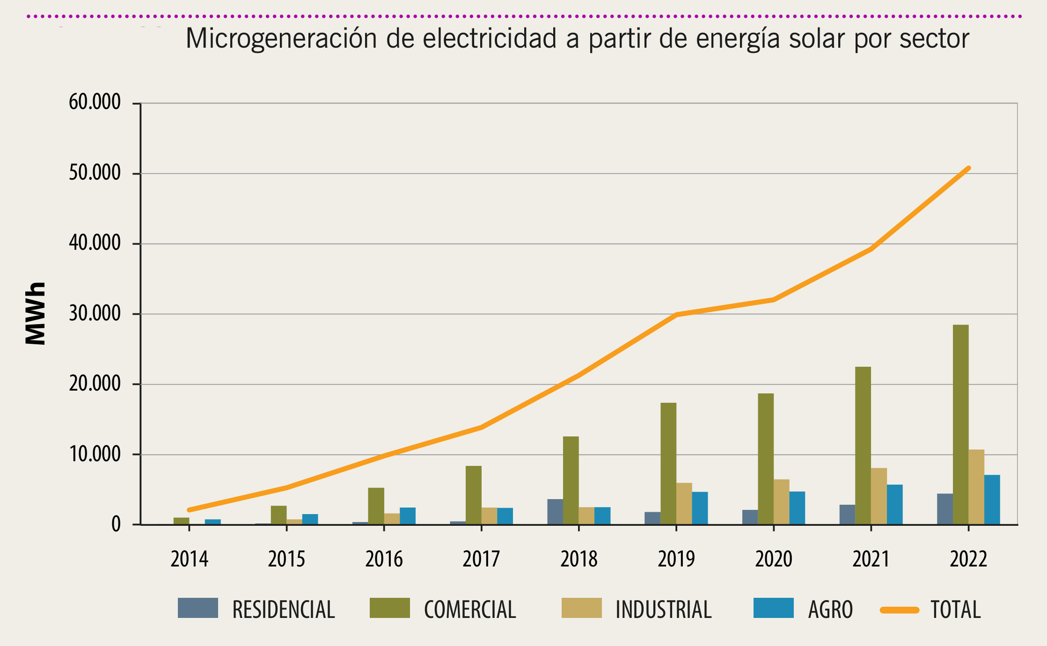
Action Plan for Power Sector Decarbonization
RESULTS
Prosumer Development
Solar microgeneration accounts for 99% of the total.
From 2014 to 2022, there was a significant increase from 2,110 MWh to 50,793 MWh.
The sectoral distribution shows that the commercial and services sector has been the most active (56%), followed by the industry sector (21%) and agriculture (14%) and finally the residential sector (9%).
Source: MIEM (2022)
Notes:
Source: https://www.gub.uy/ministerio-industria-energia-mineria/ben
https://www.ute.com.uy/institucional/ute/utei

Slide 30
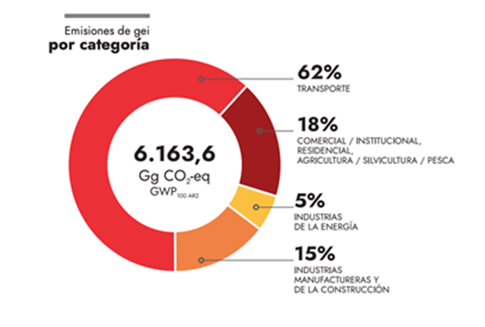
Action Plan for Power Sector Decarbonization
CHALLENGES
Uruguay has an atypical GHG emissions profile due to its production matrix → strong participation in the economy of the primary sector, mainly livestock
Despite the effort already made to decarbonize the electricity matrix, some sectors are still challenging.
the sectors that present the main opportunities are transport and industry
Source: Visualizador (2024)
Notes:
Source: https://visualizador.gobiernoabierto.gub.uy/visualizador/api/repos/%3Apublic%3Aorganismos%3Aambiente%3Avisualizador_inventario.wcdf/generatedContent

Slide 31
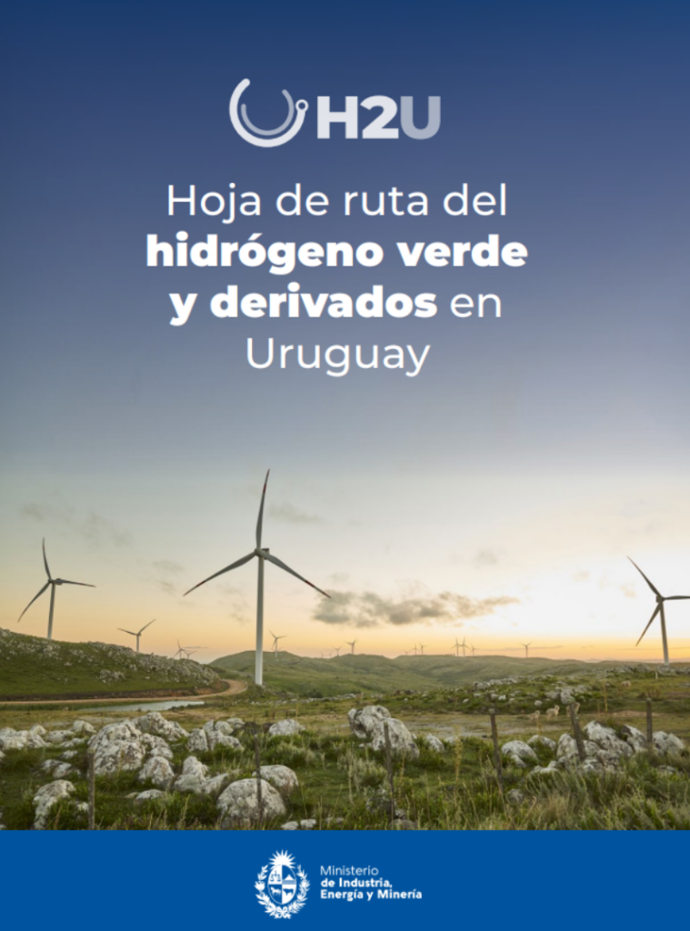
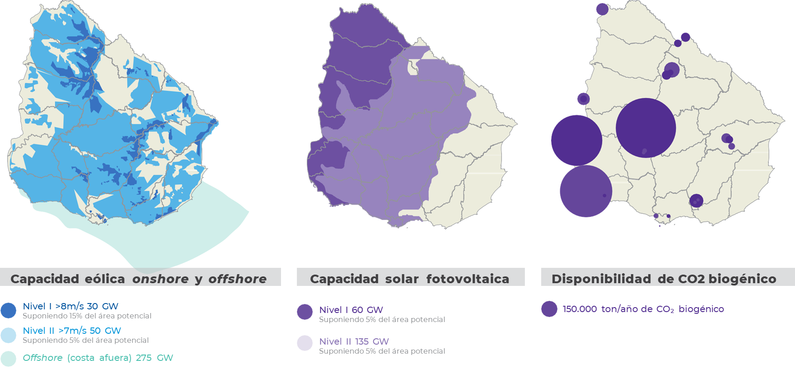
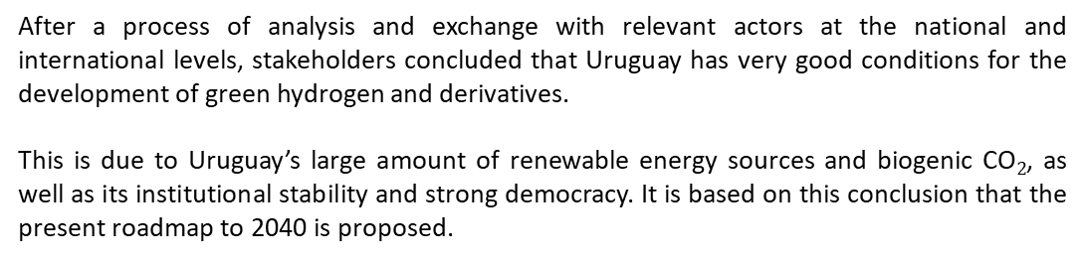
Action Plan for Power Sector Decarbonization
CHALLENGES
After a process of analysis and exchange with relevant actors at the national and international levels, stakeholders concluded that Uruguay has very good conditions for the development of green hydrogen and derivatives.
This is due to Uruguay’s large amount of renewable energy sources and biogenic CO$2$, as well as its institutional stability and strong democracy. It is based on this conclusion that the present roadmap to 2040 is proposed.
Green hydrogen
Notes:
Source: https://www.gub.uy/ministerio-industria-energia-mineria/hidrogenoverde

Slide 32
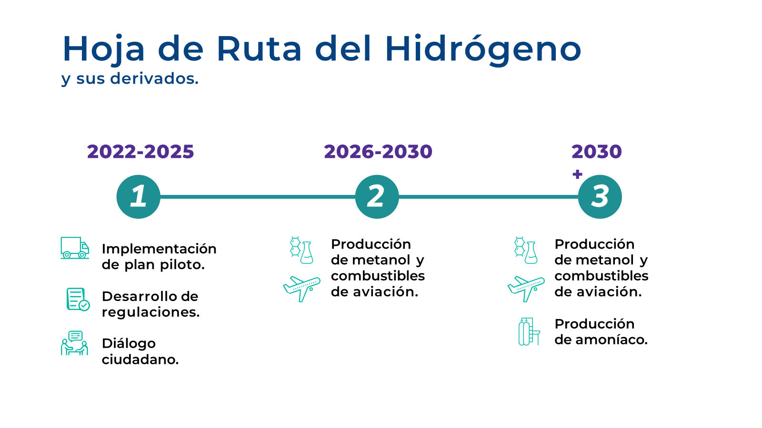
Action Plan for Power Sector Decarbonization
CHALLENGES
The roadmap for green hydrogen and its derivatives foresees its development in three phases:
The first phase, aims to learn from the development of the first pilot projects, specifically the development of missing regulations, the planning of infrastructure to be developed, and dialogue with the communities that will receive the projects.
The second phase is initiating large-scale production of hydrogen and derivatives, followed by a third phase in which the development of new export infrastructure allows for the incorporation of new derivatives for export (e.g., NH₃).
Notes:
Source: https://www.gub.uy/ministerio-industria-energia-mineria/hidrogenoverde

Slide 33
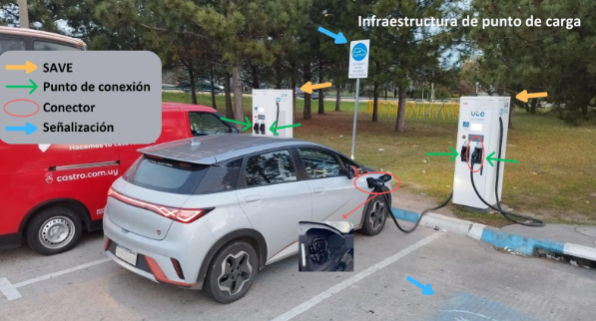
Action Plan for Power Sector Decarbonization
CHALLENGES
Interoperability
The public charging network has yet to develop in Uruguay.
There is an ever-growing increase in electric vehicle sales.
There are already public and private actors → the interoperability service manager role has become especially relevant.
Relevance of implementing interoperability on time → minimizing communication problems, compatibility problems, avoiding bad user experience with multiple charging apps, payment methods, among others.
Regulations must accompany the changes and innovations that are being processed → an environment of high uncertainty.
Notes:
Source:
https://movilidadelectrica.gub.uy
https://eficienciaenergetica.gub.uy
Stakeholder working group on interoperability led by DNE – MIEM

Slide 34
Action Plan for Power Sector Decarbonization
CHALLENGES
Energy storage (battery energy storage systems)
- For the near future, key activities:
load studies and battery energy storage system modeling
technology diffusion/awareness among stakeholders and regulatory framework development
alternative to use energy surpluses
Define a roadmap for the Uruguayan case

Slide 35
Action Plan for Power Sector Decarbonization
Thank you for your attention

Slide 36

Connect With Us Online
Clean Energy Solutions Center (CESC)
  Check out our website
  LinkedIn
  CESC updates and event invitations
21st Century Power Partnership (21CPP)
  Check out the 21CPP website
  LinkedIn
  21CPP Resources
Clean Energy Ministerial (CEM)
  Check out our website
  LinkedIn
  Subscribe to the CEM newsletter!

Slide 37
Thank You!
DO NOT CITE OR REFERENCE. This work is not for distribution or commercial purposes. The methodology, formula, and analysis used and presented in this document and the views herein do not necessarily represent the views of or are endorsed by the U.S. Department of Energy or the U.S. Government, or any agency thereof.

